Slide 1



CMS/TJC Utility Maintenance Program
Nebraska Society of
Healthcare Engineers
Fall Meeting
The Cornhusker Marriot Hotel
Lincoln, Nebraska

Slide 2


Slide 3


Slide 4


Slide 5


Slide 6


Slide 7
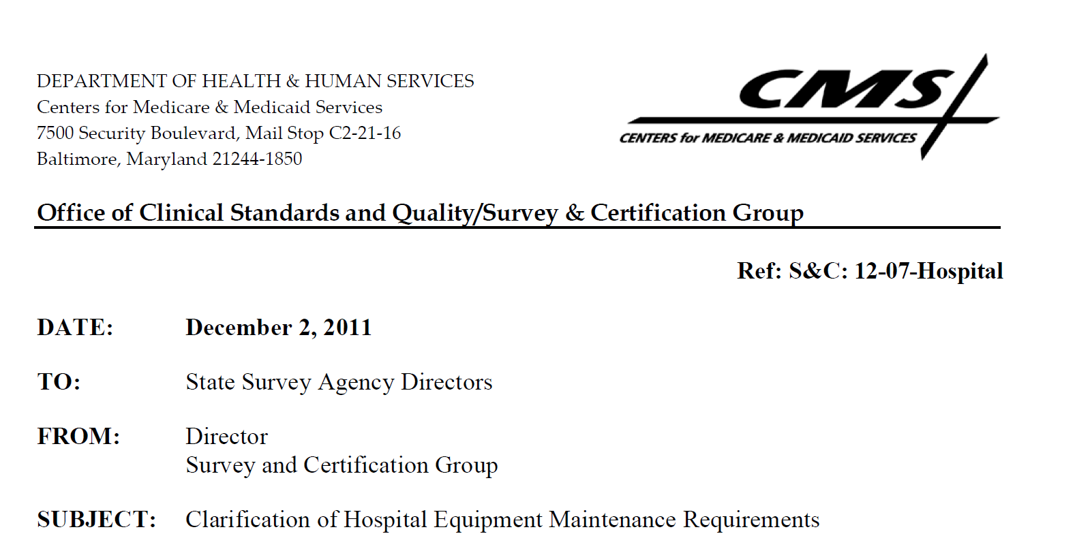
What Started all the Ruckus?

Slide 8
CMS – Clarification?
Do those words go together?

Slide 9
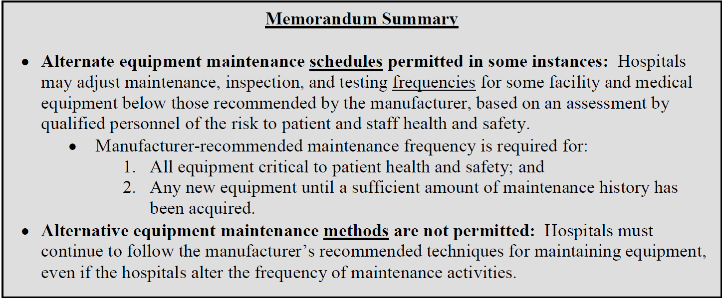
CMS Memo

Slide 10
CMS
This will have far reaching effects
CMS is going to be reviewing your maintenance records for Life Safety, Facility Equipment, Medical Equipment, Emergency Management Equipment, and any other equipment that you have not determined to be “non- critical”.
With enough documented information you might be able to reduce the frequency of the most stringent requirement but you may not reduce the method.

Slide 11
CMS
In addition, the manufacturer's recommended maintenance frequency must be utilized for all new equipment until a sufficient amount of maintenance history has been acquired to safely adjust the maintenance frequency below that recommended.

Slide 12
What Equipment CANNOT be included
Equipment that is critical to patient health and safety is not a candidate for an alternative, less frequent maintenance activity schedule.
Such equipment must be maintained at least as often as the manufacturer recommends. At a minimum such critical equipment includes, but is not limited to, life-support devices, key resuscitation devices, critical monitoring devices, equipment used for radiologic imaging, and other devices whose failure may result in serious injury to or death of patients or staff.

Slide 13
Adjustment Requirements
If a hospital is adjusting non-critical equipment maintenance frequencies to be below those recommended by the manufacturer, such adjustments must be based upon a systematic, evidence-based assessment.
The hospital must document the assessment for all equipment with less frequent maintenance than what the manufacturer recommends, including:
  The selected maintenance strategy that led to the lower adjusted frequency
  Supporting evidence.

Slide 14
Acceptable Evidence
The evidence must:
  Provide support that the frequency adjustment will not adversely affect patient or staff health and safety
  The assessment of whether it is appropriate to use a maintenance strategy that results in less frequent maintenance than what the manufacturer recommends must be performed by qualified personnel

Slide 15
Acceptable Evidence
Maintenance strategies are various methodologies for determining the most efficient and effective application of maintenance activities.
Several maintenance strategies (e.g., Preventive, Predictive, Reactive, and Reliability-Centered) can be used to determine the appropriate frequency for maintenance, inspection, and testing of equipment, based upon acceptable risk to patient health and safety.
Maintenance strategies may be applied to groups or individual pieces of equipment.

Slide 16
Acceptable Evidence
If you have been running a Utility Management Program based upon Risk Assessments you have a good basis for determining which pieces of equipment you have to have strict adherence to the manufacture's recommended methods and frequencies.
If you have been including everything for all of these years then your supporting documentation will be flimsy and you will be forced adhere to the manufacturer's methods and frequencies.

Slide 17
What is NOT Acceptable?
Although the hospital may elect to adjust the frequency of maintenance activities below those recommended by the manufacturer in some cases, the content of the recommended maintenance activities must not be substituted or eliminated.

Slide 18
So Who Will Monitor?
If you are a deemed organization, CMS will come to your facility for a validated complaint or validation survey.
But you can be assured that state and local AHJs that have knowledge of these requirements will be eager to demonstrate their new found skills to you.

Slide 19
The next six slides are the actual Guidelines for your information.
I will not read every word of them to you!
You are welcome ☺

Slide 20
Interpretive Guidelines §482.41(c)(2)
Equipment must be maintained to ensure an acceptable level of safety and quality.
In order to ensure an acceptable level of health and safety, the hospital identifies the equipment it needs to meet its patients' needs for both day-to-day operations and in a likely emergency/disaster situation, such as mass casualty events resulting from natural disasters, mass trauma, disease outbreaks, internal disasters, etc. In addition, the hospital must make adequate provisions to ensure the availability and reliability of its equipment needed for its operations and services. Equipment includes both facility equipment (e.g., elevators, generators, air handlers, medical gas systems, air compressors and vacuum systems, etc.) and medical equipment (e.g., biomedical equipment, radiological equipment, patient beds, stretchers, IV infusion equipment, ventilators, laboratory equipment, etc.).

Slide 21
All equipment must be tested for performance and safety before initial use and after major repairs or upgrades.
Equipment maintenance activities may be conducted using hospital personnel, contracts, or through a combination of hospital personnel and contracted services. Qualified individual(s) must be responsible for overseeing the development, implementation, management and performance of all equipment maintenance. In the case of medical equipment, a clinical or biomedical engineer would be considered qualified. The hospital must maintain records of hospital personnel qualifications and be able to demonstrate how they assure contracted personnel are qualified.

Slide 22
The hospital must perform specific scheduled maintenance activities on the required facility and medical equipment. Federal or State laws and regulations (including Life Safety Code requirements adopted as part of Federal regulations) may require that maintenance activities be performed in accordance with the manufacturer 's recommendations or may have other maintenance requirements. In these instances, the hospital must be in compliance with the most stringent maintenance requirements. An example of a specific federal regulatory requirement would be at §482.41(b)(9)(v),which requires hospitals to adhere to the manufacturer's maintenance guidelines for alcohol- based hand-rub dispensers. Absent such specified required maintenance directives in Federal and State laws, a hospital may schedule more stringent and/or frequent maintenance activities than what the manufacturer recommends, or, in some instances and under certain circumstances, may adjust equipment maintenance activity frequencies below those recommended by the manufacturer.

Slide 23
If the hospital is following or exceeding the manufacturer-recommended maintenance activities, the hospital must maintain documentation of the manufacturer's recommendations and associated hospital maintenance activity records. However, if the hospital is adjusting maintenance activity frequencies below those that are recommended by the manufacturer, such adjustments must be based upon a systematic evidence-based assessment. The hospital must document this assessment procedure for all equipment with less frequent maintenance activities than the manufacturer recommends, as well as the actual maintenance strategy and frequency, and the supporting evidence. The evidence must provide support that the frequency adjustment will not adversely affect patient or staff health and safety. It is emphasized that, although the hospital may elect to adjust the frequency of maintenance activities below those recommended by the manufacturer in some cases, the content of the recommended maintenance activities must not be substituted or eliminated.

Slide 24
In determining alternative maintenance strategies that reduce (or increase) equipment maintenance activity frequency, factors that may be considered in determining an alternative maintenance strategy may include, but are not limited to; information, if available, on the rationale for the manufacturer's recommendations; how the equipment is used (e.g. life support versus non-life support); the age of individual devices; the maintenance history for that model of equipment and for the individual device (e.g., number and frequency of previous failures and service requests); the availability of alternate devices or backup systems; the complexity of the equipment; its durability; the hospital's experience with that type of equipment, industry experience with that type of equipment, etc. The rationale for using an alternative maintenance strategy that results in less frequent maintenance activity than the manufacturer recommends must be documented. The hospital must also periodically re-evaluate the alternative maintenance strategy and frequency determination. The re-evaluation and subsequent modifications, if applicable, in the maintenance activities schedule must also be documented.

Slide 25
Equipment that is critical to patient health and safety is not a candidate for an alternative, less frequent maintenance activity schedule. Such equipment must be maintained at least as often as the manufacturer recommends. At a minimum such critical equipment includes, but is not limited to, life-support devices, key resuscitation devices, critical monitoring devices, equipment used for radiologic imaging, and other devices whose failure may result in serious injury or death of patients or staff. Manufacturer's recommendations must also be followed for all new equipment until a sufficient amount of maintenance history has been acquired to safely adjust in certain cases the maintenance frequency below what is recommended by the manufacturer.

Slide 26
So how do we insure compliance?
Hospitals are expected to maintain an inventory of all facility and medical equipment required to meet its patients' needs, which includes, at a minimum.
  Identification of critical or non-critical equipment, including associated risk criteria;
  Required maintenance activities (maintenance, inspection, and/or testing);
  The frequency of each required activity, including whether the frequency is based on or exceeds the manufacturer's recommendations or is based on an alternative, evidence-based maintenance schedule;
  Equipment incoming date (i.e., date new or repaired equipment is inspected and put into service);
  Dates of most recent maintenance activities;
  and Equipment incident history.
  ● Inventories that include maintenance strategies and maintenance activity frequencies other than those recommended by the manufacturer must also reference a documented determination that explains how the alternate maintenance frequency was determined.

Slide 27
Joint Commission Requirements
EC.02.05.01: The hospital manages risks associated with its utility systems.
EP2 - For hospitals that do not use Joint Commission accreditation for deemed status purposes : The hospital maintains a written inventory of all operating components of utility systems or maintains a written inventory of selected operating components of utility systems based on risks for infection, occupant needs, and systems critical to patient care (including all life support systems). The hospital evaluates new types of utility components before initial use to determine whether they should be included in the inventory. (See also EC.02.05.05, EPs 1, 3-5)
For hospitals that use Joint Commission accreditation for deemed status purposes. The hospital maintains a written inventory of all operating components of utility systems. (See also EC.02.05.05, EPs 1, 3-5)
EP3- The hospital identifies high- risk operating components of utility systems on the inventory for which there is a risk of serious harm or death to a patient or staff member should the component fail.
Note: High- risk utility system components include life- support equipment

Slide 28
Risk Based Equipment Inclusion Program
Utility Function | Rating
Life Support (High Risk) | 10
Infection Control | 9
Environmental Support | 7
Equipment Support | 5

Slide 29
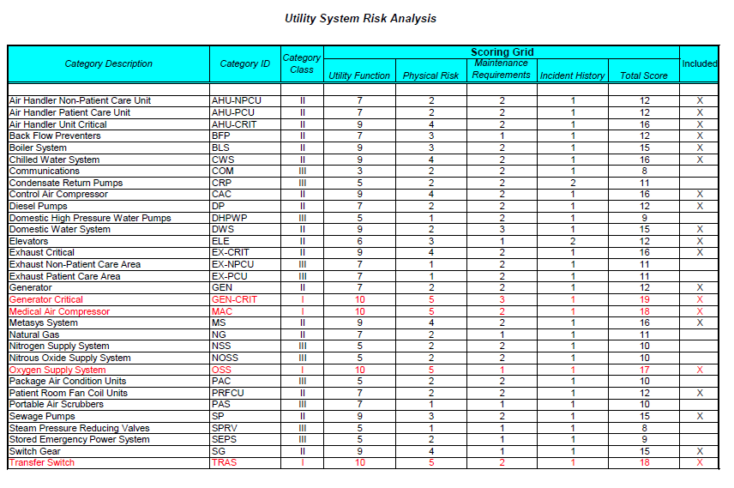
Risk Based Equipment Inclusion Program

Slide 30
Survey Procedures (by CMS, TJC, DNV, etc.)
Interview personnel in charge of equipment maintenance:
  Determine if there is an equipment inventory for equipment required to meet patient needs; review it for completeness, including all required information.
  Determine if the inventory is periodically reviewed and updated.
  Select a sample of equipment for which the facility uses the manufacturer's recommendations for maintenance frequency. Sample selection should be based on:
    Risk to patient safety from equipment failure (e.g., sample high/medium/low risk).
    Critical equipment (e.g., life-support devices, key resuscitation devices, critical monitoring devices, equipment used for radiologic imaging, etc.) with higher risk should make up the sample majority.)
    Service Requests (e.g., sample equipment with high service requests)
    Failure Records (e.g., sample high failure rates)
    Equipment Usage (e.g., sample high use)
    Type of Equipment (e.g., sample medical equipment & facility components)

Slide 31
For the sample selected:
  Review maintenance records to determine if
  Maintenance, inspection, and testing records are complete and accurate;
  Maintenance records include equipment failures and down-time;
  Equipment failures are corrected (through repair or replacement) in a timely manner;
  Equipment failure patterns are investigated and addressed,
  Records (certifications, degrees, etc.) of hospital personnel responsible for performing maintenance and/or the hospital is able to demonstrate how they assure contracted personnel are qualified. In the case of medical equipment, qualified personnel would be clinical or biomedical technicians or engineers.
  Records contain documents required to support maintenance activities (e.g., manufacturer's operation and maintenance manual, standards, studies, guidance, recall information, service records, etc.)
  Maintenance is being performed in accordance with manufacturer's recommendations.

Slide 32
If a facility has elected to use maintenance activity frequencies for facility and medical equipment other than those recommended by the manufacturer:
  Review the equipment inventory to ensure that critical equipment (e.g., life-
  support devices, key resuscitation devices, critical monitoring devices, equipment used for radiologic imaging, etc) or specific equipment subject to a regulatory requirement are not included under an alternative, lesser maintenance frequency.
  Select a sample of equipment which are subjected to less frequent maintenance than what the manufacturer recommends to determine;
    The rationale for the alternative maintenance schedule is well- documented, reasonable, based on evidence on the associated risks, and approved by responsible personnel in the clinical maintenance and/or safety department.
    There is evidence of periodic review to determine whether the chosen alternative schedule is still appropriate.

Slide 33
For the sample selected.
Review maintenance records to determine if
  Maintenance, inspection, and testing records are complete and accurate;
  Maintenance records include equipment failures and down-time;
  Equipment failures are corrected (through repair or replacement,)in a timely manner;
  Failure patterns are investigated, addressed, result in changes to
  the alternate maintenance strategy or frequency, as necessary;
  Records contain the qualifications (e.g., training certificates, certifications, degrees, etc) of hospital personnel responsible for performing maintenance and/or the hospital is able to demonstrate how they assure contracted personnel are qualified. In the case of medical equipment, qualified personnel would be clinical or biomedical technicians or engineers.
  Records contain documents required to support maintenance activities (e.g., manufacturer's operation and maintenance manual, standards, studies, guidance, recall information, service records, etc.)
  Equipment is actually maintained according to the alternative schedule.
  Interview equipment users to determine if equipment failures are occurring and causing problems for patient safety.

Slide 34
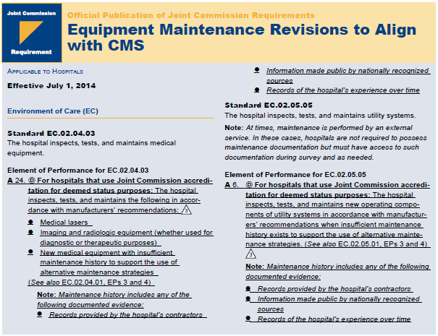

Slide 35
Quick Summary
CMS has already begun this process
TJC new standards are effective July 1, 2014
Review maintenance records to determine:
  Insure accurate inventory. Preferably risk based
  Determine what, if any equipment can be maintained with alternative methods
  Ensure qualifications of person making this decision
  Ensure documentation to back up decision (history trails, maintenance records, etc.)
  Re-evaluate ALL equipment you currently have for accuracy to manufacture’s recommendations
  Appoint someone to oversee this process to insure new equipment is inventoried properly, and existing equipment is being maintained appropriately.
On the bright side, CMS is now focusing on changing Emergency Management ☺

Slide 36
Questions

Slide 37
Ken Gregory
Vice President – South Atlantic
TSIG Consulting
740 Broadway
New York, NY 10003
(615) 598-2652
gregoryk@tsigconsulting.com

