Slide 1
NSHE 2015 Fall Conference St Mary’s Community Hospital Geothermal Heat Recovery Central Utilities Plant (CUP)
Skanda Skandaverl – Catholic Health Initiatives
Jason Studt – JE Dunn
Mark Morris – Mechanical Sales
Frederick Lerouge – Control Management

Slide 2
St Mary’s Community Hospital Geothermal Heat Recovery CUP
1st Fully Geothermal Hospital in Nebraska
and one of a few in US
CHI had been looking at the advantages of geothermal for some time
Strong desire to experience a geothermal system – learn first hand
St Mary’s - a new facility - of the scale which lent itself to move ahead
Geothermal CUP footprint fit the mechanical space
Site accommodated the well field near the Central Utilities Plant
CW and HW systems were already selected using Propylene Glycol
Test wells, preliminary narratives and visits to operational geothermal sites were all being done by CHI as traditional design was being done.

Slide 3
St Mary’s Community Hospital Geothermal Heat Recovery CUP
The New St Mary’s Hospital HVAC system was designed using:
Variable Air Volume AHU’s
Re-Heat Terminal Units
Air-Cooled Chillers and Gas Boilers
The decision to implement geothermal came after the traditional project had been bid and awarded – presenting significant time line challenges
Example - submittals for AHU’s, Chillers, Boilers & Pumps had been approved prior to when a decision was made for geothermal
RFP was issued by CHI to select a geothermal team - needed to move quickly to design the geothermal CUP and Well Field
Well field installation needed to start immediately!!!
JE Dunn and their subcontractors did an excellent job collaborating to get the project completed on time and under budget

Slide 4
St Mary’s Community Hospital Geothermal Heat Recovery CUP
Reasons CHI chose a geothermal Central Utilities Plant:
Strong Support from Hospital President Daniel Kelly
Redundancy for cooling and heating built into the system…..
Chiller, Pumps, Well Field Vaults, Electrical Emergency Power
Ease of operation for facilities staff
Ease of operating smaller modular systems
No seasonal start-up / shut-down requirements
Lower maintenance costs
No water treatment
No condenser cleaning (cottonwood)
Standard components like scroll compressors
No equipment outside on grade (air cooled chillers)
Low sound levels indoors and no sound outdoors

Slide 5
St Mary’s Community Hospital Geothermal Heat Recovery CUP
Reasons CHI chose a geothermal Central Utilities Plant:
Lower operating costs
Heating – Use earths heat - Heat Pump
Cooling – Cooler condensing temperatures
Heat Recovery – Use the heat we already own for heating hot water and for pre-heating domestic hot water
System expansion capabilities
Demonstrate “Green” to the Nebraska City Community
CHI Pilot Project
Gain first hand experience with geothermal

Slide 6
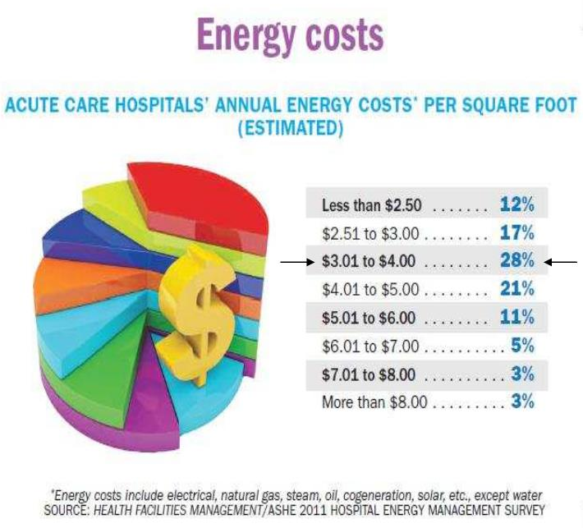
St Mary’s Community Hospital Geothermal Heat Recovery CUP
BENCHMARK
OBJECTIVES
30-35%
Reduction
Approaching One Year of Operation
Facility Commissioning
Ongoing
Anticipate
~ 10-12 Year
Simple Payback

Slide 7
St Mary’s Community Hospital Geothermal Heat Recovery CUP
CHI Chose Mechanical Sales to Work Under JE Dunn and Lead Geothermal Execution Effort -Unconventional Approach
Project Team
Owner – Catholic Health Initiatives (CHI)
St Mary’s Community Hospital
Architect – Earl Swenson Architects
Civil Engineer – Little John Engineering
MEP Engineer – Cator Ruma
Construction Manager – JE Dunn Construction
Mechanical – Midlands Mechanical
Controls – Control Management, Inc
Electrical – Commonwealth Electric
Commissioning Agent – Specialized Engineering Solutions
Geothermal Partners
Equipment – Mechanical Sales
Well-Field Design – Specialized Engineering Solutions Well Drilling & Piping – Mid America Drilling

Slide 8
St Mary’s Community Hospital Geothermal Heat Recovery CUP
New Replacement Hospital
Project Scope
Approximately 111,000-SF Hospital
18 Patient Rooms
Radiology Suite (MRI, 2 X-Rays, CT Scan, Nuclear Med, etc.)
35,000-SF Clinic
Administration Wing
30-acre site
2 Operating Rooms, Pharmacy, ER, Chapel, Dining & Kitchen, and Lab
3500-SF CUP including two (2) mezzanines
Steel Structure
Exterior Skin including Masonry, Glass, EIFS, and Metal Panels
EPDM Roofing

Slide 9
St Mary’s Community Hospital Geothermal Heat Recovery CUP
Decision Made Late & Still On-Time
Project Timeline
JE Dunn Awarded Project – November 2012
Preconstruction & Value Management – November 2012 – May 2013
100% Construction Documents – May 2013
Decision Finalized for Geothermal Heat Recovery CUP – June 2013
Revised 100% CDs with Geothermal – August 2013
Drilling Geothermal Wells – October 2013
St Mary Hospital Substantially Complete – October 2014

Slide 10
St Mary’s Community Hospital Geothermal Heat Recovery CUP
On Time Delivery - TEAMWORK
Conceptual pricing complete between Mechanical Sales, JE Dunn Construction, Mid America Drilling, etc. to analyze construction cost vs. payback prior to spending money on design changes
With geothermal decision coming late in design, and after construction had started, real-time decisions made by design teams to keep construction progressing without delays
Collaborative submittal review process between engineering teams, construction manager, equipment suppliers, building control contractor and commissioning team to accelerate procurement process.

Slide 11
Heat Recovery Centralized vs De-Centralized Decision Central Station Geothermal Operation
St Mary’s Community Hospital Geothermal Heat Recovery CUP
Discussion

Slide 12
DEDICATED HEAT RECOVERY CHILLERS
“There’s Nothing Cheaper Than Using the Heat You Already Own”
No matter if it’s a
Traditional Boiler / Chiller
or Geothermal System

Slide 13
WHY DHRC for St Mary’s Community Hospital
Air Change Rate ~ 6-20 air changes per hour (let’s say 6)
100,000 SF x 10’ = 1,000,000 Cubic Feet
6 ACH x 24 Hours = 144 Air Changes Per Day
Potentially 144,000,000 Cubic Feet of Air / Per Day Leaving the Cooling Coil Between 52-55 Degrees F to Satisfy the Warmest Zone and Provide Dehumidification to All Zones
It is then Re-Heated at the Room Terminal Device As Needed to Meet the Demands of the Individual Space Conditions.

Slide 14
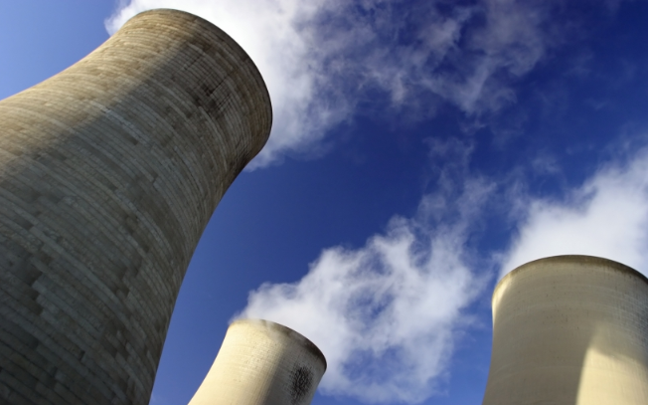
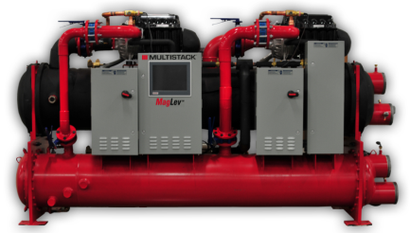
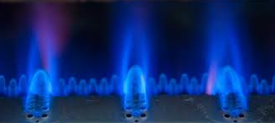
WHY DHRC’s in a Hospital Environment
Heat Moves
Through the Facility
One and Done

Slide 16
Concurrent Heating/Cooling Load Economic$

Slide 17
Concurrent Heating/Cooling Load Air Cooled Chiller – Gas Boiler
Chiller Cooling = 1.25 kw/Ton @ $0.08/kwh
= $0.83/100 MBTU
Boiler Heating = $0.70 THERM Natural Gas @ 85% Efficiency = $1.03/125 MBTU
Total = $1.86

Slide 18
Concurrent Heating/Cooling Load Economizer Cooling – Gas Boiler
Economizer Cooling = 100 MBTU Free Cooling (Outside Air)
Boiler Heating = $0.70 THERM Natural Gas @ 85% Efficiency
= $1.03/125 MBTU
Total = $1.03

Slide 19
Concurrent Heating/Cooling Load HR Chiller Cooling – HR Chiller Heating
HR Chiller Cooling = 1.068 kw/Ton @ $0.08/kwh
= $0.71/100 MBTU
HR Chiller Heating = 125 MBTU Free Heating
Total = $0.71
SAME UNITS OF ENERGY
PROVIDED TO THE BUILDING
$1.86 Chiller & Boiler
$1.03 Economizer & Boiler
$0.71 DHRC

Slide 20
Your Traditional Chilled Water and Heating Hot Water System can Benefit from DHRC

Slide 21
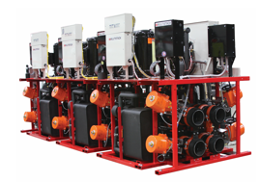
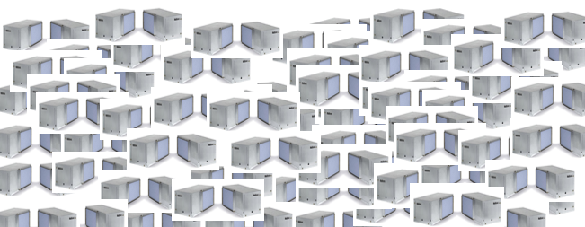
Centralized?
OR
De-Centralized?

Slide 22
Traditional WSHP
Centralized DHRC
Decentralized Mechanical Equipment | Centralized Mechanical Equipment
Limited Arrangements | AHU Flexibility – Fans, Filters, Coils, Custom Sections
Comfort Issues When The Compressor Cycles Off | Temperature and Dehumidification Easily Managed
Challenging To Deliver Outside Air To WSHP’s | Traditional AHU Ventilation, Economizer, HR Options
15-Year WSHP Compressor / Fan Life | 30 -Year Chiller / AHU Life (and ease of replacement)
May Have Limited Service Access – Occupied Spaces | Service in a Mechanical Space
MANY FINAL FILTER LOCATIONS to Maintain | Fewer Locations to Service Compressors, Fans, Filters
Inherent Compromise in Heat Transfer Efficiency | Optimum Heat Transfer Efficiency
Reversing Valve Pressure Drop and Reliability
Loss of Counter-Flow HX when Reversing
Two Lifts or Compression Cycles to Recover Heat
No Reversing Valve
Always Counter-Flow HX
One Lift or Compression Cycle to Recover Heat

Slide 23
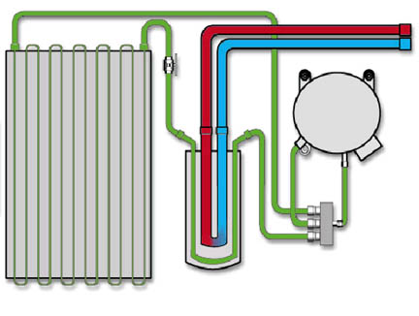
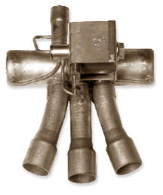
MULTISTACK VME II Eliminates The Reversing Valve Pressure Drop Increasing Efficiency 3%
refrigerant-to-air
heat exchanger
reversing
valve
Notes:
The reversing valve, sometimes called a four-way valve, is the component that allows the heat pump to perform heating as well as cooling. It is called a reversing valve because it is used to reverse the direction of refrigerant flow through the cycle. In the heating mode, refrigerant vapor from the compressor is diverted by the reversing valve to the refrigerant-to-air heat exchanger. In this heat exchanger, heat is transferred from the refrigerant vapor to the air, heating the air.

Slide 24
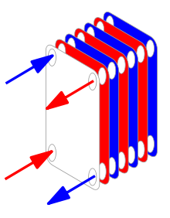
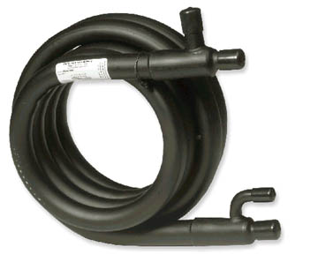
MULTISTACK VME II Eliminates the Reverse Cycle So HX Efficiency is not Reduced by 4%
DHRC Plate refrigerant-to-water heat exchanger
Counter-flow maximizes mean temperature difference for most efficient heat transfer
WSHP Coaxial refrigerant-to-water heat exchanger
Conventional heat pump systems lose counter-flow in reverse cycle. A 4 % energy penalty
Notes:
The refrigerant-to-water heat exchanger may be a tube-in-tube, tube-in-shell, or brazed-plate design. The example shown here is a tube-in-tube, or coaxial, heat exchanger. It is constructed as a small tube running inside another larger tube. The water flows through the inner tube and refrigerant flows through the outer tube.
In the cooling mode, the refrigerant-to-water heat exchanger acts as the condenser. The water flowing through the inner tube absorbs heat from the refrigerant flowing through the outer tube. In the heating mode, it acts as the evaporator and the refrigerant absorbs heat from the water.

Slide 25
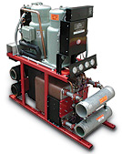
Conventional WSHP
Compressor Lift Reduction MULTISTACK VME II Has Reduced Lift to Heat & Cool
89 F Condensing
53 F Suction
Geothermal
Geothermal
70 F
84 F
70 F
58 F
70 F Geothermal Water
Cooling &Heating Compressor Lift = 122 F
44 F
57 F
120 F
105 F
Cooling Load
Heating Load
39 F Suction
125 F Condensing
Notes:
11.64 # CO2 per Therm of NG burned. 0.6kw/Ton Central Plant Chiller. 0.9kW/Ton MS Chiller in HR Mode. 1.8# CO2 per kW/h of electricity. 90% efficient Condensing Gas Boiler. 0.15 Therms of heat produced per Ton of refrigeration from the HR Chiller. $1.00 per therm of NG, $.05 per kW/h
25

Slide 26
Compressor Lift Reduction MULTISTACK VME II Has Reduced Lift to Heat & Cool
39 F Suction
Cooling Load
MULTISTACK VME II
57F
44F
70 F Geothermal Water
Cooling &Heating Compressor Lift = 86 F
120 F
105 F
Conventional 122 vs. VME II 86
30% Reduction in Lift
Heating Load
125 F Condensing
Notes:
11.64 # CO2 per Therm of NG burned. 0.6kw/Ton Central Plant Chiller. 0.9kW/Ton MS Chiller in HR Mode. 1.8# CO2 per kW/h of electricity. 90% efficient Condensing Gas Boiler. 0.15 Therms of heat produced per Ton of refrigeration from the HR Chiller. $1.00 per therm of NG, $.05 per kW/h
26

Slide 27
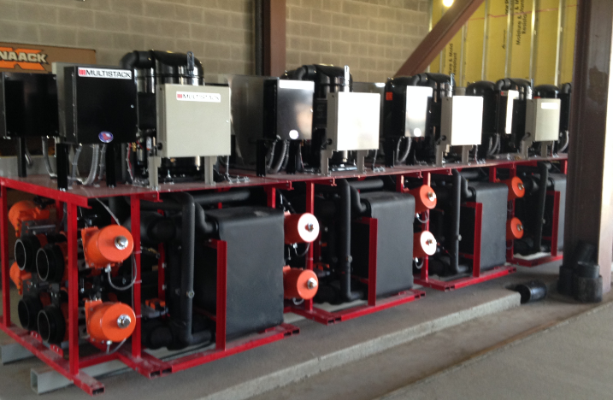
Central Station Geothermal Operation
MULTISTACK VME II

Slide 28
Central Station Geothermal Operation – Built in Redundancy
Compressors
VME Valves
Evaporator
Condenser
HW-CW Header

Slide 29
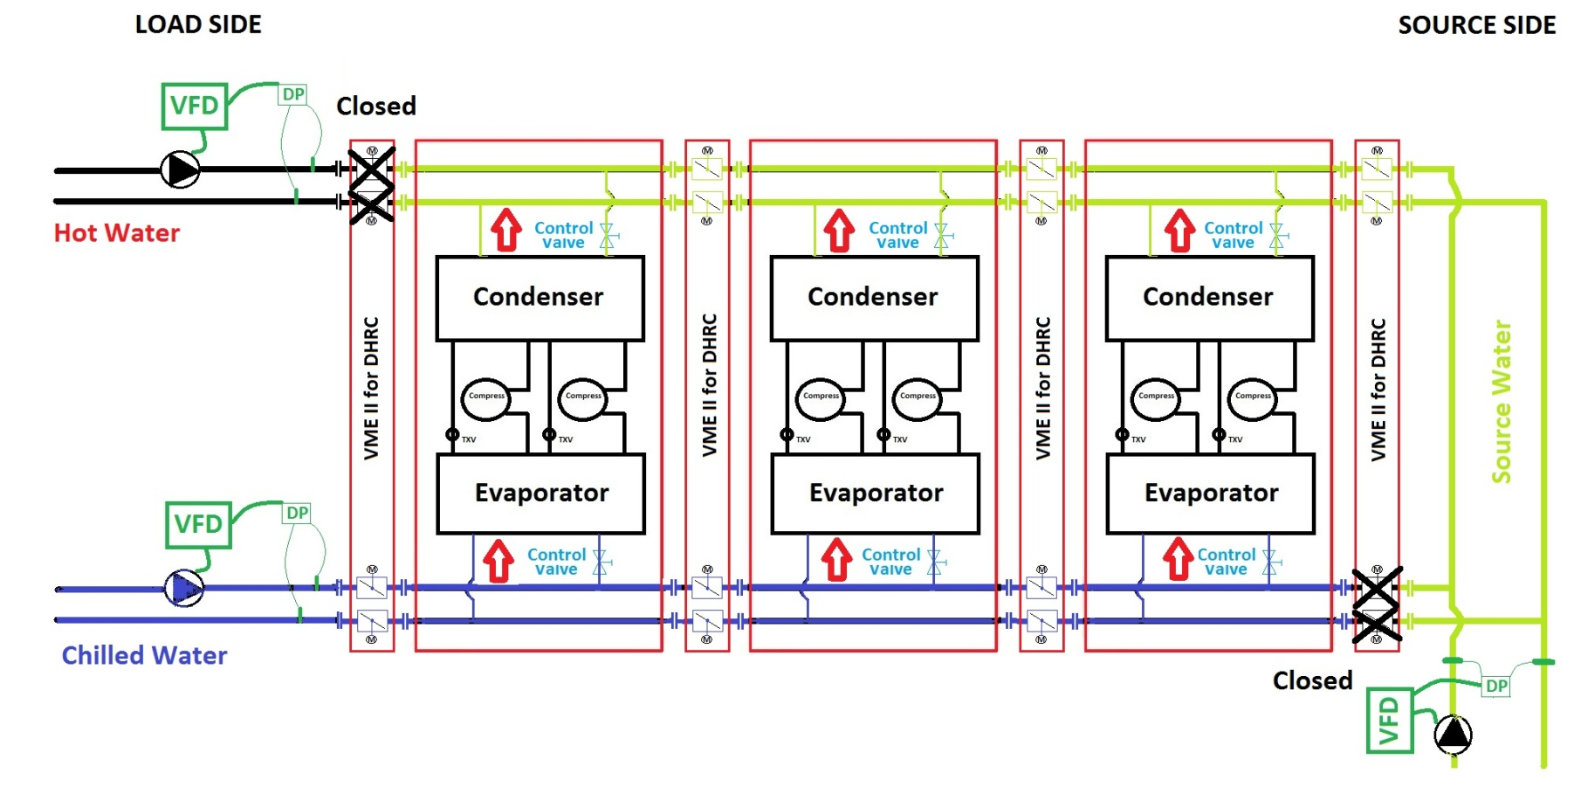
Modular Simultaneous H/C with Integrated Heat Recovery (Geothermal Source Water)
3 Cooling
0 Heating
3 Source rejecting
0 Simultaneous load
VME 2

Slide 30
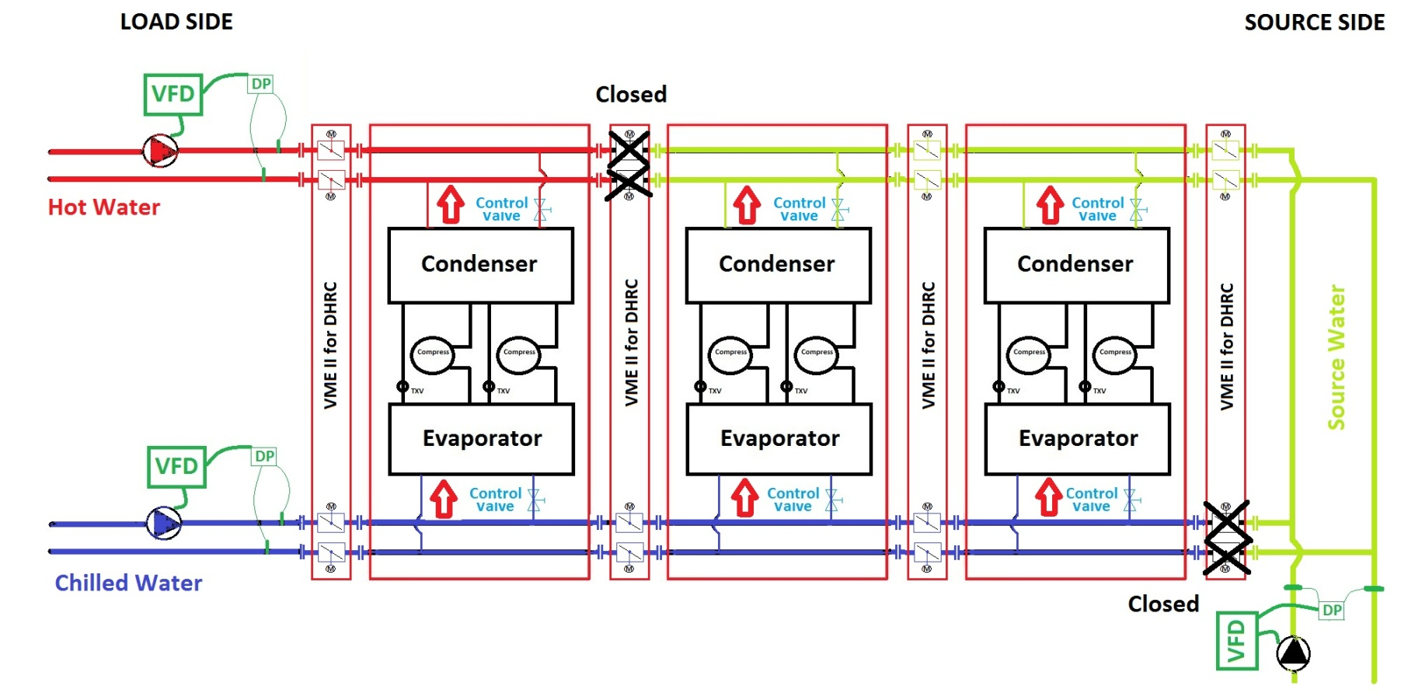
Modular Simultaneous H/C with Integrated Heat Recovery (Geothermal Source Water)
3 Cooling
1 Heating
2 Source rejecting
1 Simultaneous load
VME 2

Slide 31
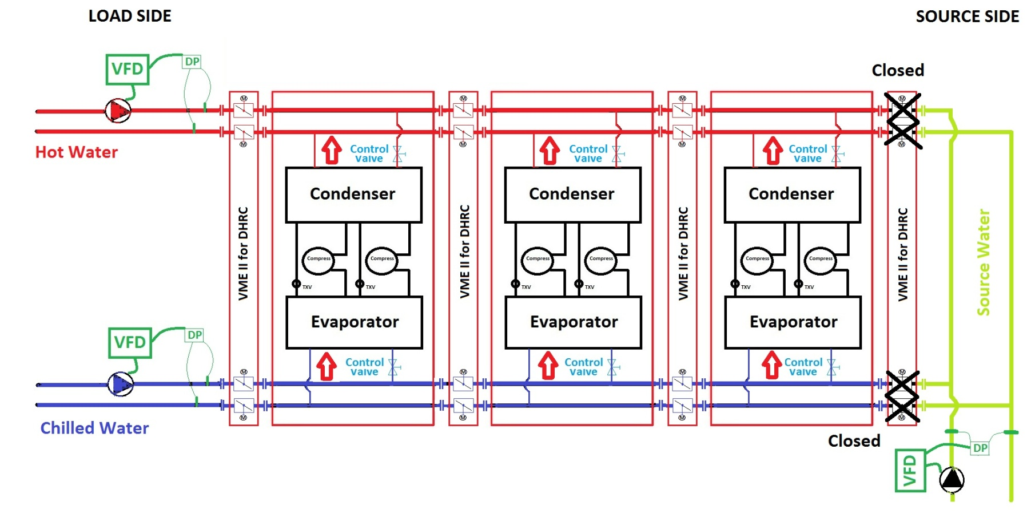
Modular Simultaneous H/C with Integrated Heat Recovery (Geothermal Source Water)
3 Cooling
3 Heating
0 Source
3 Simultaneous load
VME 2

Slide 32
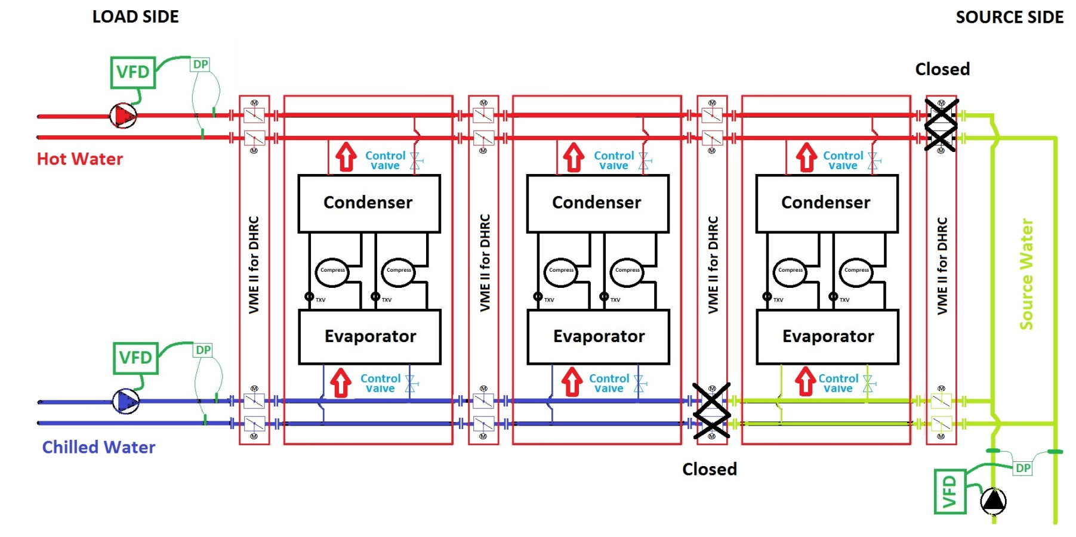
Modular Simultaneous H/C with Integrated Heat Recovery (Geothermal Source Water)
2 Cooling
3 Heating
1 Source extracting
2 Simultaneous load

Slide 33
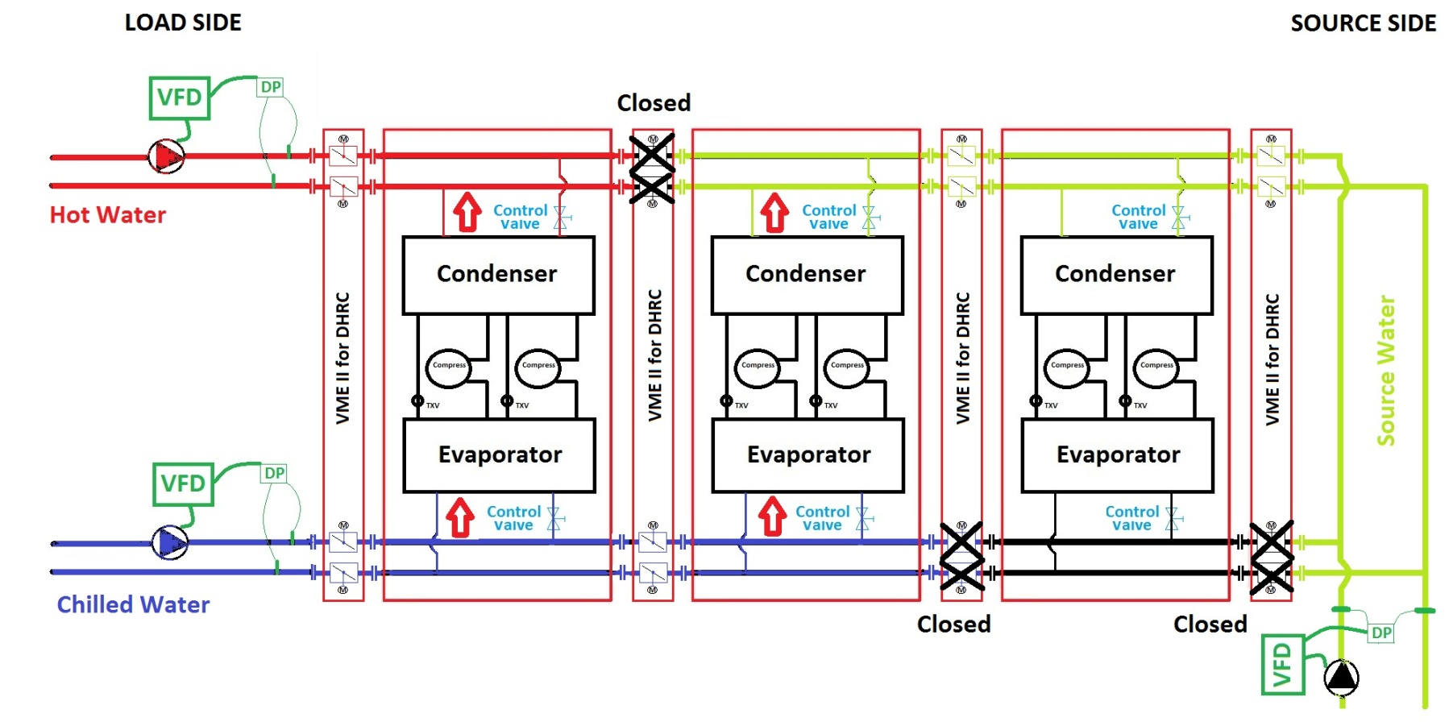
Modular Simultaneous H/C with Integrated Heat Recovery (Geothermal Source Water)
2 Cooling
1 Heating
1 Source rejecting
1 Simultaneous load
VME 2

Slide 34
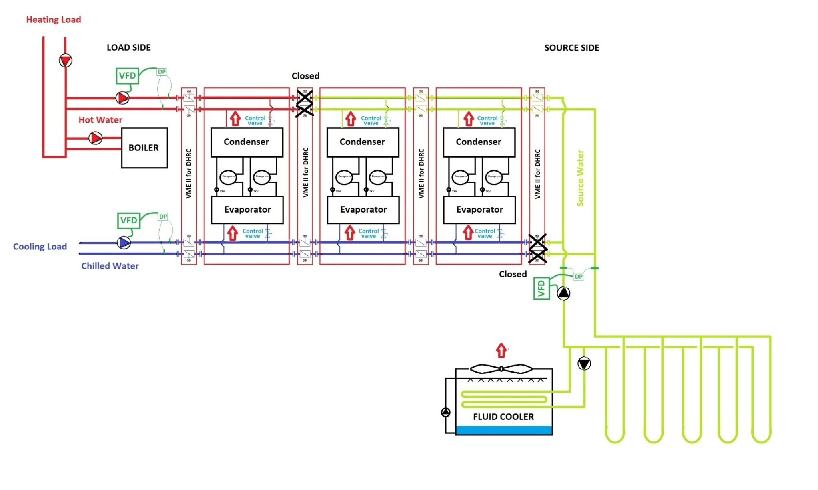
Modular Simultaneous H/C with Integrated Heat Recovery (Geothermal Source Water)
System Redundancy Considerations SMCH
Cooling 5 + 1 Modules
Heating 5 + 1 Modules + Back-up Boiler
Pumping (3) 50% Pumps on each Loop
Dual Power Feeds (Generator)
FANWALL Technology for Surgery AHU

Slide 35
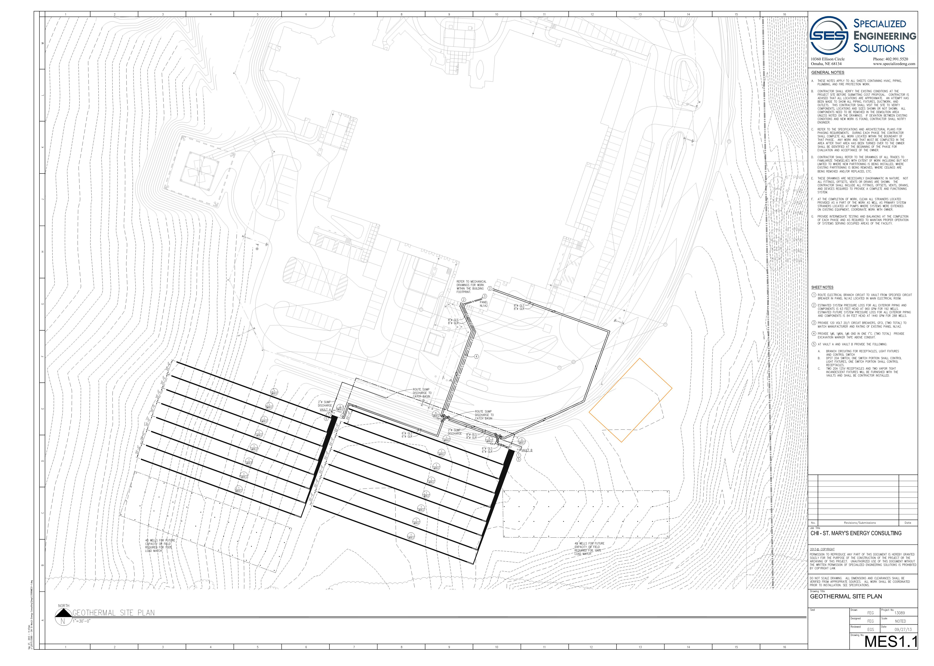
System Redundancy Considerations
Dual Geo Mains
Dual Vaults each with:
7 + 1 Independent Circuits
Room for 50% Growth

Slide 36
St Mary’s Community Hospital THANK YOU!
Design Teamwork
Eric Granzow SES
Eric Sherman SES
Bob Weber CR
Sam Meints CR
Ash Prabhakar CR
Blake Winter CR
Bruce Barrett - Multistack
Contractor Teamwork
Fred Henry – Mid America Drilling
Jodi Crane – Mid America Drilling
Alan Busch - CMI
Frederick Larouge - CMI
Brian Crogg – Midlands
Phil Frank – Midlands
Ron Lannin - Commonwealth
Bob Philips – Commonwealth
Jennifer Harris – JE Dunn
Mark Morris – Mechanical Sales
CHI Leadership
Skanda Skandaverl
Daniel Kelly
Steven Walker
Frank Emsick
JE Dunn Leadership
Jason Studt
Joe Jelden
Corey Erdkamp
John Hoodjer
Mike Miskowiec
Doug Duren
Ryan Watzke
Commissioning Teamwork
Carl Beebe – JE Dunn
Terry Stohs – SES
James Stauch - SES
Andy Morrow – Mechanical Sales
Wayne Bobek – Mechanical Sales
Brett Schillin - Multistack

Slide 37
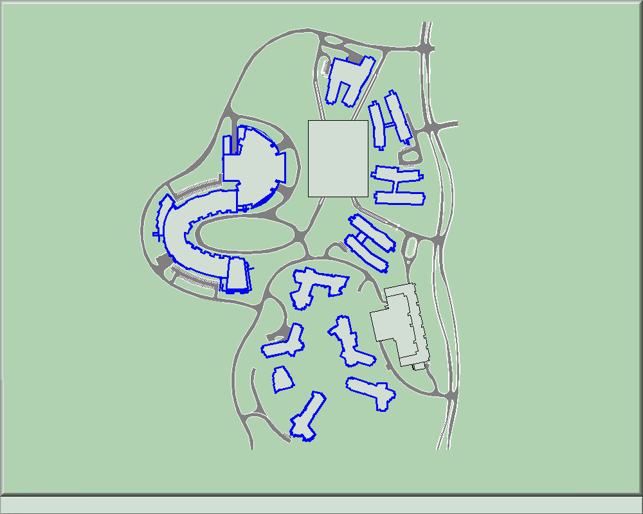
Other Installations - Epic Systems
Learning Center
Parking
Campus 2
Campus 1
Parking
Epic Systems Corporation is a privately held healthcare software company. According to the company, Hospitals that use its software hold medical records of 54% of patients in the U.S.

Slide 38
Verona,Wisconsin
One of The Largest Geothermal Projects In The World (5,000,000 SF + 3,000,000 SF Under Construction.
Centralized Geothermal Heating & Cooling
20,000 Tons of MULTISTACK Geothermal Heat Recovery Chillers
80,000 GPM of Source Water Capability
Solar PV Farms
Approximately 900 acres
Underground parking
Buildings connected with sky bridges or underground tunnels

Slide 39
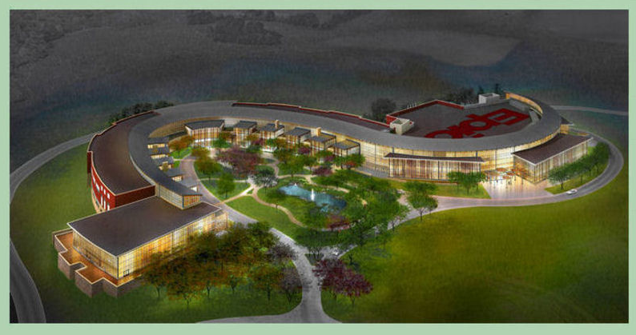
Epic Systems Learning Center Campus

Slide 40
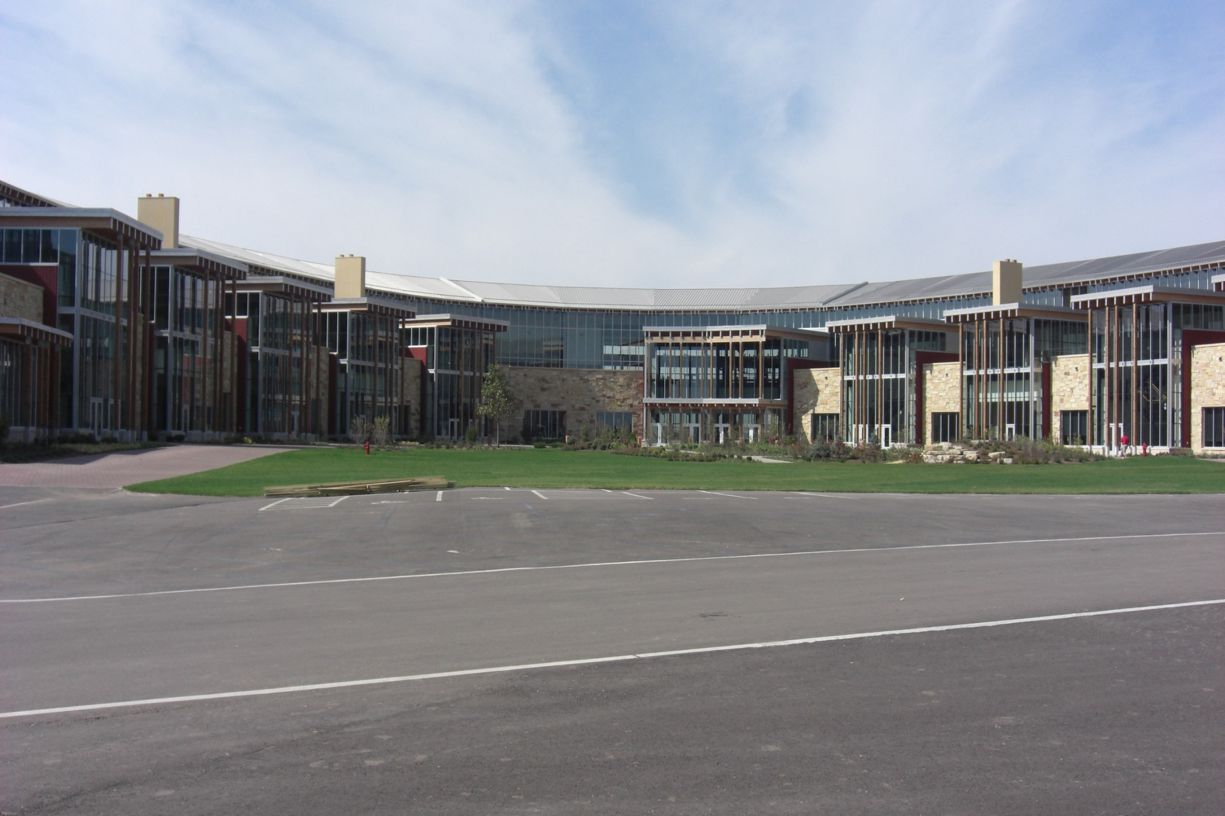

Slide 41
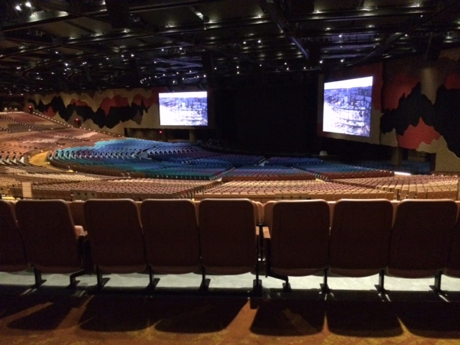

Slide 42
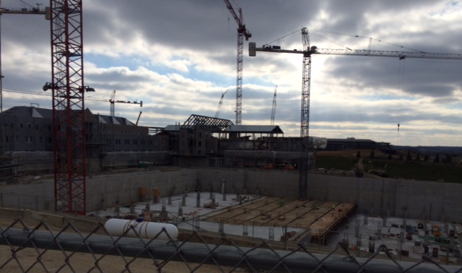
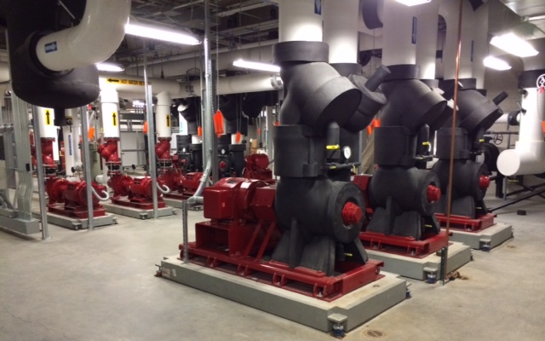
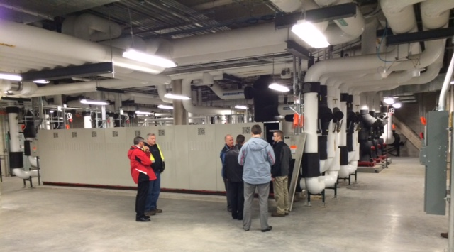

Slide 45
NSHE 2015 Fall Conference St Mary’s Community Hospital Geothermal Heat Recovery Central Utilities Plant (CUP)
Live System Demonstration
THANK YOU

