Slide 1
Hospital Top Ten Deficiencies
2014
Presented by Don Fritz
Assistant State Fire Marshal

Slide 2
Survey to determine compliance with regulations to participate in CMS Medicare/Medicaid program.
2000 Life Safety Code
Referenced NFPA Standards
  10, 13, 25, 45, 54, 70, 72, 80, 90A, 90B, 96, 110, 220, 251, 253, 255, 265, 267, 286, 701
  CMS Directives

Slide 3
Facility is responsible for maintaining compliance with the regulations at all times.
Should not “get ready for the survey”
Should always be in compliance with the regulations
Fire plays no favorites and sets no schedules

Slide 4
The very first thing is the entrance interview
Explain process
Facility would provide surveyor with any categorical waivers the facility has elected to use.
Copies of any other waivers

Slide 5
DOCUMENTATION
Fire Drills
Hood Inspections
Hood Cleaning
Sprinkler Inspections
Fire Alarm Inspections
Central Receiving Station logs for fire alarm activations
Spec sheets for interior finish, drapes, curtains, etc.
Documentation for flame retardant applications
Generator testing and inspections
Fire procedures and evacuation plan
Fire watch policy
Smoking policy and resident evaluation procedure
Facility floor plan
Resident census
Waivers
See handout for complete list

Slide 6
National Top 10 LSC Deficiencies FY14
K29 – Hazardous Areas
K147 -Electrical Wiring
K62 - Sprinkler Maintenance
K18 - Corridor Doors
K130 –Miscellaneous
K50 - Fire Drills
K25 - Smoke Partitions
K 38 - Means of Egress
K56 - Sprinkler Systems
K52 – Fire Alarm Systems

Slide 7
Life Safety K Tag Comparison
Comparison – Nebraska – VHS – Region VII – Nation
Nebraska Tag Description Region VII Nation
K29 Hazardous Area Protection K147 K62
K147 Electrical Wiring and Equipment K62 K147
K38 Exits Accessible at All Times K25 K25
K62 Automatic Sprinkler Maintenance K29 K29
K52 Fire Alarm IMT K50 K18
K56 Sprinkler Systems K18 K38
K69 Cooking Facilities K38 K50
K11 Building Construction K46 K144
K144 Generator Testing / Maintenance K12 K56
K130 Miscellaneous K144 K52

Slide 8
THE TOP 10

Slide 9
K029 Hazardous Areas
One hour fire rated construction (with ¾ hour fire-rated doors) or an approved automatic fire extinguishing system protects hazardous areas. When the approved automatic fire extinguishing system option is used, the areas are separated from other spaces by smoke resisting partitions and doors. Doors are self-closing. 19.3.2.1
Deficient Practices that require tag cited:
Doors aren’t equipped with a self closing device, or don’t latch.
Penetrations through rated wall/ceiling not sealed with fire rated caulking.
Rated door label painted over or removed from door.
Soiled linen room door blocked open
Shower rooms converted to storage rooms

Slide 10
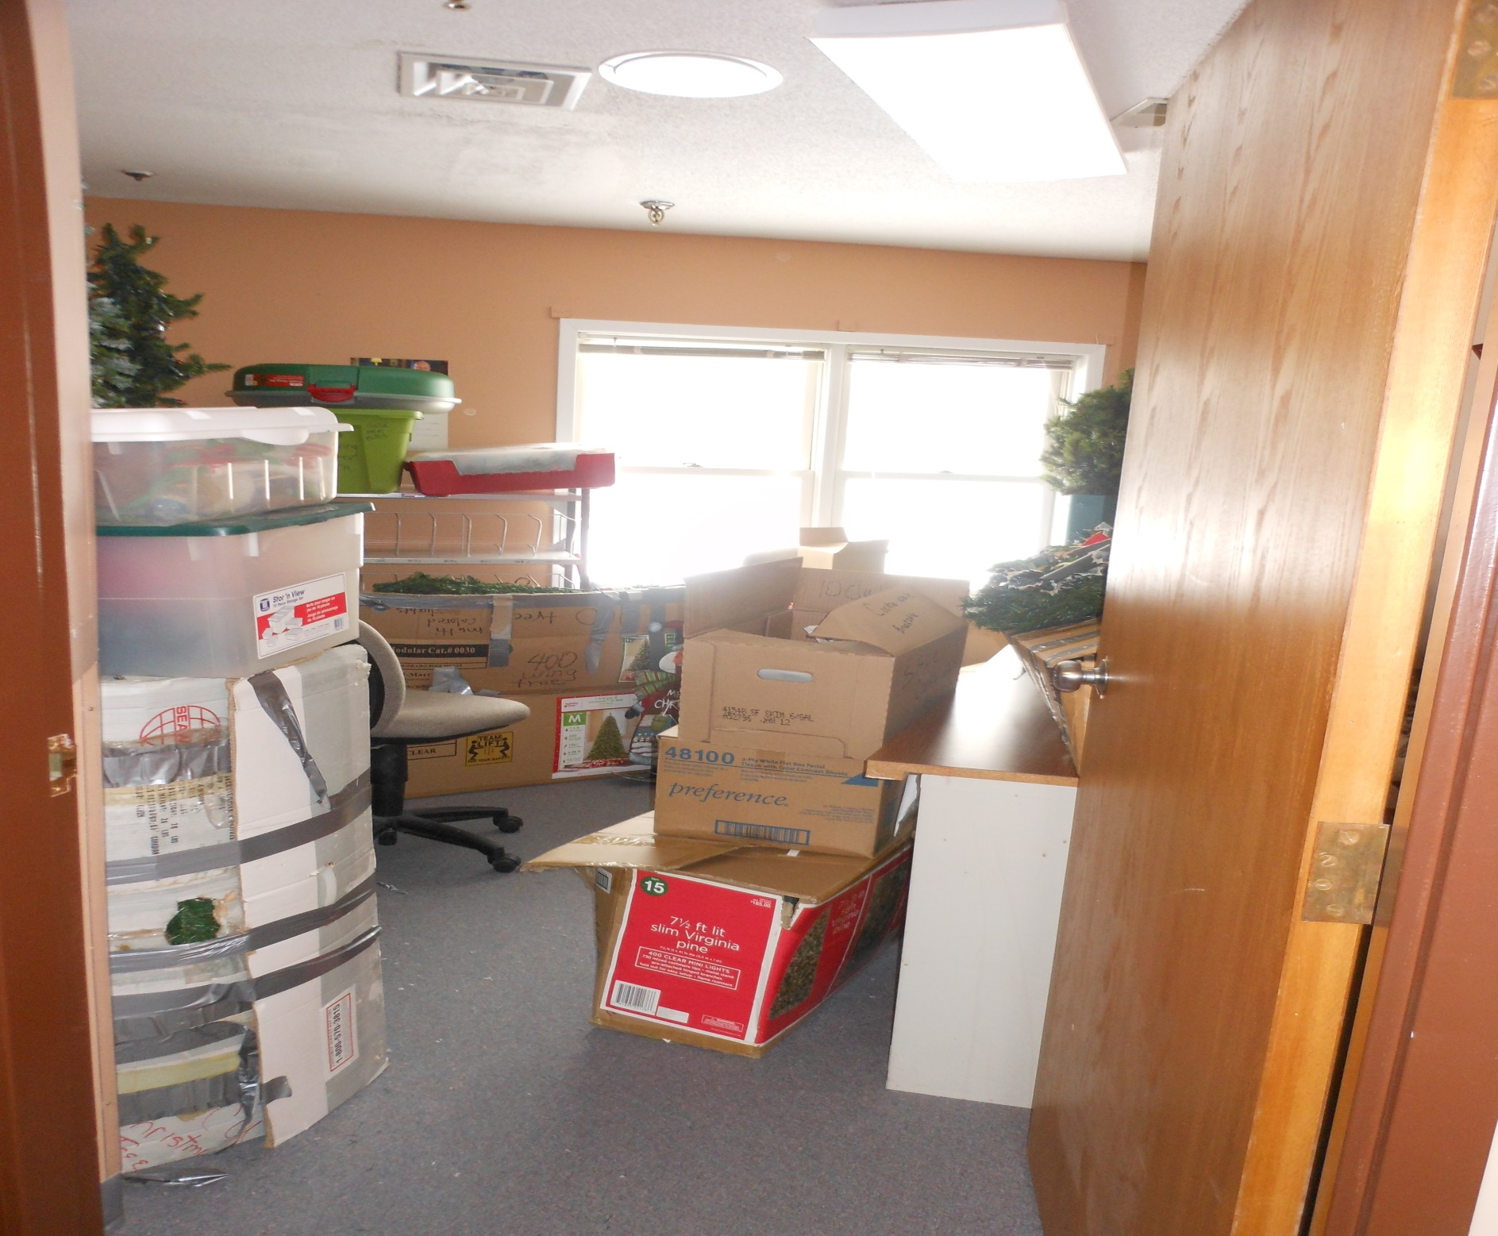

Slide 11
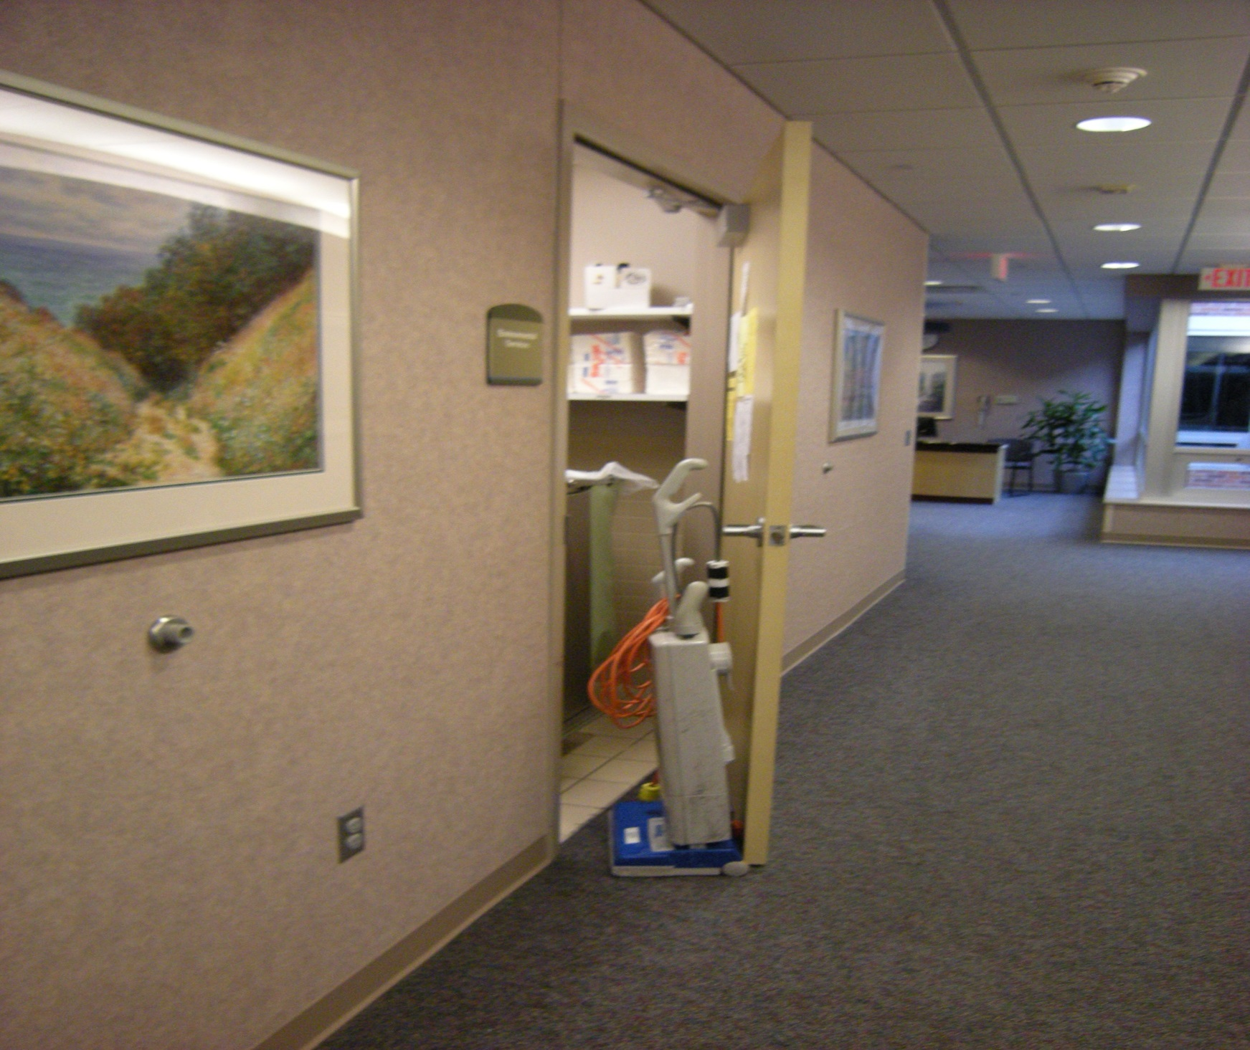

Slide 12
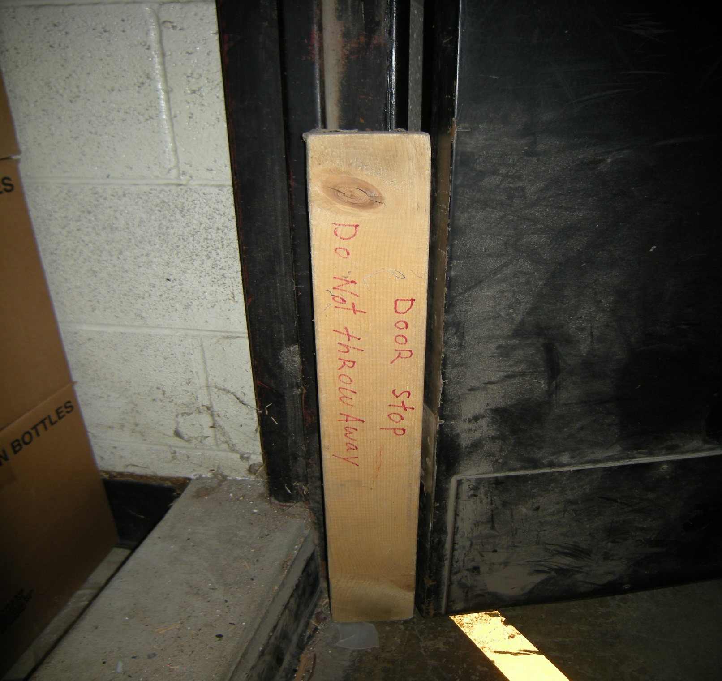

Slide 13
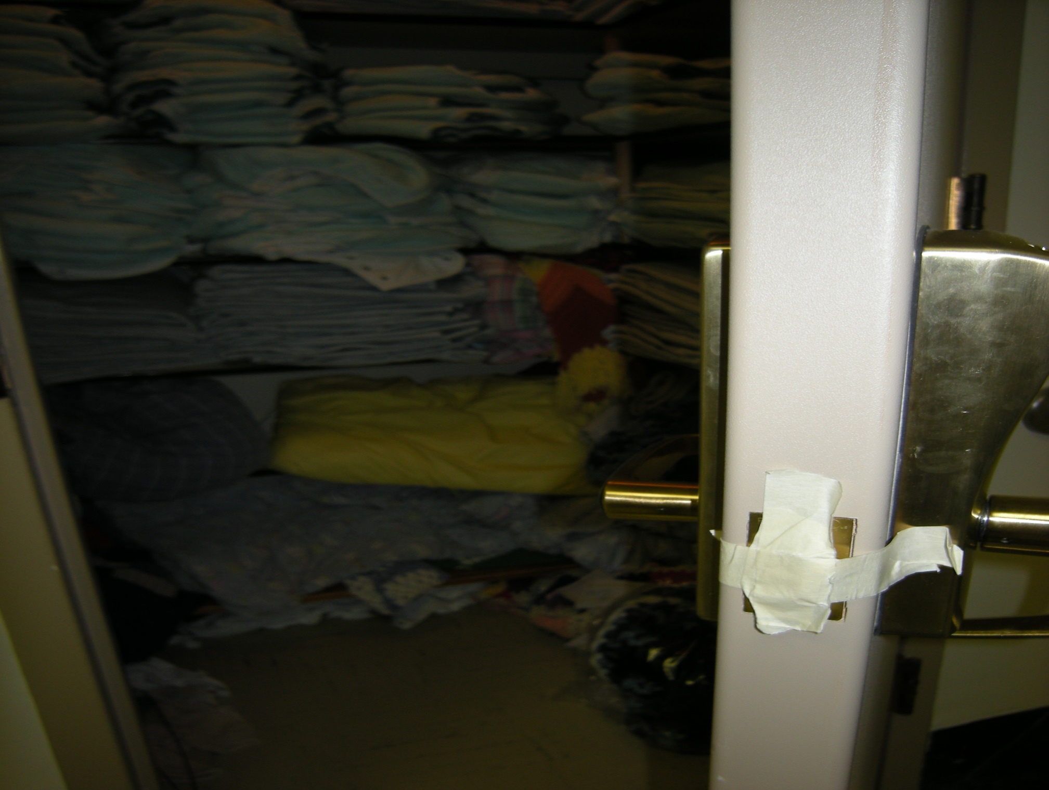

Slide 14
K147 Electrical Wiring & Equipment
Electrical wiring and equipment is in accordance with NFPA 70, National Electrical Code. 9.1.2
Deficient Practices that require tag cited:
Extension cords used for permanent wiring.
Open electrical junction boxes, broken or missing receptacle face plates.
Working space electrical panel: storage in front of electrical panels.
Openings in electrical panel.
Dead front covers missing electrical panels.

Slide 15
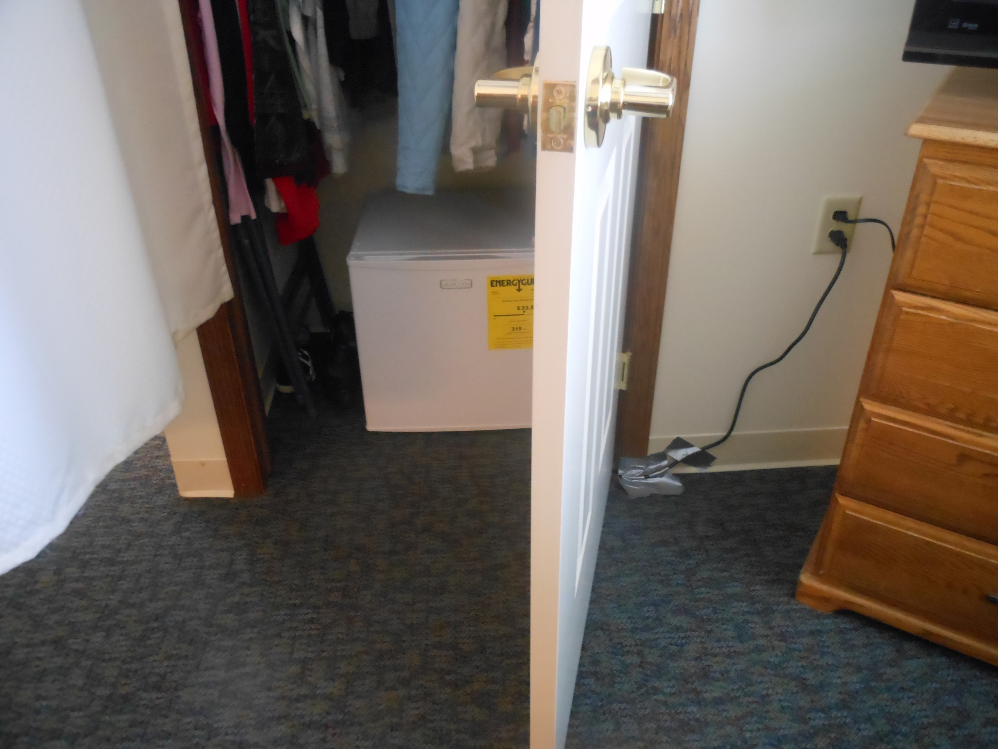

Slide 16
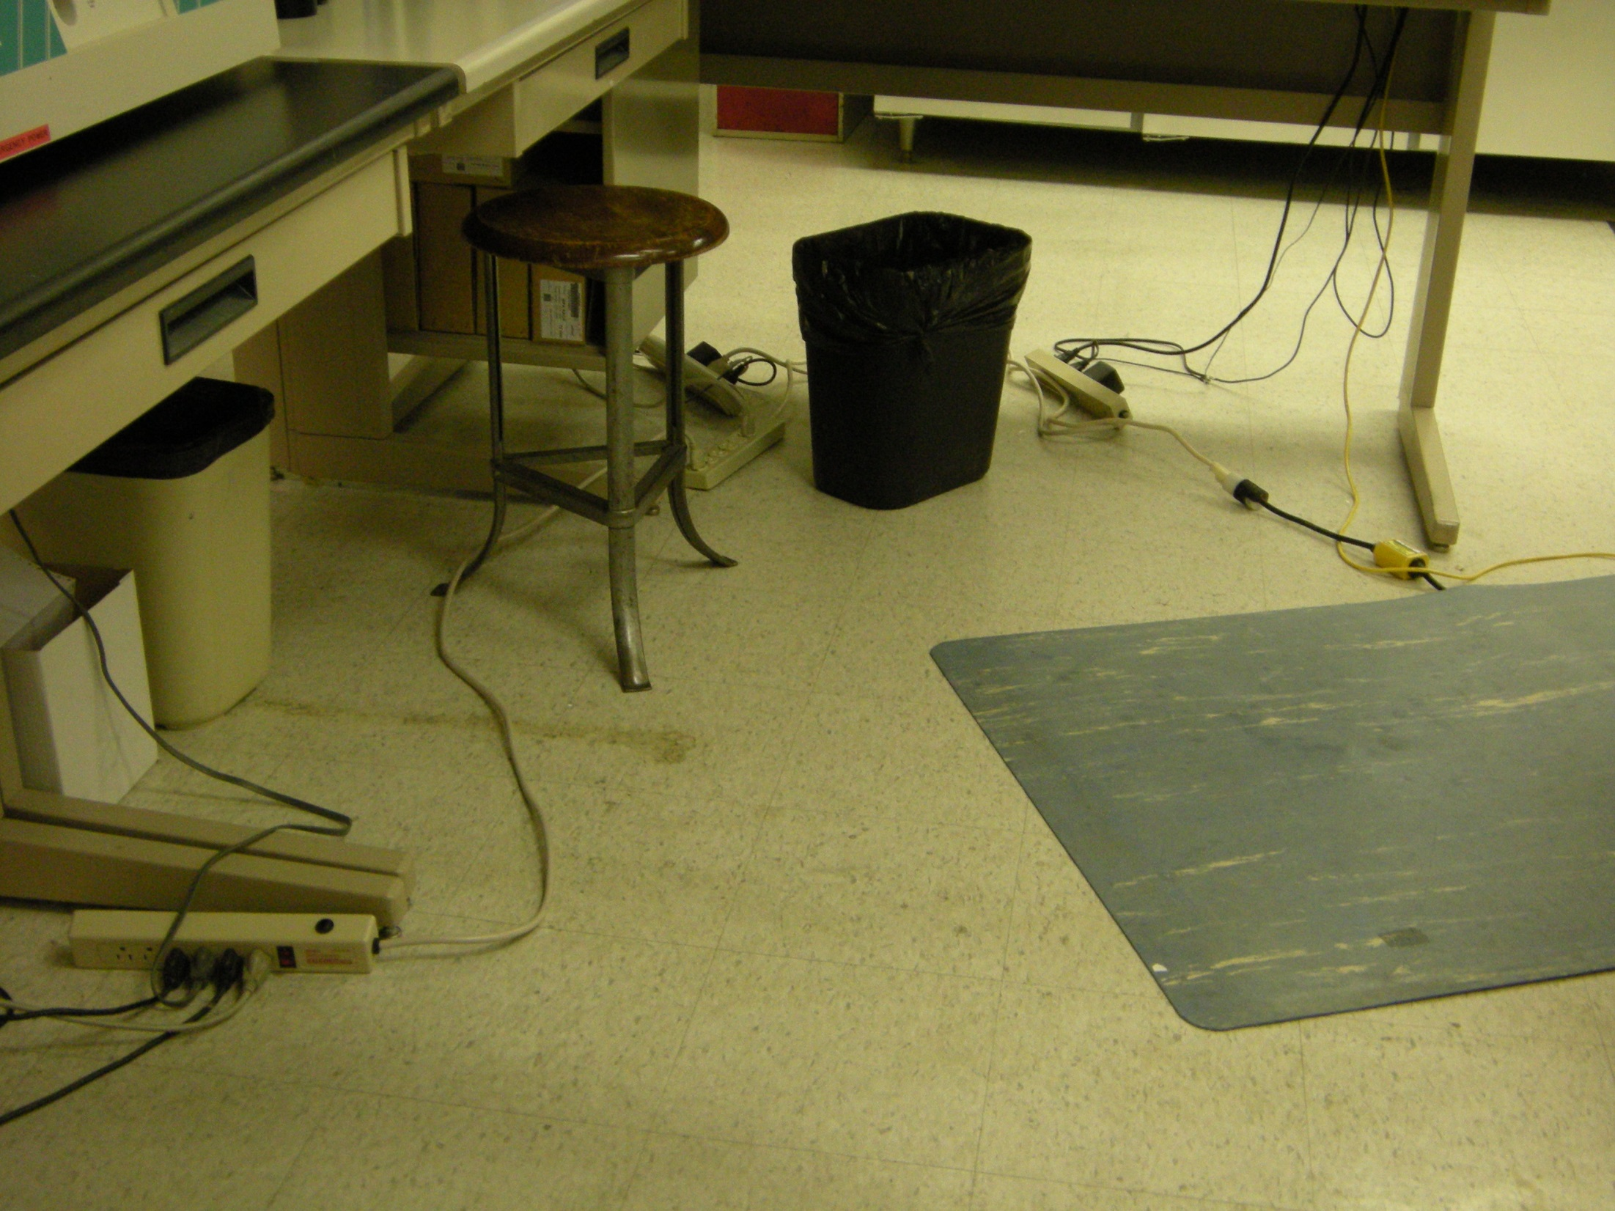

Slide 17
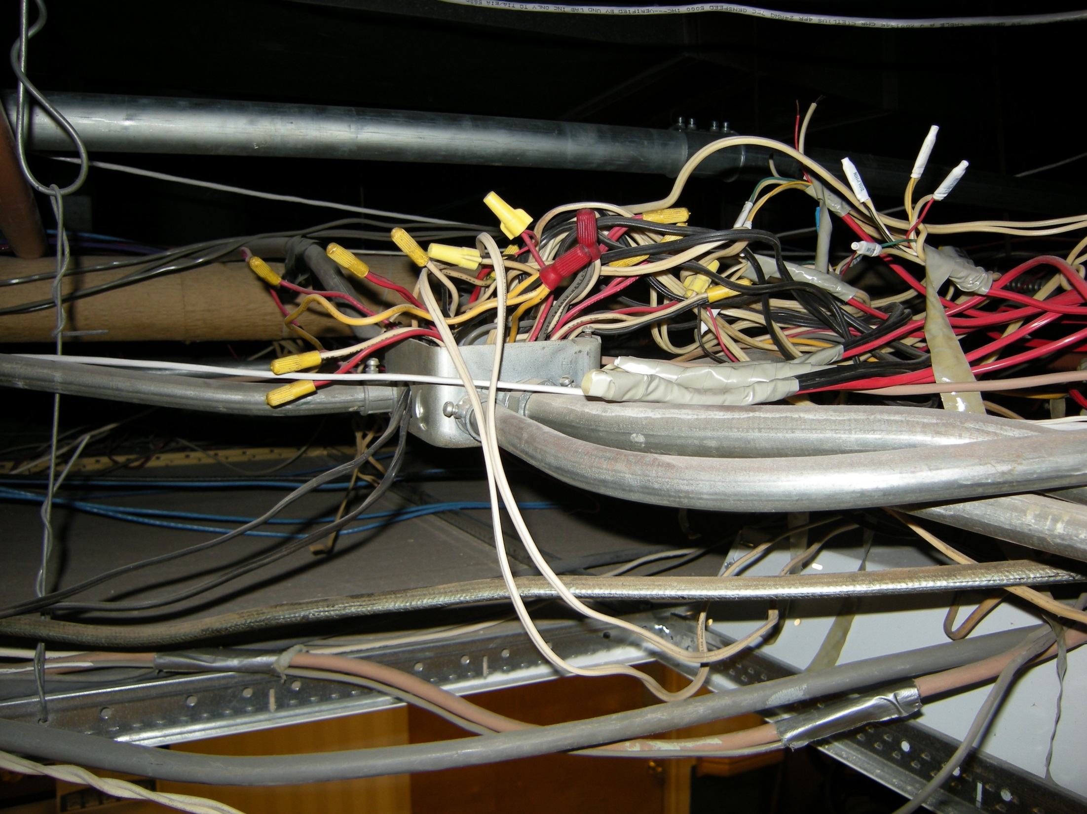

Slide 18
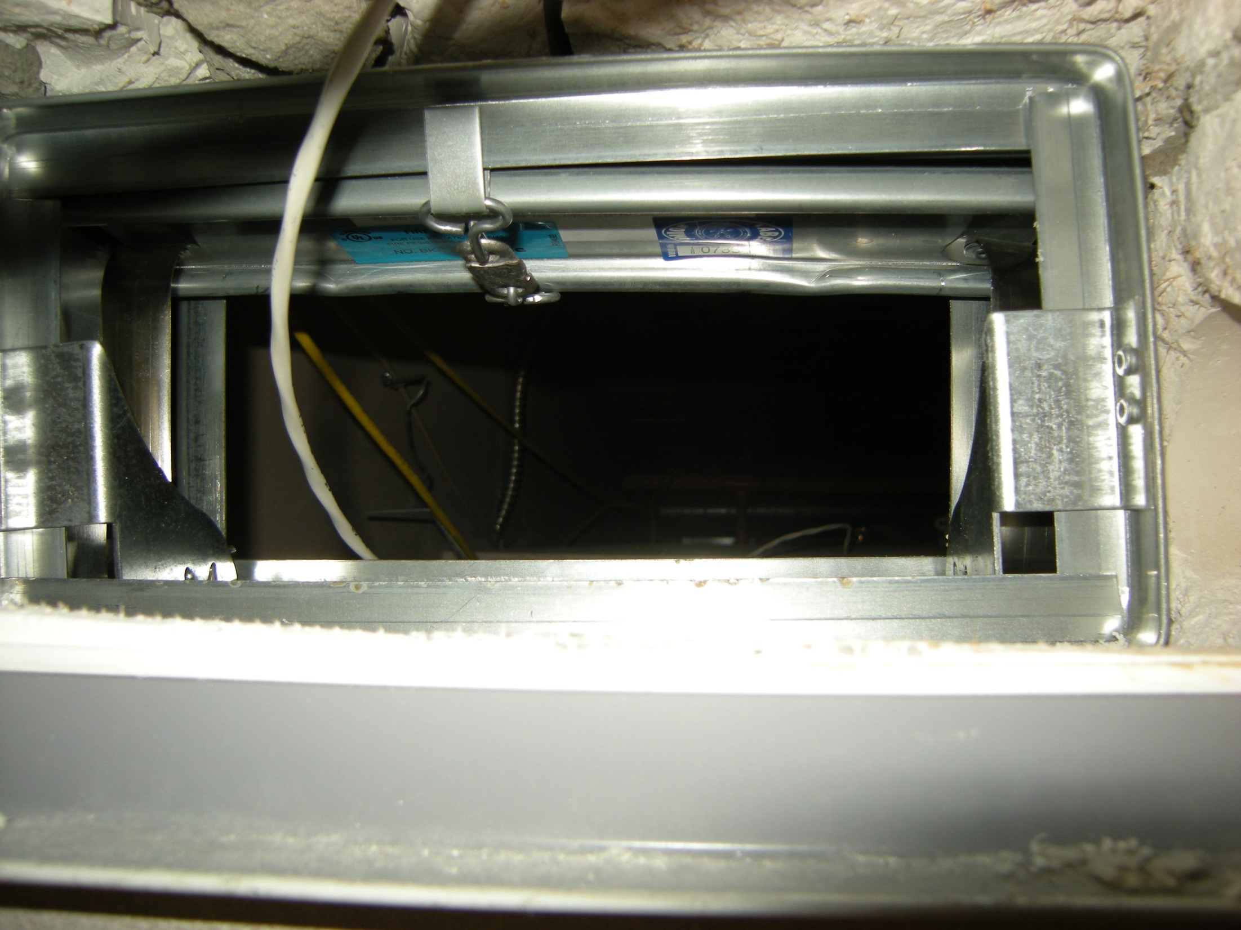

Slide 19
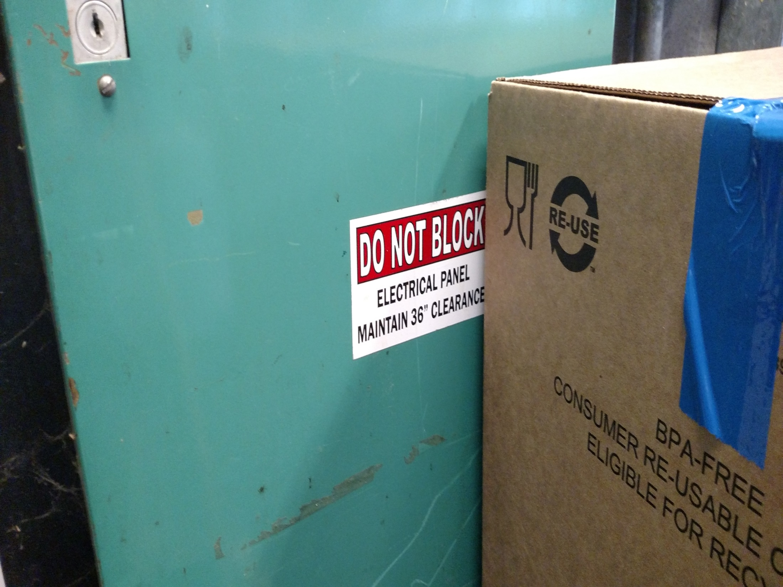

Slide 20
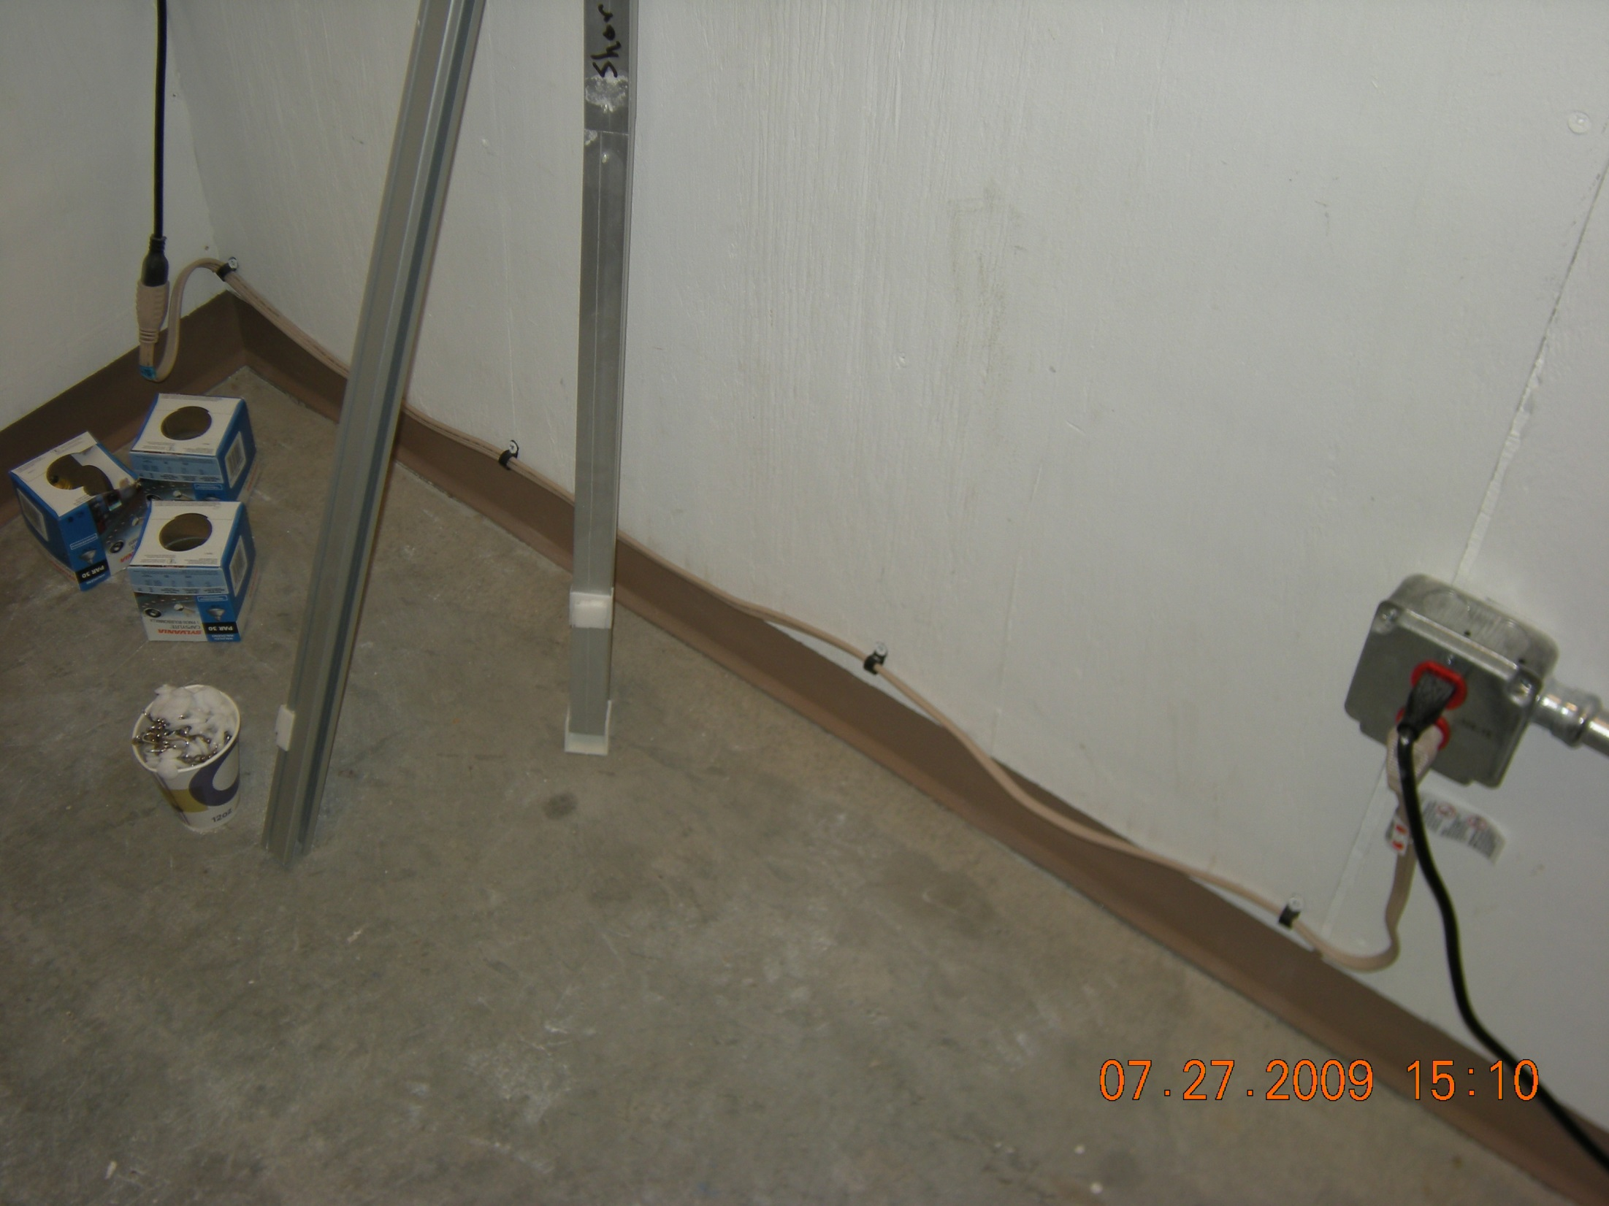

Slide 21
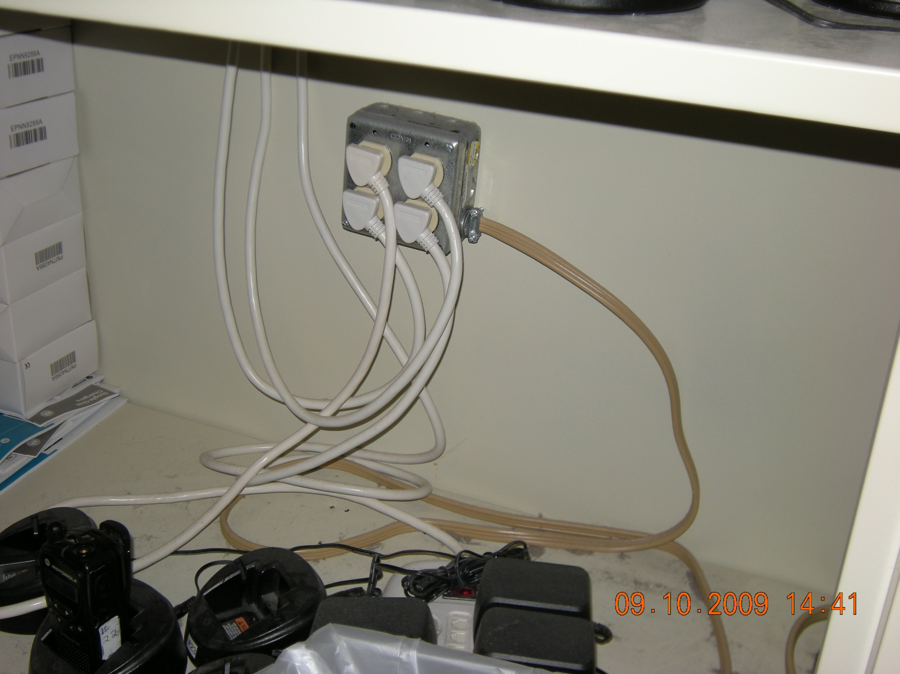

Slide 22
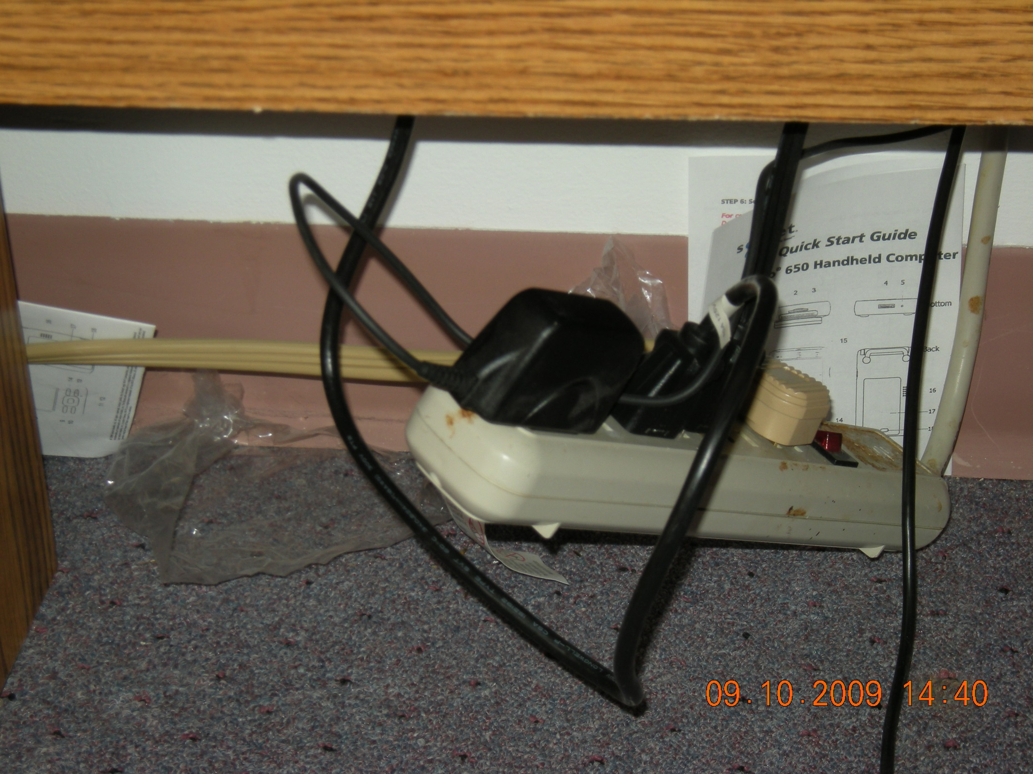

Slide 23
K038 Exit Access
Exit access is arranged so that exits are readily accessible at all times in accordance with section 7.1. 19.2.1
Deficient Practices that require tag cited:
Delayed egress locks not operating correctly. Required to release within 15 seconds. Signage posted on the door advising operation of delayed egress. Limit one delayed egress lock in a means of egress.
Card control electronic locks all staff required to carry card.
Key pad electronic locks all staff required to know code to release doors. Code to release doors is available to all visitors and patients that do not require specialized security measures.
Special door locking arrangements that incorporate card reader/key pad or delayed-egress must automatically unlock the electronic locks upon activation of the building fire protective signaling systems or automatic sprinkler systems or loss of power to the part of the access control systems.
Door Swing and force to be able to open the door.
Exterior sidewalks not cleared of snow and ice to a public way.
Required sidewalks not terminating at a public way.
Decorations, wall hangings over exit signs or egress doors.
Corridor obstructions.

Slide 24
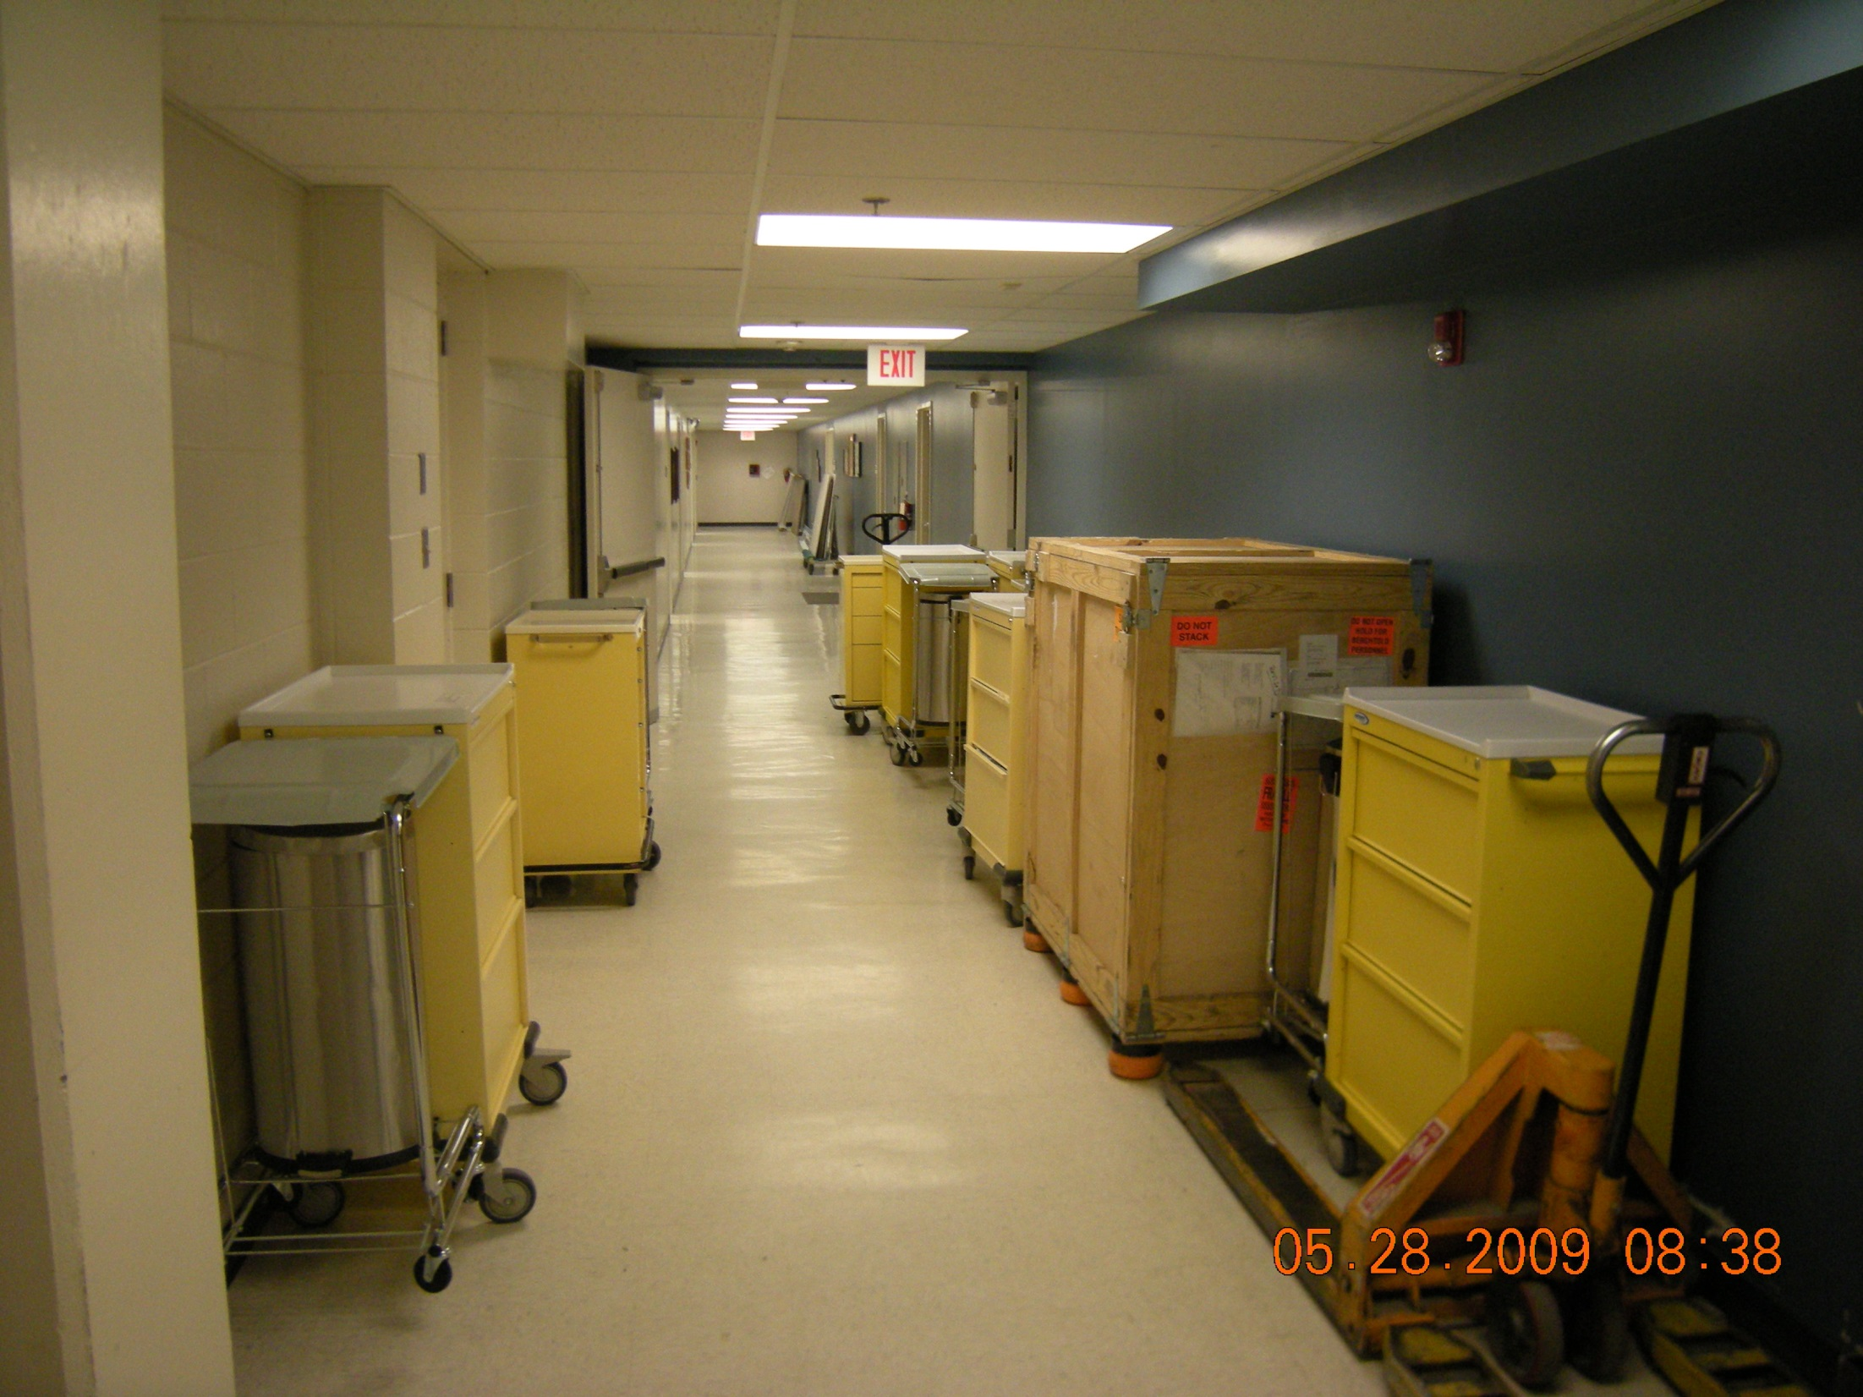

Slide 25
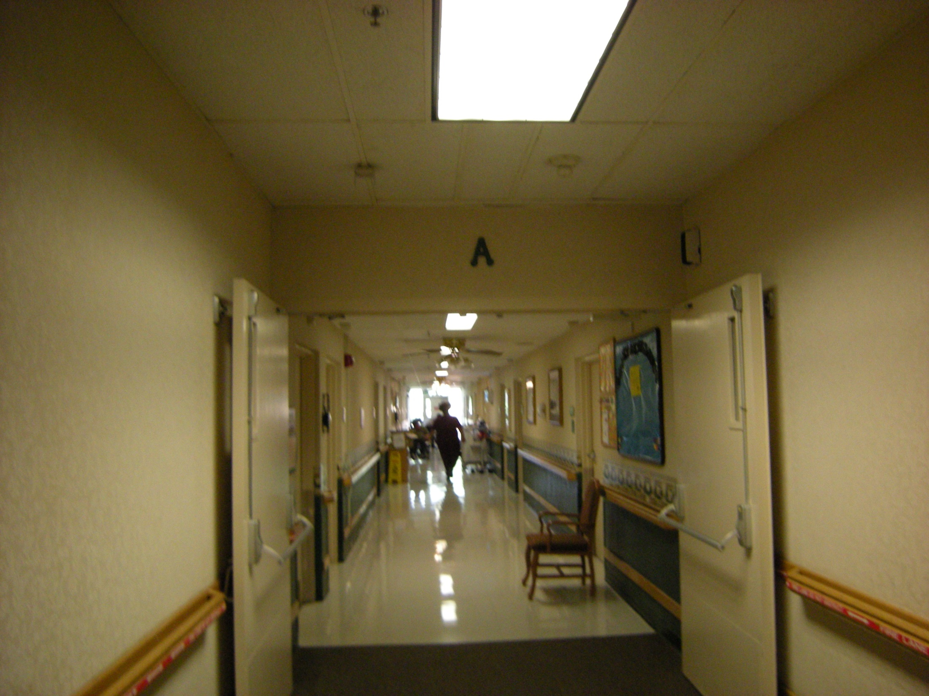

Slide 26
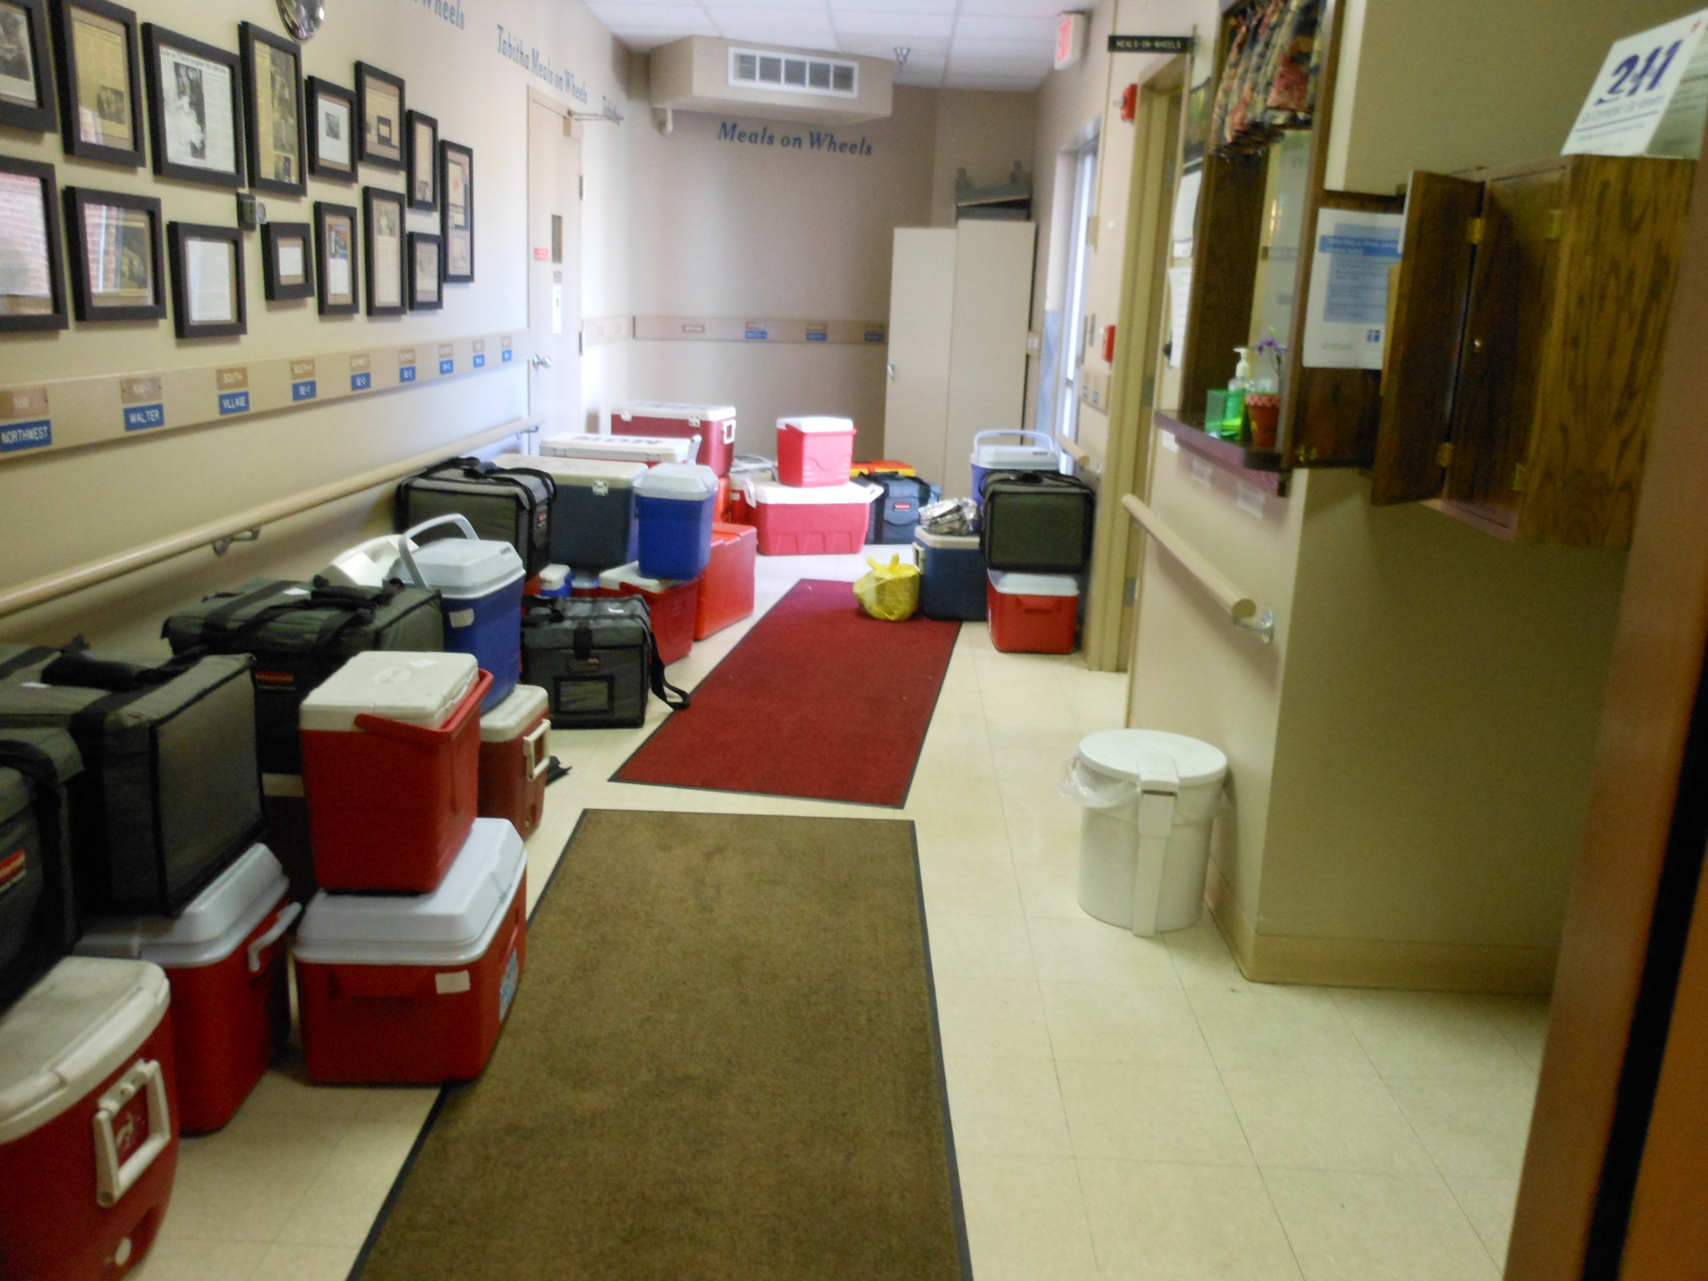

Slide 27
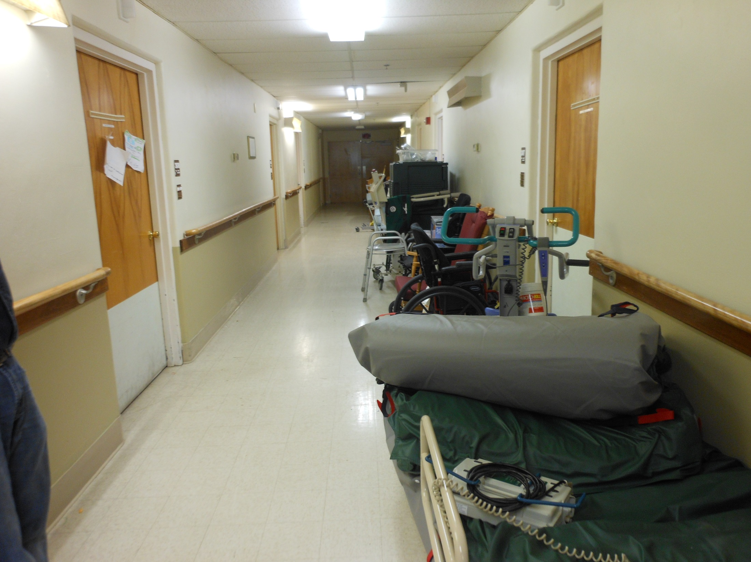

Slide 28
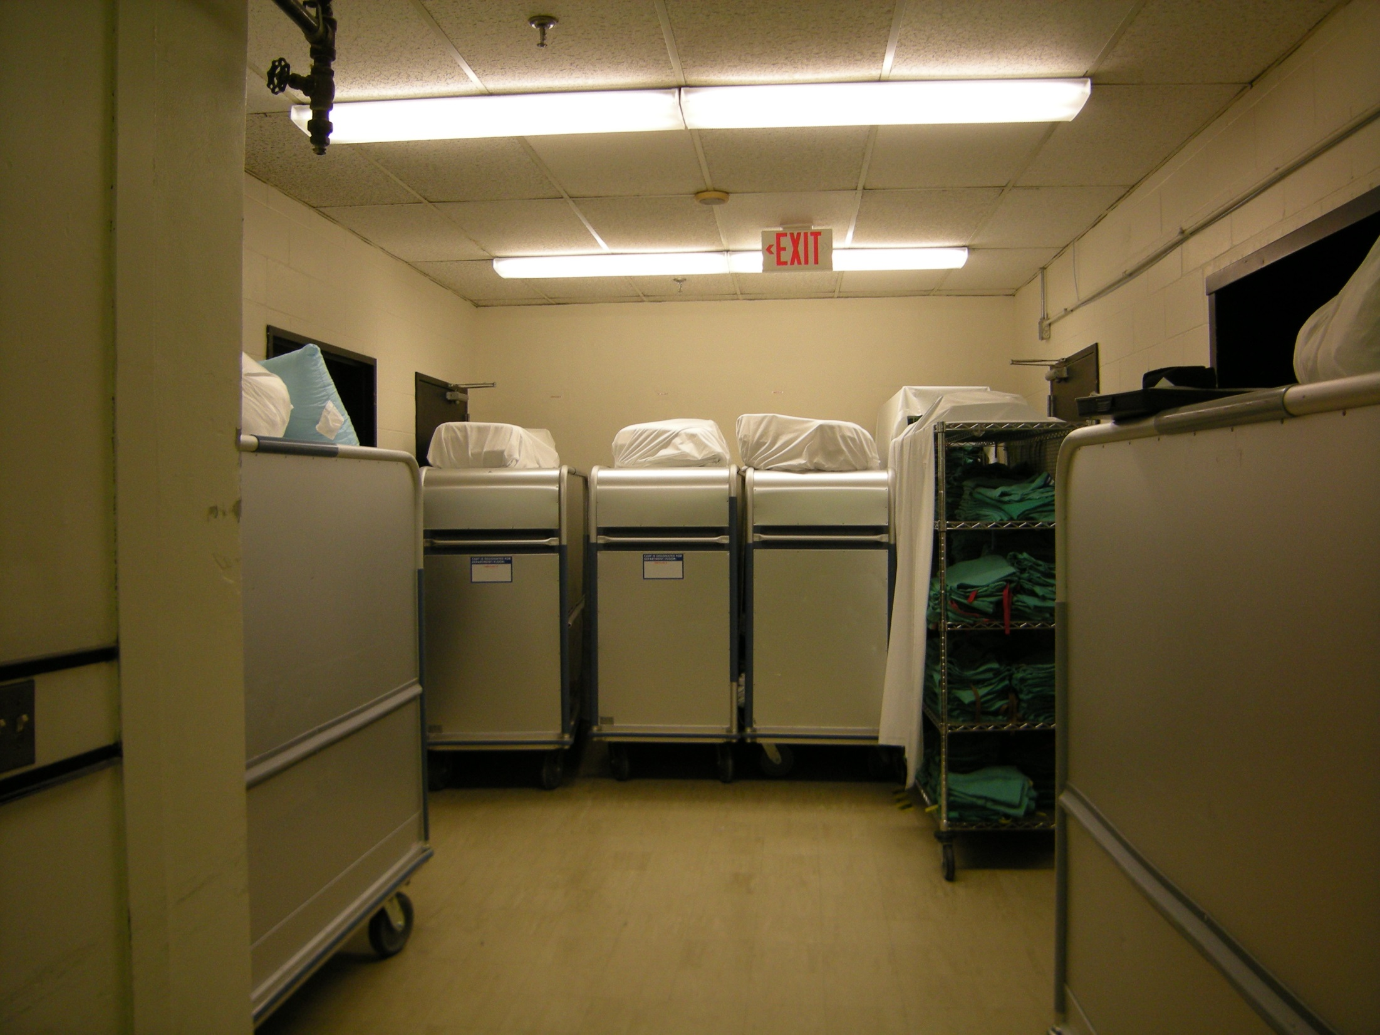

Slide 29
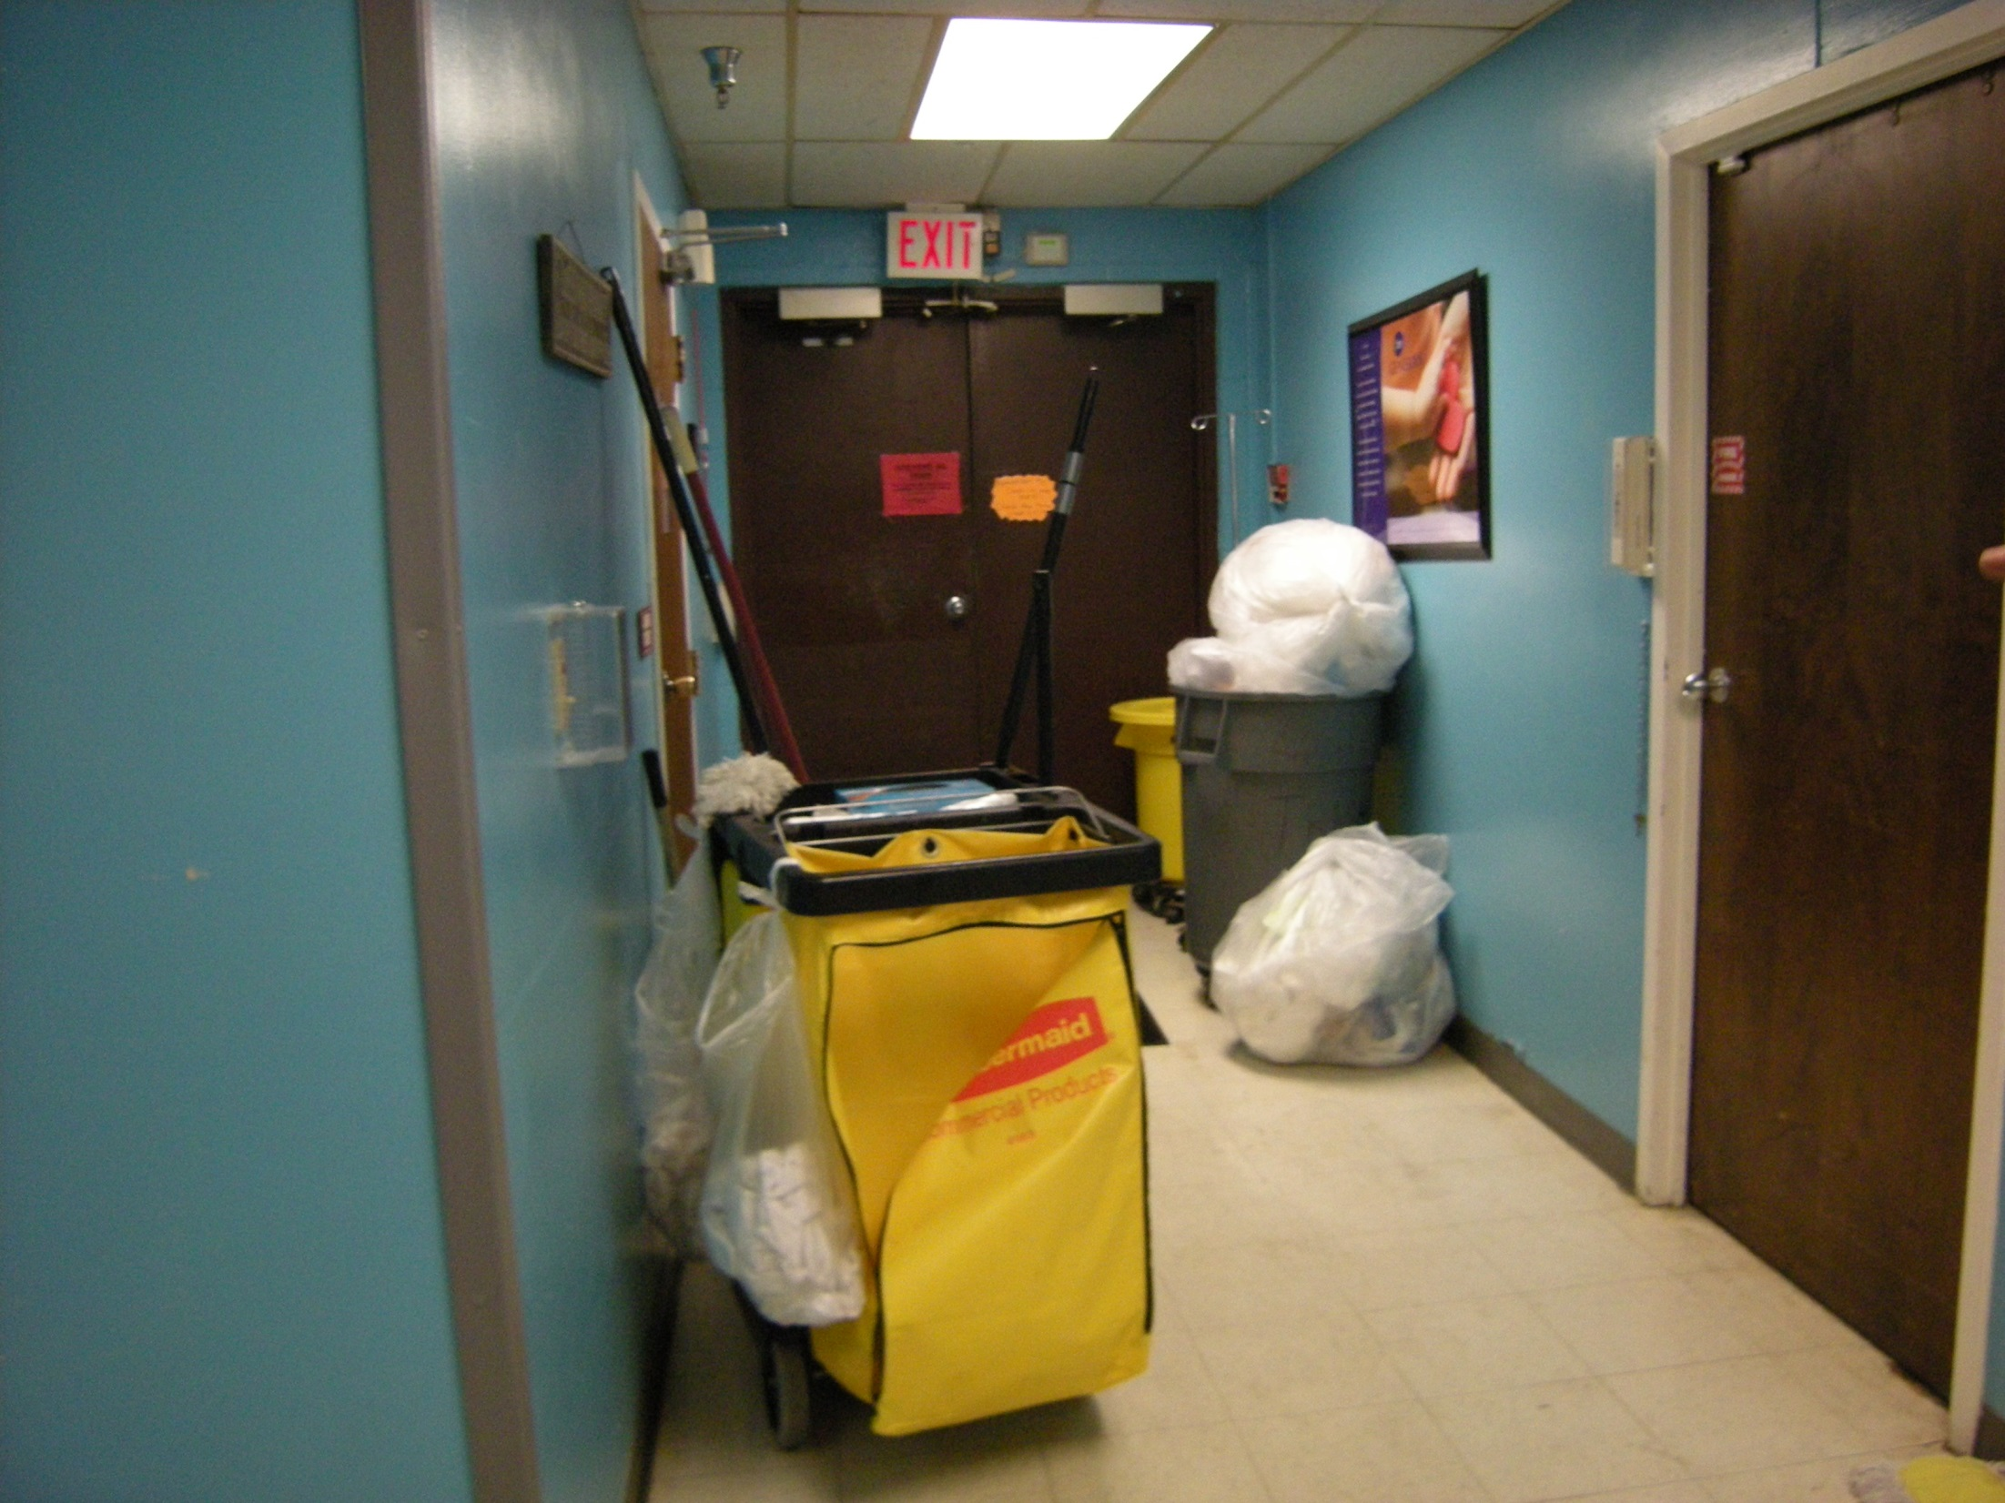

Slide 30
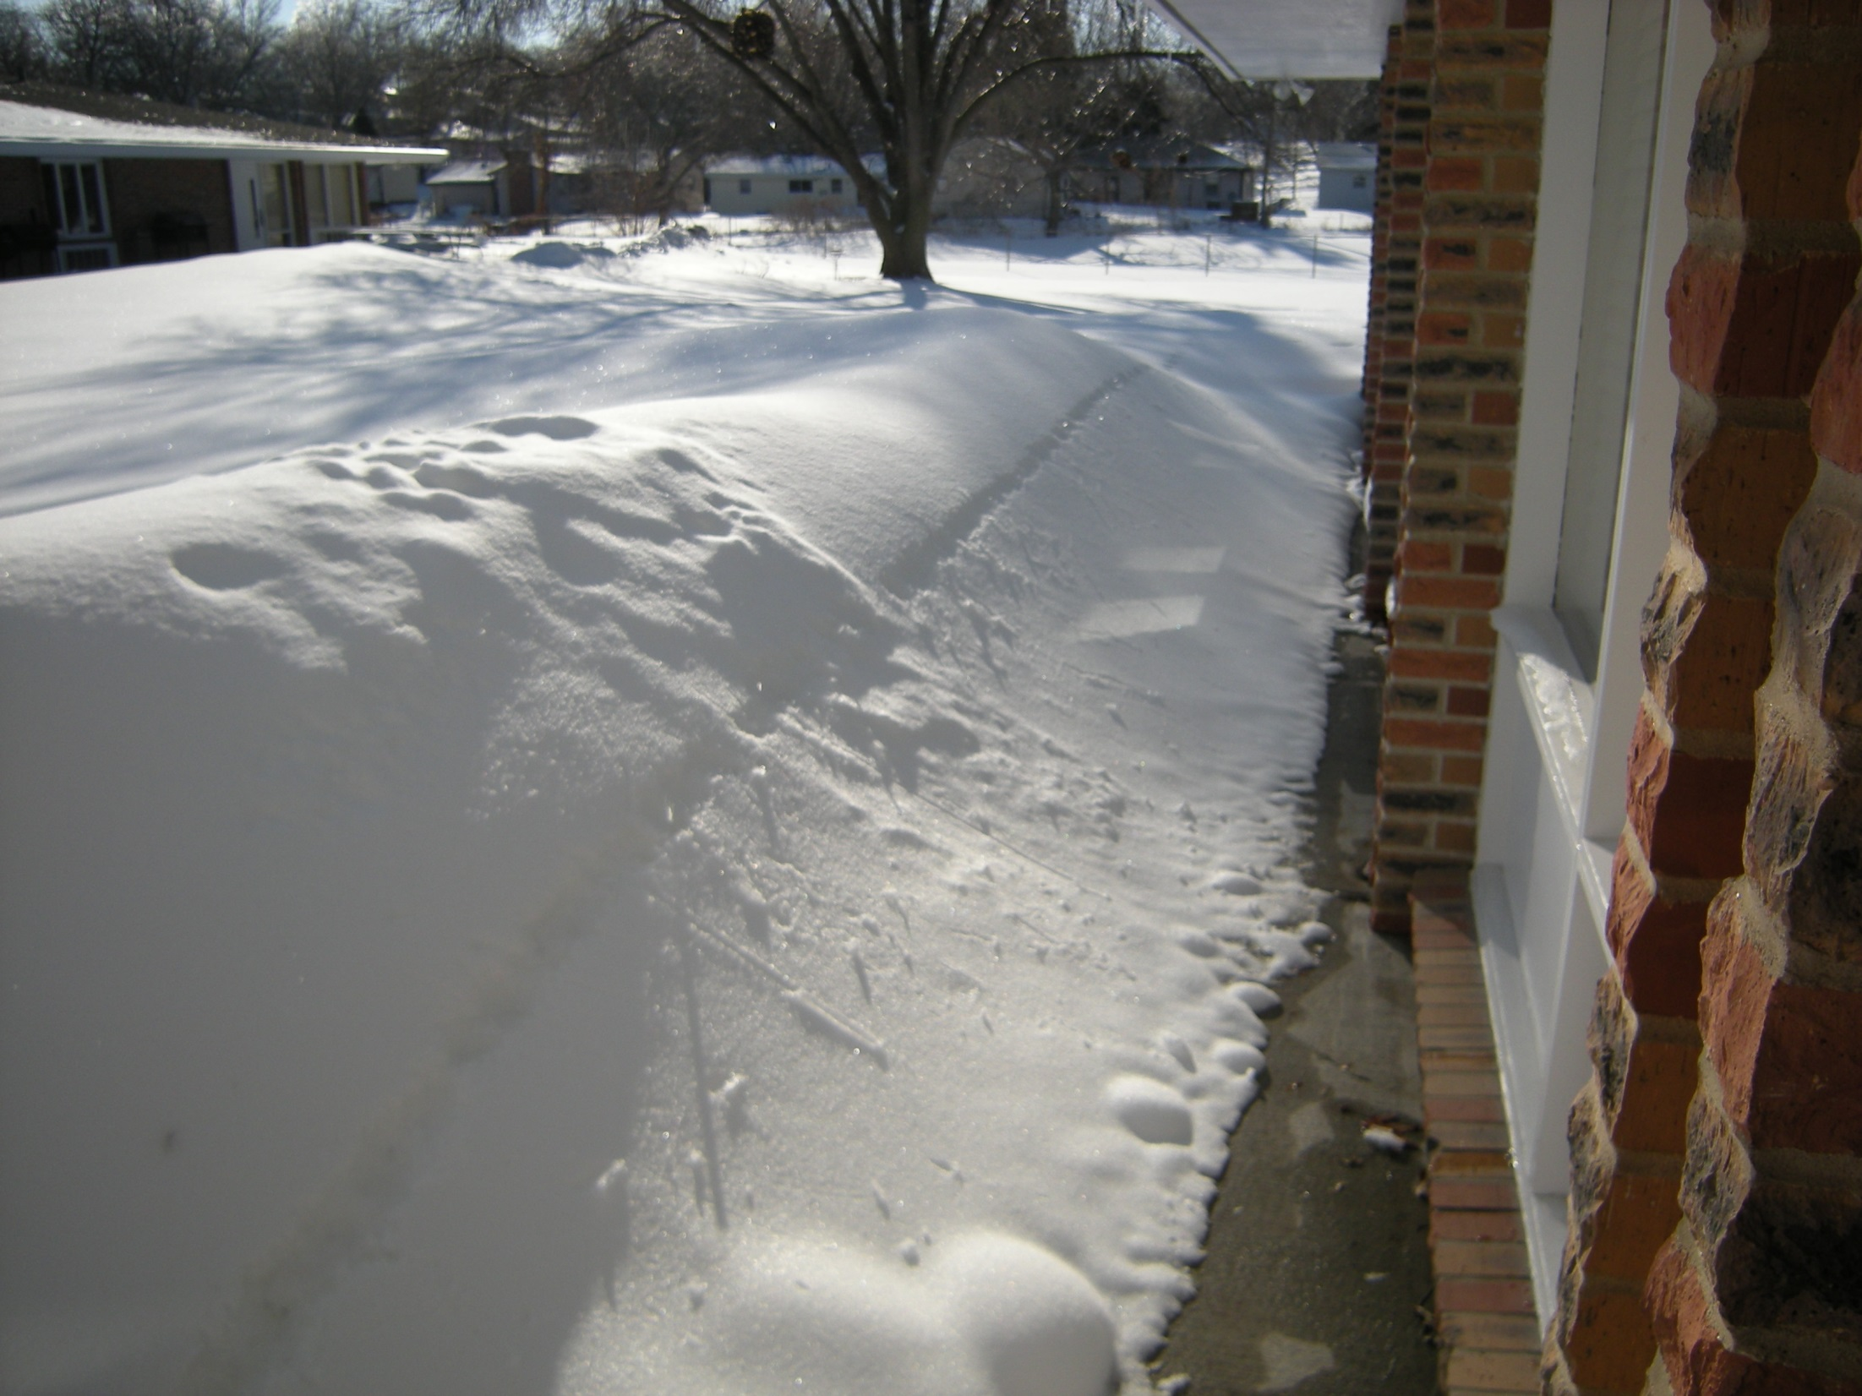

Slide 31
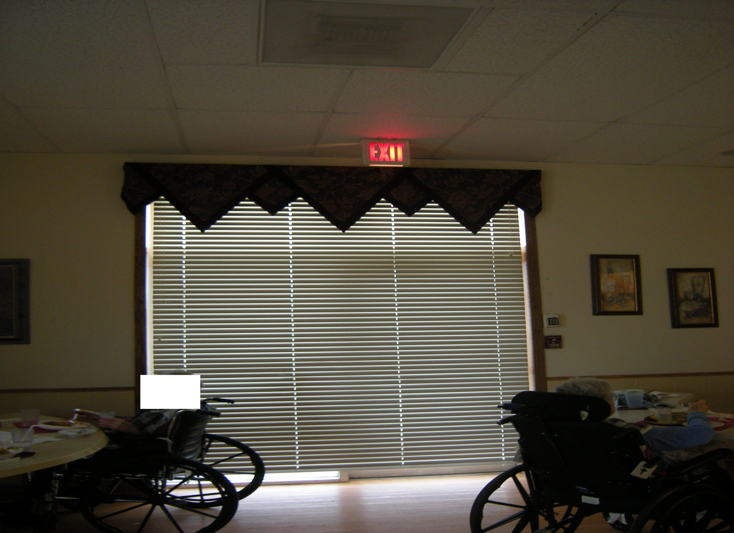

Slide 32
K062 Sprinkler System Maintenance
AND TESTING
Required automatic sprinkler systems are continuously maintained in reliable operating condition and are inspected and tested periodically. 19.7.6, 4.6.12, NFPA 13, NFPA 25, 9.7.5
Deficient Practices that require tag cited:
Automatic sprinkler system inspection documentation not on site for review.
Quarterly sprinkler inspection testing not performed.
Storage within 18 inches of sprinkler head deflectors.
Escutcheons missing from sprinkler heads, missing extra sprinkler replacement heads, missing sprinkler head wrench.
Dirty, painted, or corroded sprinkler heads.
Five year sprinkler obstruction testing not done.

Slide 33
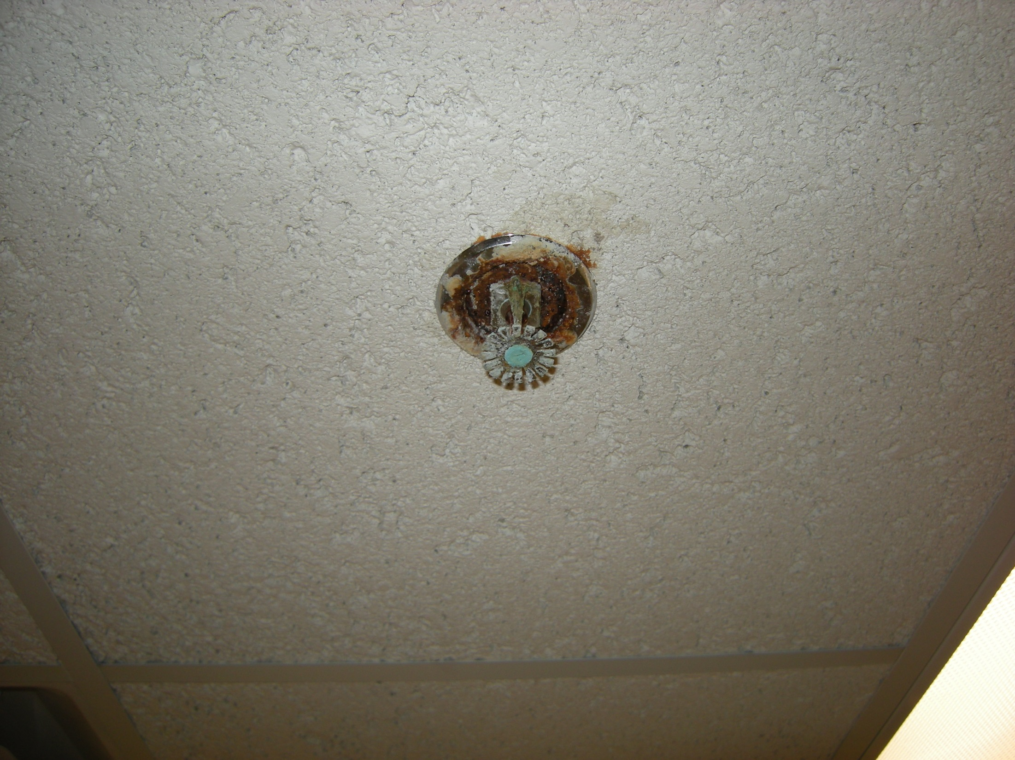

Slide 34
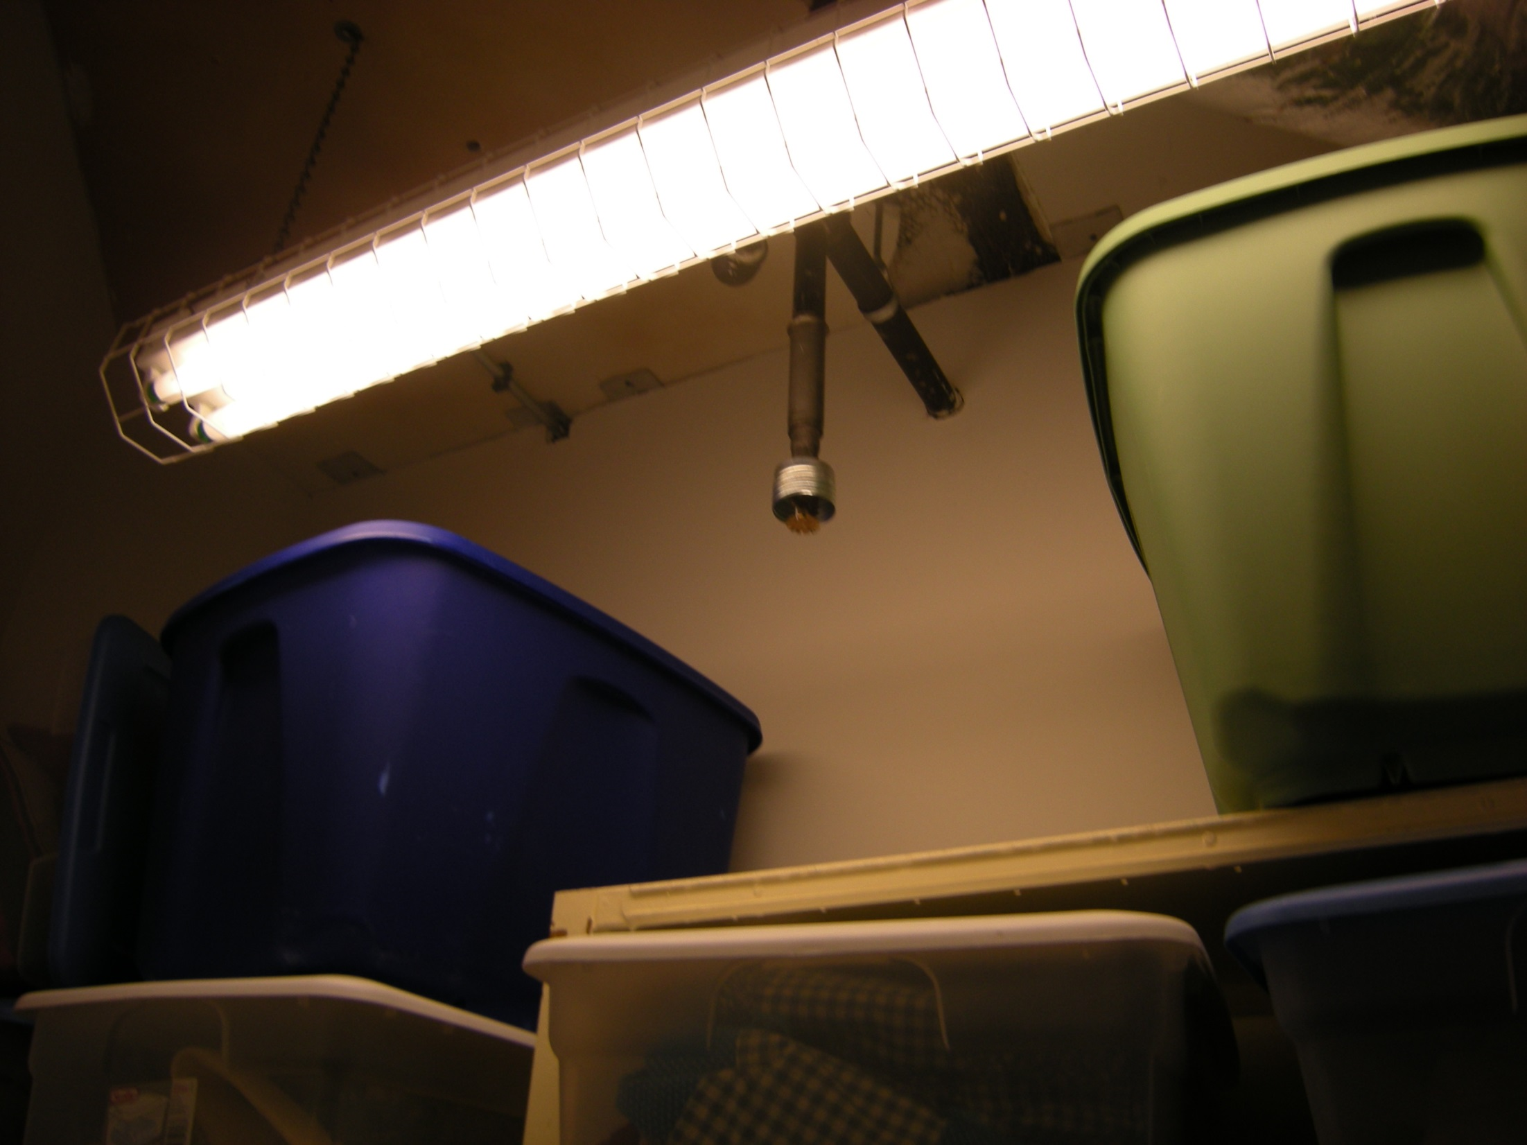

Slide 35
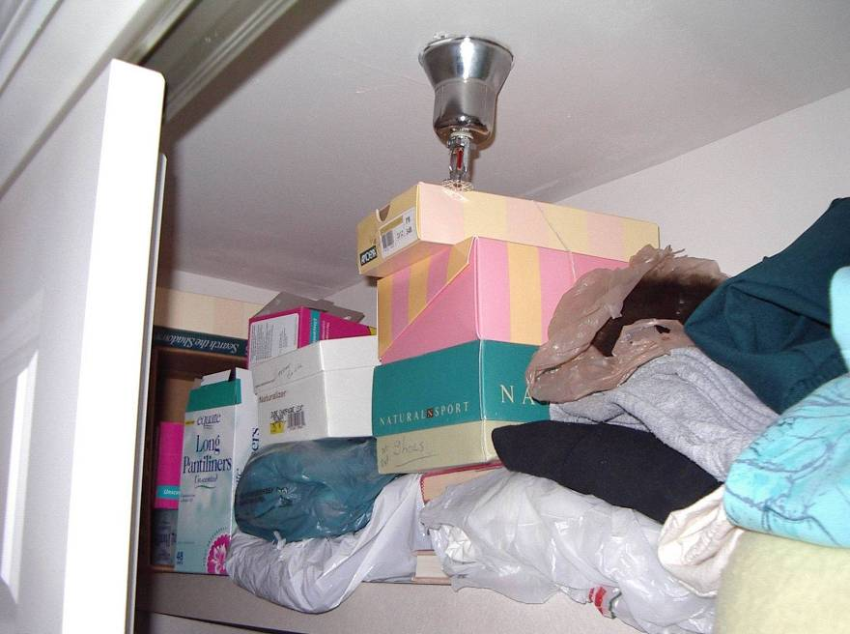
Must maintain 18” obstruction free around every sprinkler head

Slide 36
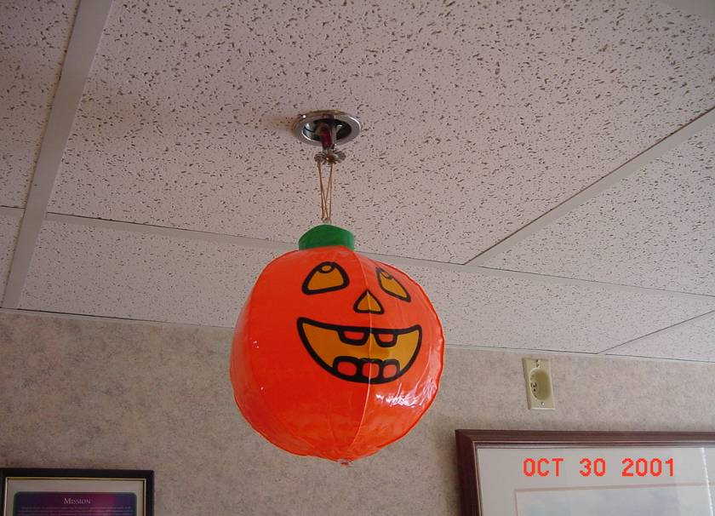

Slide 37
K052 Fire Alarm IMT
Smoke sensitivity testing
100% devices tested annually
Records available for review
Proper inspection form used – NFPA 72

Slide 38
K056 Automatic Sprinkler System
If there is an automatic sprinkler system, it is installed in accordance with NFPA 13, Standard for the Installation of Sprinkler Systems, to provide complete coverage for all portions of the building. The system is properly maintained in accordance with NFPA 25, Standard for the Inspection, Testing, and Maintenance of Water-Based Fire Protection Systems. It is fully supervised. There is a reliable, adequate water supply for the system. Required sprinkler systems are equipped with water flow and tamper switches, which are electrically connected to the building fire alarm system. 19.3.5
Deficient Practices that require tag cited:
Facility partially sprinkler protected or none and building construction requires sprinklers.
Combustible canopies/overhangs over four feet in width not sprinkler protected.
Walk-in coolers/freezers not sprinkler protected.
Closets not sprinkler protected.

Slide 39
K069 Cooking Facilities
Cooking facilities shall be protected in accordance with 9.2.3 NFPA 101 18/19.3.2.6 & NFPA 96
Deficient Practices that require tag cited:
All seams, joints, and penetrations of the hood enclosure that direct and capture grease-laden vapors shall have liquid tight continuous external weld. Internal hood joints, seams, filter support frames shall be sealed or otherwise made grease tight
Fire extinguishing system inspected every 6 months and documentation of the last year inspections on site and available for review
The entire exhaust system shall be inspected every 6 months for contamination from grease-laden vapors by a properly trained, qualified company or person(s). Documentation of the last year of inspections showing date of inspection or cleaning shall be maintained on the premises. After cleaning is completed, the vent cleaning contractor shall place or display within the kitchen area a label indicating the date cleaned and the name of the servicing company.

Slide 40
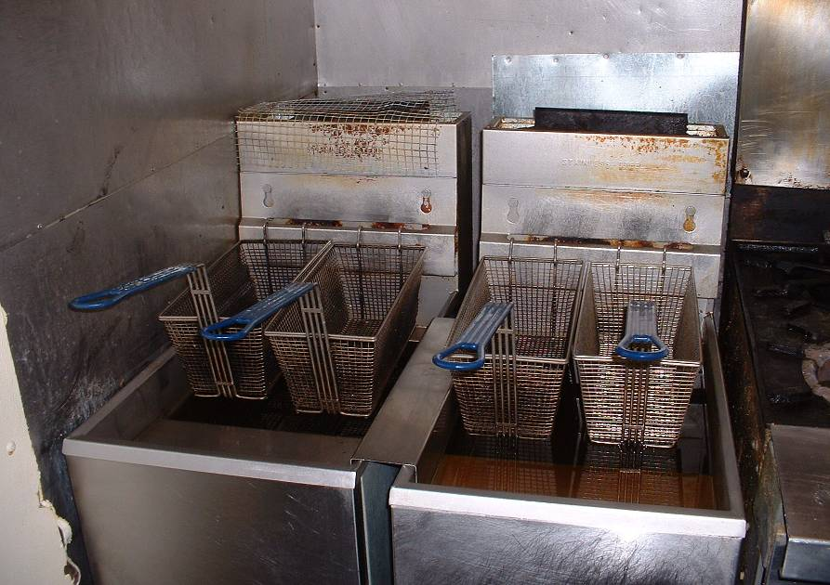
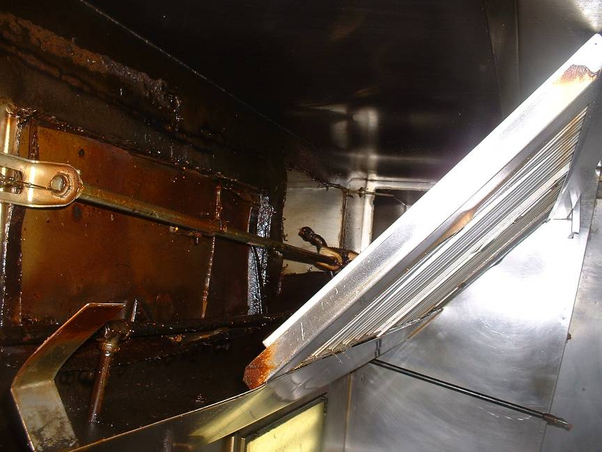
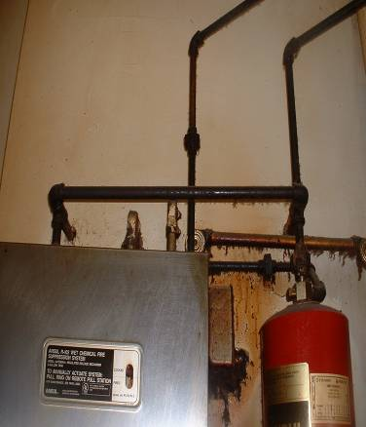

Slide 41
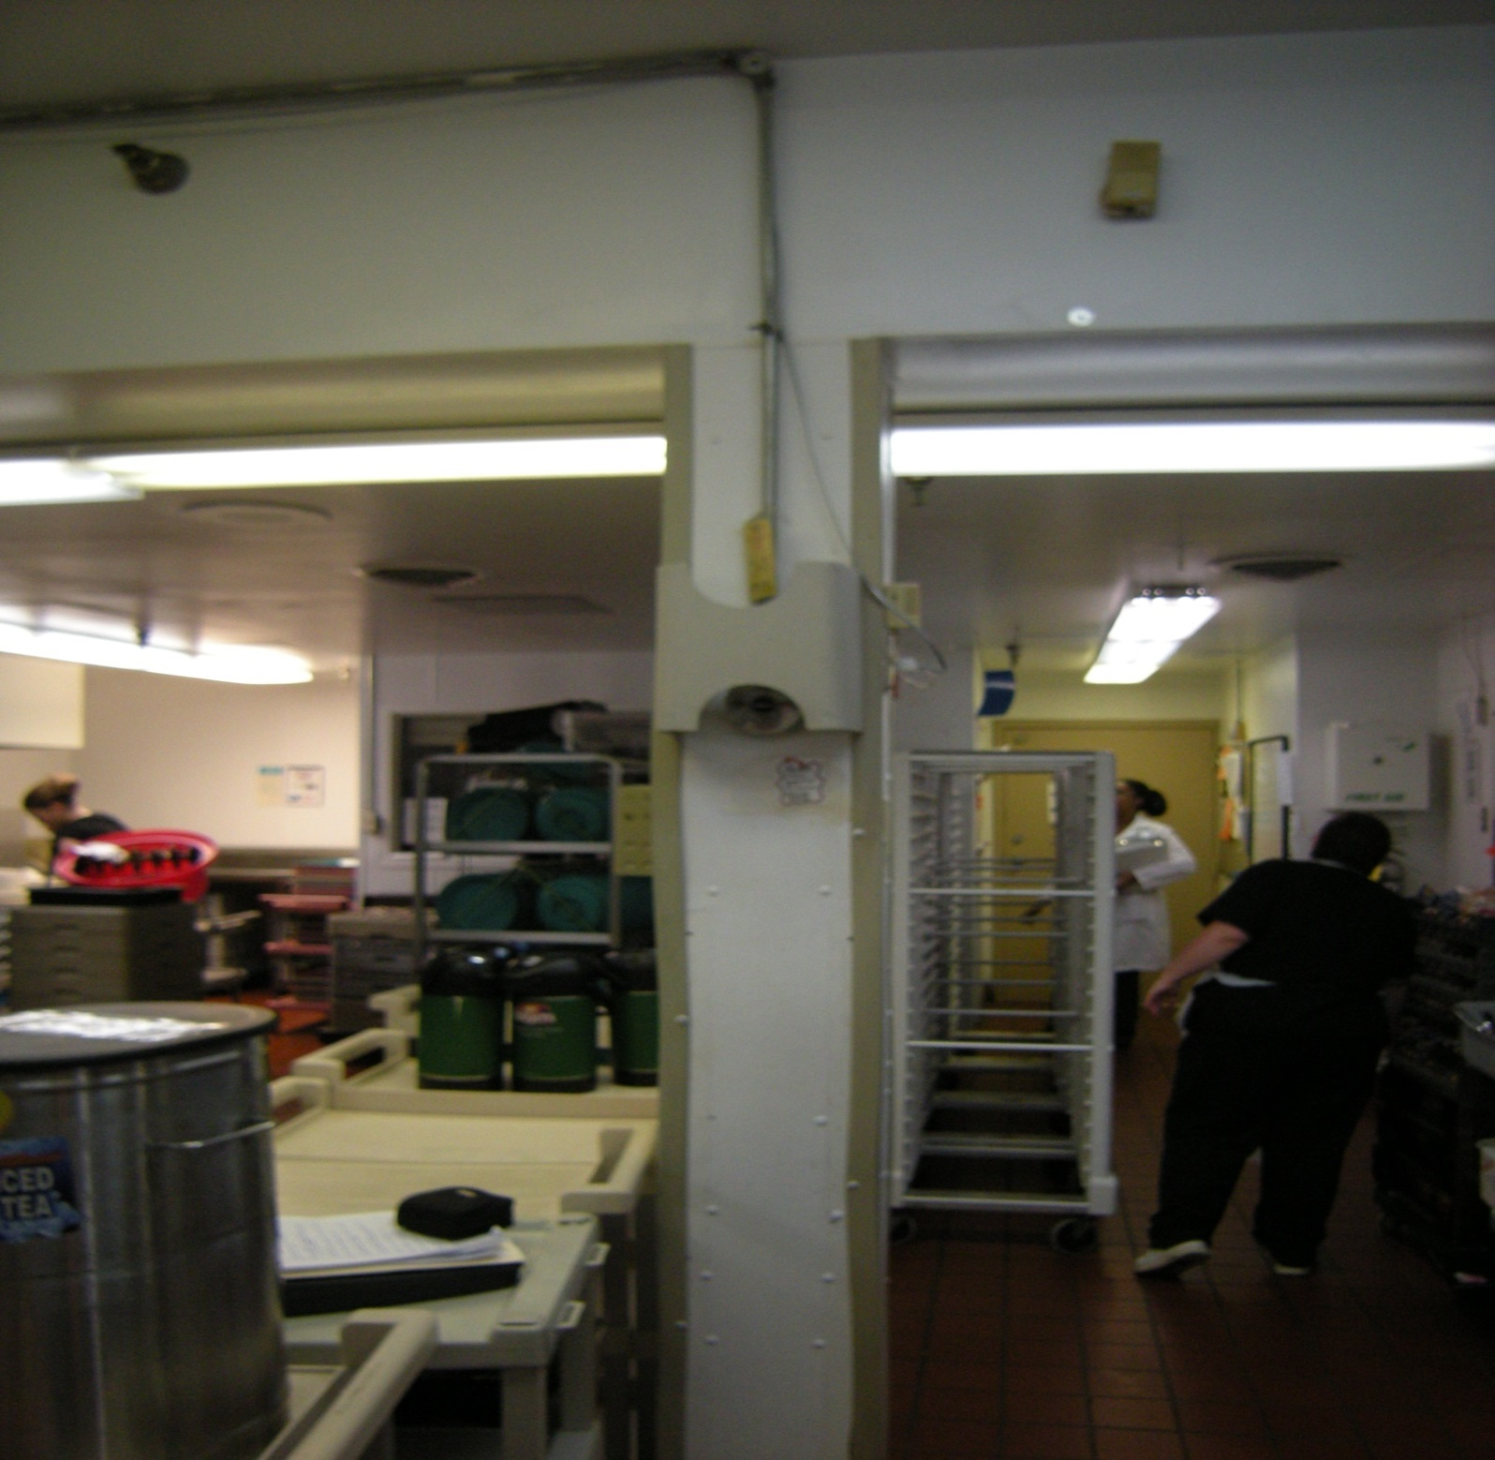

Slide 42
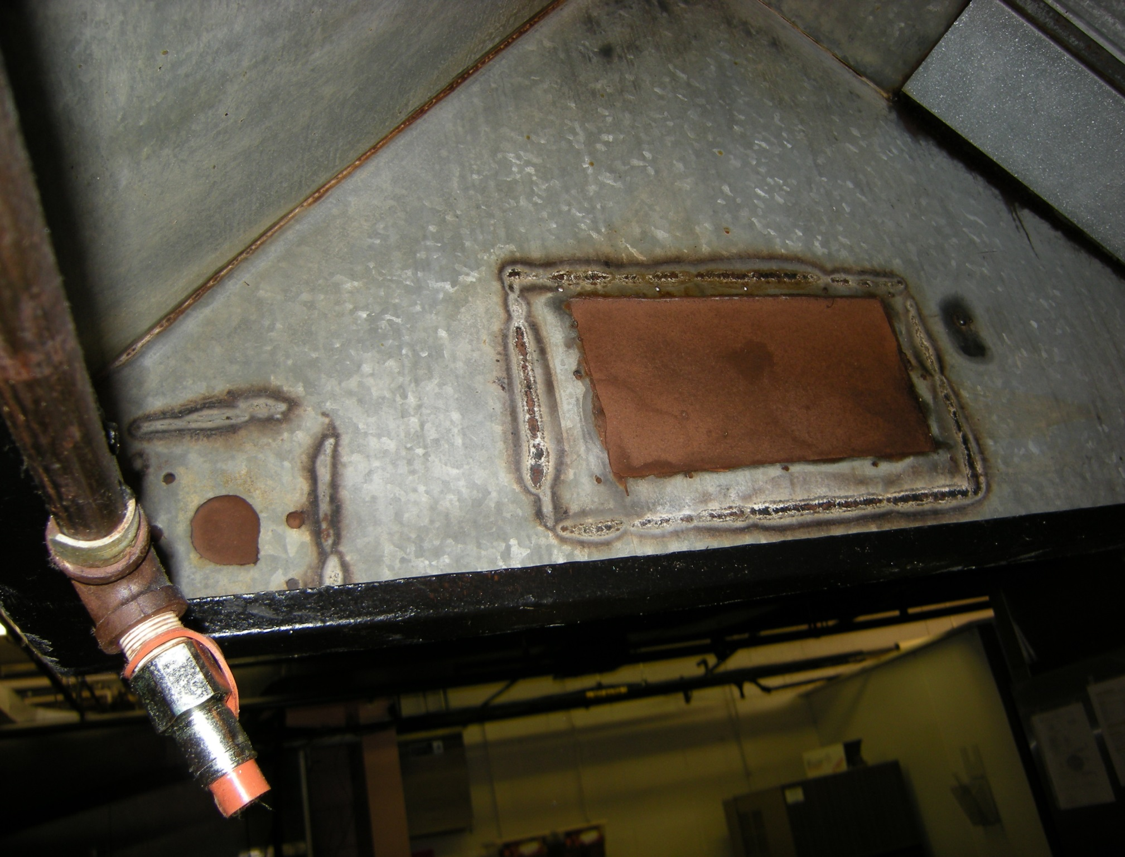

Slide 45
K011 Building Construction
If the building has a common wall with a nonconforming building, the common wall is a fire barrier having at least a two-hour fire resistance rating constructed of materials as required for the addition. Communicating openings occur only in corridors and are protected by approved self-closing fire doors. 19.1.1.4.1, 19.1.1.4.2
Deficient Practices that require tag cited
Building with two different construction types not separated with two-hour fire resistance construction.
Communication openings (doors & windows) not 90 minute fire rated construction or doors not equipped with self closing devices.

Slide 46
K144 Generator Testing/Maintenance
Applicable Standards
NFPA 110 – Standard for Emergency and Standby Power Systems 1999 Edition
  Requirements for testing of generator
NFPA 99 – Standard for Health Care Facilities 1999 Edition
  Requirements for testing of essential electrical system

Slide 47
Testing Requirement Overview
Weekly Visual Inspections (Preventative Maintenance)
Monthly Load Tests (Operational Testing)
Annual Load Bank Test
  If monthly load tests for diesel generators do not meet minimum criteria
Annual Maintenance
Documentation of all testing

Slide 48
Weekly Visual Inspections
NFPA 110, Figure A-6-3.1(a) contains ten components
  Fuel, Lubrication System, Cooling System, Exhaust System, Battery System, Electrical System, Prime Mover, Generator
  Each component has subcomponents
  At least one subcomponent of each component requires a weekly visual inspection
    Examples: Fuel level, oil level, cooling system hoses, battery electrolyte level, service room/housing housekeeping

Slide 49
Weekly Visual Inspections Cont’d
What is required to meet visual inspections requirements?
  Itemized documentation that shows weekly visual inspections have been performed
  List of weekly visual inspections should be compiled from manufacturer information and NFPA 99 and 110 requirements
  Battery inspections at least every 7 days, as specified by NFPA 110 Section 6-3.6 and NFPA 99 Section 3-4.4.1.3
    Starting batteries are the most common reason for emergency power sources failing to come on-line

Slide 50
Weekly Visual Inspections Cont’d
What does not meet requirements
  Weekly run test of generator
  Single line item stating visual inspections conducted
  Incomplete list of visual inspections

Slide 51
Monthly Load Tests Cont’d
NFPA 110 Section 6-4.1 – Level 1 and 2 Emergency Power Supply Systems (EPSSs) shall be exercised under load at least monthly
NFPA 110 Section 6-4.2 – Generator sets shall be exercised at least once monthly, for a minimum of 30 minutes, using one of the following methods
  (a) Under operating temperature conditions or at least 30% of nameplate rating
  (b) Loading that maintains the minimum exhaust gas temperatures as recommended by manufacturer

Slide 52
Monthly Load Tests Cont’d
NFPA 110 Section 6-4.3 – Load tests of generator sets shall include complete cold starts
NFPA 110 Section 6-4.5 – Level 1 and 2 transfer switches shall be operated monthly. The monthly test shall consist of electrically operating every transfer switch
NFPA 99 Section 3-4.4.1.1(b)2. – The test under load shall include cold start and appropriate automatic and manual transfer of all essential electrical loads
  This does not specify two separate load tests (one manual and one automatic transfer) must be conducted

Slide 53
Monthly Load Tests
NFPA 99 Section 3-4.4.1.1(b)1. – Generator sets shall be tested 12 times a year with test intervals between 20 and 40 days. Generator sets shall be tested in accordance with NFPA 110.
  The actual running time of the engine must be long enough to ensure engine parts have been lubricated… this must be balanced to ensure acids and carbon are purged by the operating temperature of the engine

Slide 54
Monthly Load Tests Cont’d
What is required to meet monthly load test requirements?
  Complete documentation (written or electronic) that clearly demonstrates one of the monthly load test requirements has been met
  Supporting documentation to prove the test values meet the minimum criteria

Slide 55
Understanding Load Tests
Nameplates list generator capacity in kilowatts (kW) and kilovolt-amps (kVA)
  True power is measured in watts
  Apparent power is measured in volts
  kW = Power Factor * kVA
  Power factor – Efficiency of the power distribution system
  Documentation that shows 30% of either kW or kVA is acceptable

Slide 56
Understanding Load Tests Cont’d
Single Phase Generator Calculation
  Power(kW) = Current(Amps) * Voltage(Volts)*Power Factor /1000
  Power(kVA) = Current * Voltage/1000

Slide 57
Examples – Single Phase
15kW generator with a typical power factor of .8
  (15kW/.8) = 18.75kVA
  30% = 4.5kW (5.625kVA)
  Measurements made during load test reveal a voltage of 120V and 10A
  P(kW) = (10*120*.8)/1000
  P(kW) = .96kW
  Load test did not meet 30% of nameplate rating requirement

Slide 58
Examples – Single Phase
15kW generator with a typical power factor of .8
  (15kW/.8) = 18.75kVA
  30% = 4.5kW (5.625kVA)
  Measurements made during load test reveal a voltage of 120V and 50A
  P(kW) = (50*120*.8)/1000
  P(kW) = 4.8kW
  Load test meets 30% of nameplate rating requirement

Slide 59
Annual Maintenance
1999 NFPA 110 6-3.1 Follow manufacturer’s instructions or suggested schedule A-6.3.1

Slide 60
K130 Miscellaneous
Remote generator stop
Remote generator annunciator
Other State Regulations

Slide 61
K154/K155 fire plan or watch:
  must have policy in place outlining what is to occur when fire alarm and/or sprinkler system is out of service
  great idea: cross reference to water outage policy

Slide 62



?

Slide 63
Contact Information
State Fire Marshal Office
246 South 14th Street
Lincoln, NE. 68508
Phone #: 402 471 2027
Email: don.fritz@nebraska.gov
Health & Human Services
Po Box 95026
Lincoln, NE. 68509
Phone #: 402 471 3121

