Slide 1

Med Gas Survey:
Top Items Found
Presented By:
Larry Schutt, ASSE 6020,6030,6035,6040
Medical Gas Technical Services

Slide 2
What is a Medical Gas Survey
Standard EC.02.05.09
In time frames defined by the hospital, the hospital inspects, tests, and maintains critical components of piped medical gas systems. Including, master signal panels, area alarms, automatic pressure switches, shutoff valves, flexible connectors, and outlets. These activities are documented.
The hospital test piped medical gas and vacuum systems for purity, correct gas, and proper pressure when these systems are installed, modified, or repaired. The completion date of the tests is documented.
The hospital makes all main supply valves and area shutoff valves for piped medical gas and vacuum systems accessible and clearly identifies what the valves control

Slide 3
Series 6000 • Annex D
Maintenance Procedures for Personnel
Qualified under ASSE Standard 6040
This Annex is provided for informational purposes only, and is not a mandatory part of ASSE Standard 6040. It reflects typical maintenance procedures for medical gas systems and equipment.

Slide 4
D.3 Minimum Maintenance Schedule
D.3.1 Daily
Bulk liquid systems - check tank contents, reorder as needed. Visually inspect for any leakage or unusual icing.
Bulk supply cylinder system with reserve – check proper pressure of reserve bank.
Bulk systems - check to assure that proper pressure is maintained.
Manifold systems - Check to assure that proper pressure is maintained.
Mainline pressure gauges - check pipeline pressure for acceptable limits. Variations of more than 5% should be investigated and corrected.
Moisture removal system - check for proper operation (e.g. aftercooler, dryer drains, receiver drains, sight gauges, etc.).
Dew point and CO monitor - check for proper operation.

Slide 5
D.3 Minimum Maintenance Schedule
D.3.2 Monthly
Area alarm - activate all audible and visual signals using test buttons.
Test master alarm functions for audible and visual signal.
Vacuum area alarm panel with test buttons -activate audible and visual alarm signals.
Area alarm panel gauges/pressure readouts - check line pressures.
System main line low and high pressure alarms- test audible and visual signals at the master alarm panel(s).
Manifold reserve in use alarm - test audible and visual signals.
Reserve supply low warning signals - test audible and visual signals.
Dew point and CO alarm - test audible and visual signals.
i. Vacuum main line low vacuum alarm – test audible and visual signals at the master alarm panel(s).
Medical air compressors and vacuum pumps - check for proper operation and preventive maintenance per manufacturers specifications.
Pressure check across filters.

Slide 6
D.3 Minimum Maintenance Schedule
D.3.3 Quarterly
Intake for medical air compressors - check intake location and filter for trash and debris
Source evaluation on medical air and vacuum systems
  Function of automatic alternating controls.
  Correct pressure/vacuum switch.
  Frequency of pump starts and duration of runs.
  Cut in/out pressure/vacuum.
Proper water flow to water-cooled aftercoolers (where present).
Check hour meters for required maintenance schedule for pumps and compressors. Service in accordance with manufacturer’s instructions.

Slide 7
D.3 Minimum Maintenance Schedule
D.3.4 Semi-Annually
Manifold system - leak check (valves, pigtails, and regulators). Visually check cylinder pigtails for physical damage.

Slide 8
D.3 Minimum Maintenance Schedule
D.3.5 Annually
Check all outlets in critical care areas – flow, pressure/vacuum, damage and wear (e.g., ICU, CCU, NICU, Surgery, Recovery, ER).
Bulk liquid systems- test the operation of the reserve and activation of reserve-in-use signal.
Bulk system supply - check proper level activating switch.
Manifold reserve-in-use alarm - test proper function of switch.
Manifold - test operation of the changeover for the secondary supply.
Pressure gauges - assure gauges are mechanically functional.
Air compressor - performance testing.
Dew point and CO monitor - calibrate and test operation.
Maintenance and periodic testing of the bulk system in conjunction with the bulk gas supplier.

Slide 9
D.3 Minimum Maintenance Schedule
D.3.6 Periodically
Shut-off valves - External leakage test.
Station outlets and inlets - check for leakage and flow.
Calibration of pressure gauges

Slide 10
D.5 Test Procedures

Slide 11
Labeling
Area Of Surveillance
Area Alarm
Zone Valve
Service valves
Source Valves
All Valves in between
Piping

Slide 12
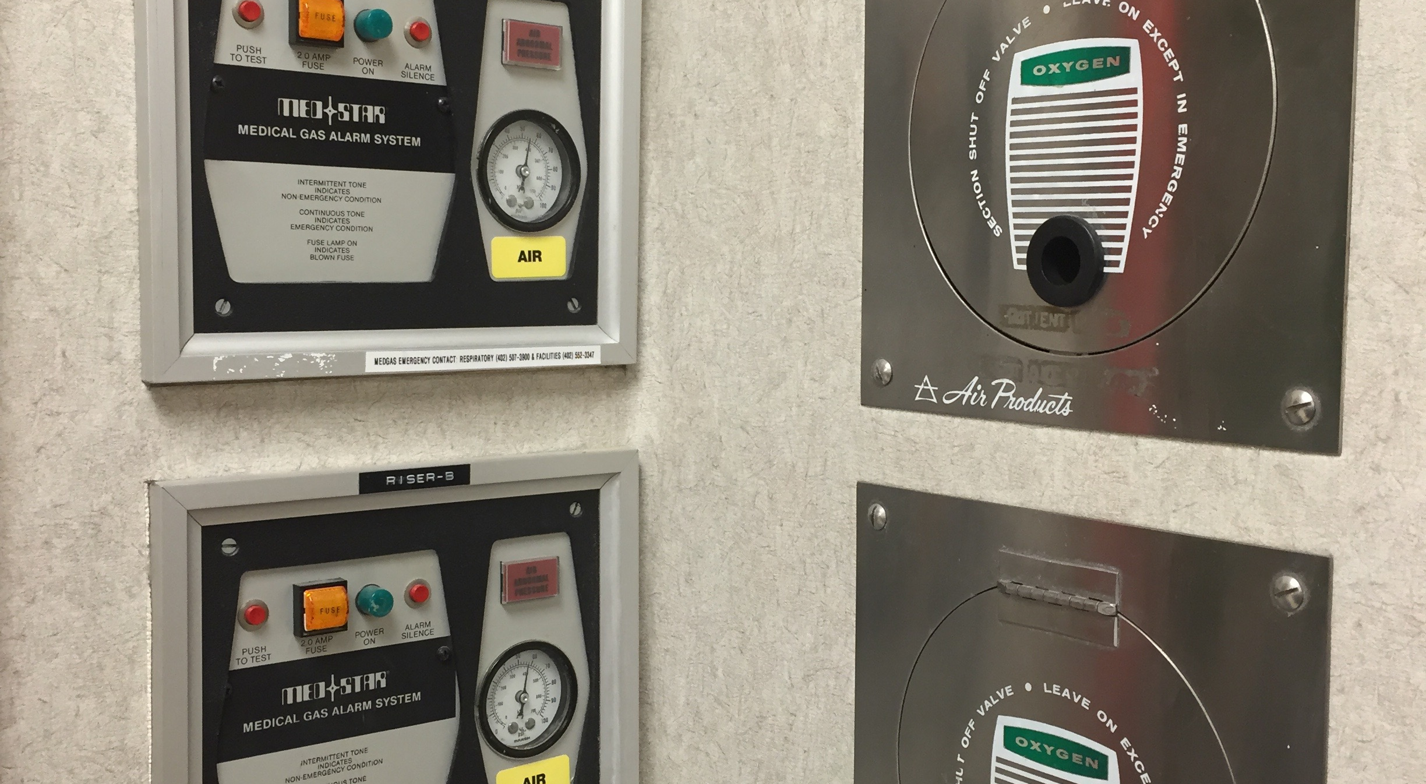
Alarms labeled for Air, but they monitor O2

Slide 13
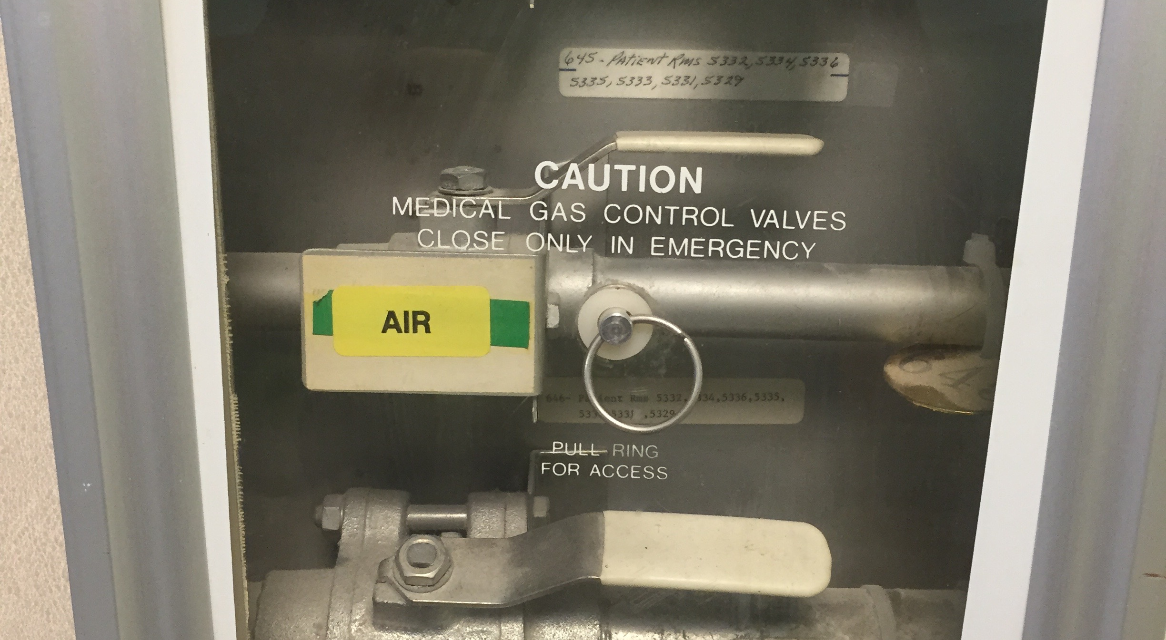
Air label over O2 label, it was O2 not Med Air

Slide 14
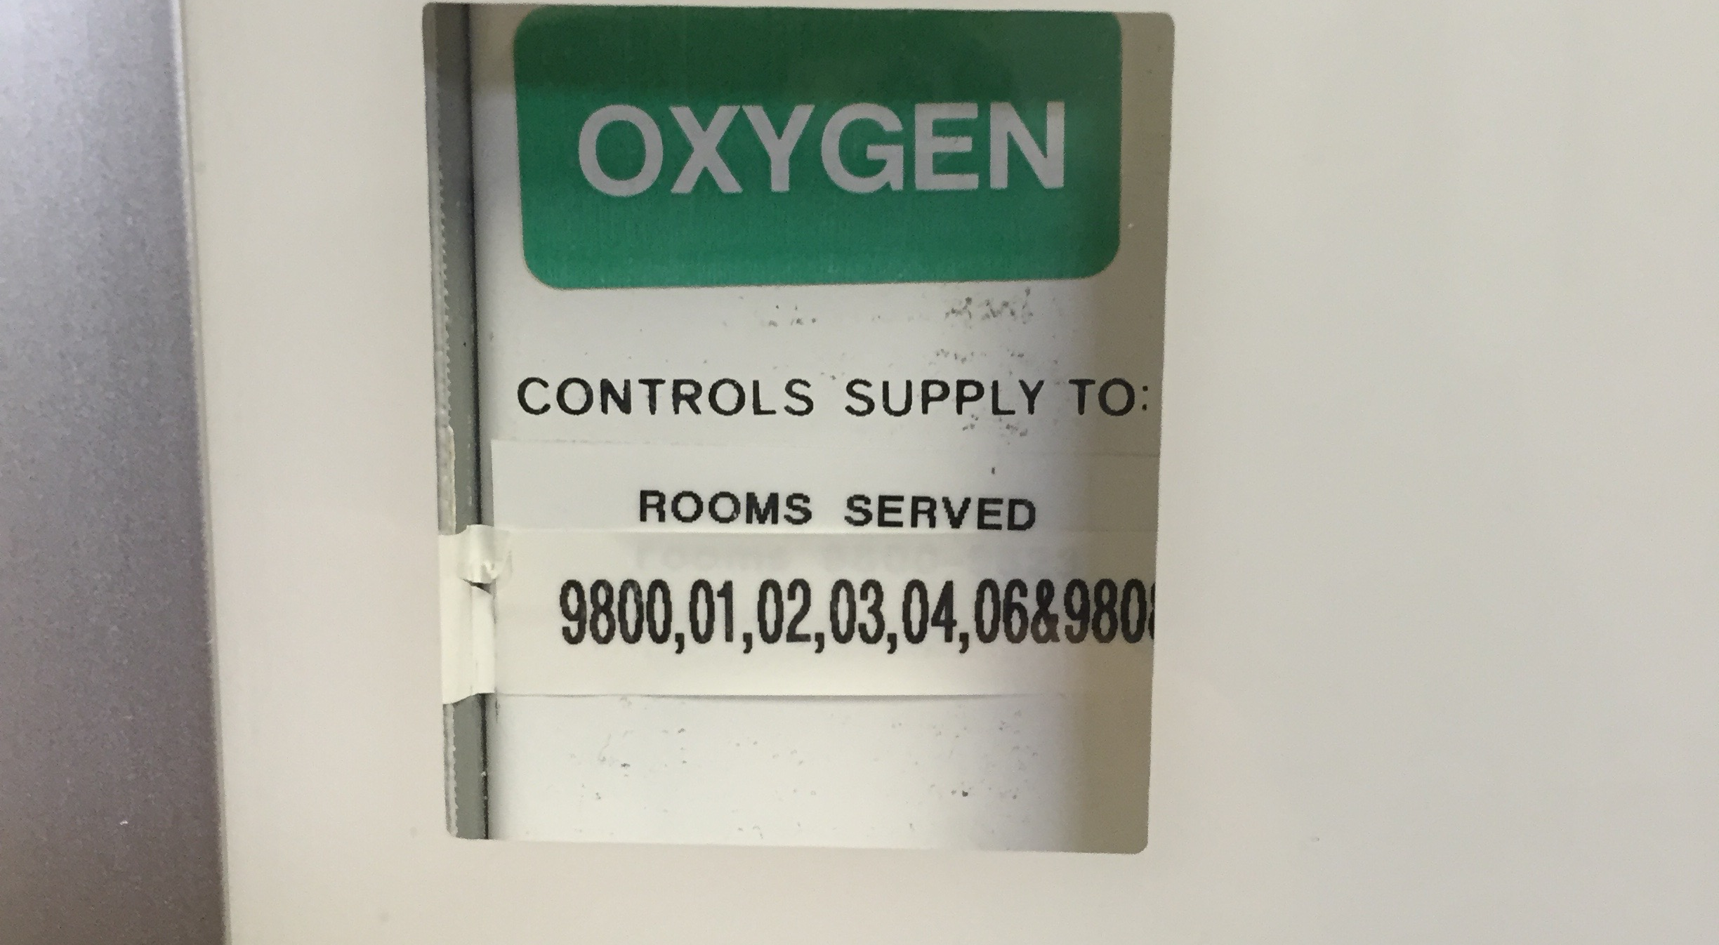
Abbreviations for room number lead to missed rooms

Slide 15
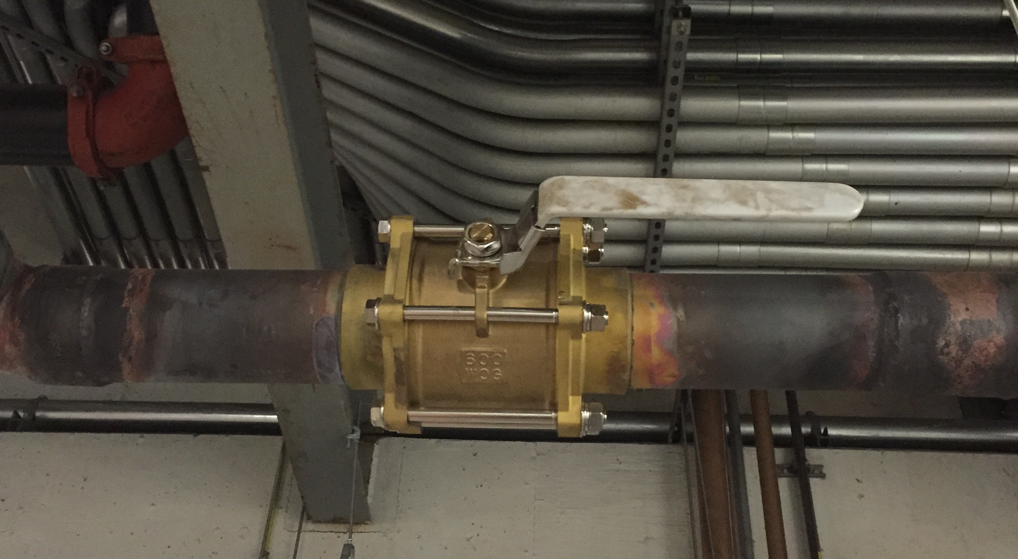
Source valve with no gas specific label

Slide 16
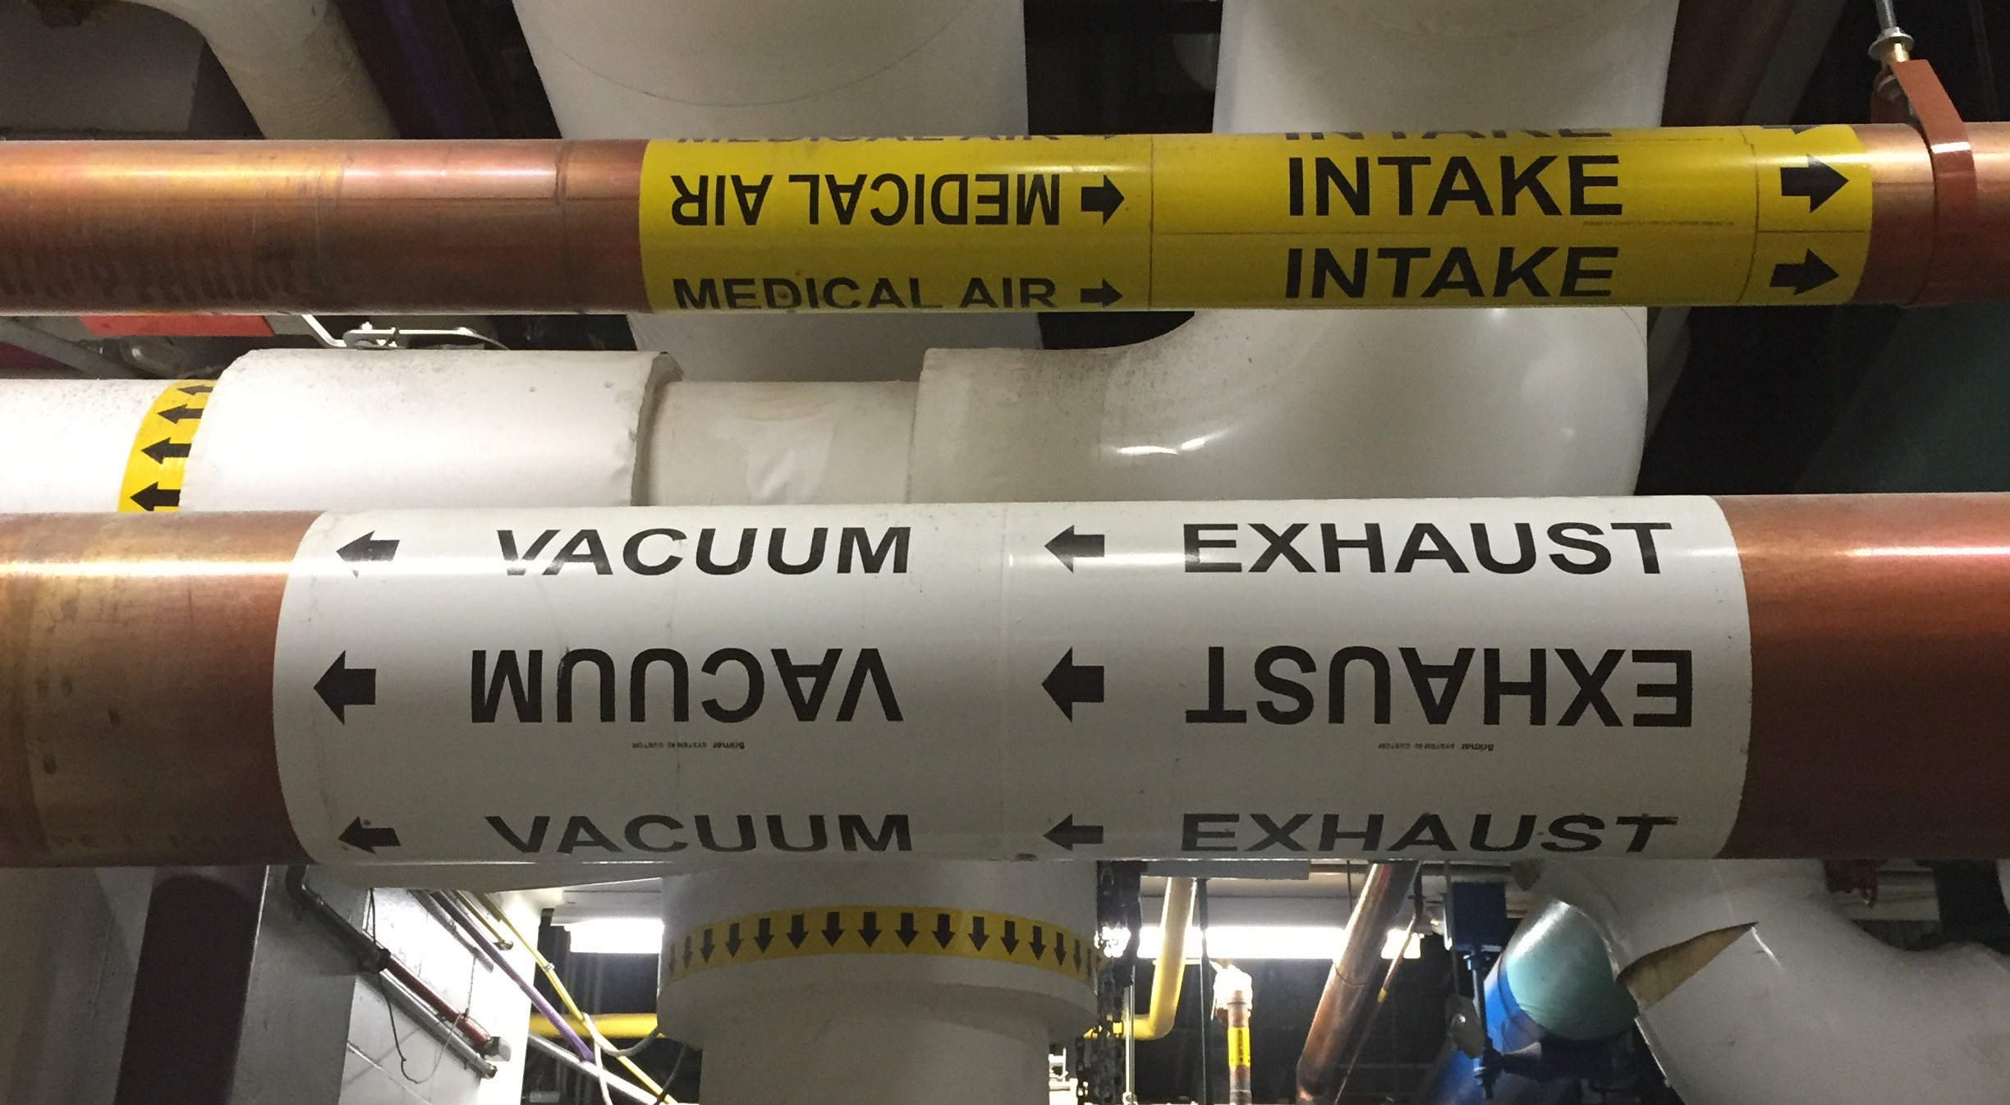
Proper pipe labeling

Slide 17
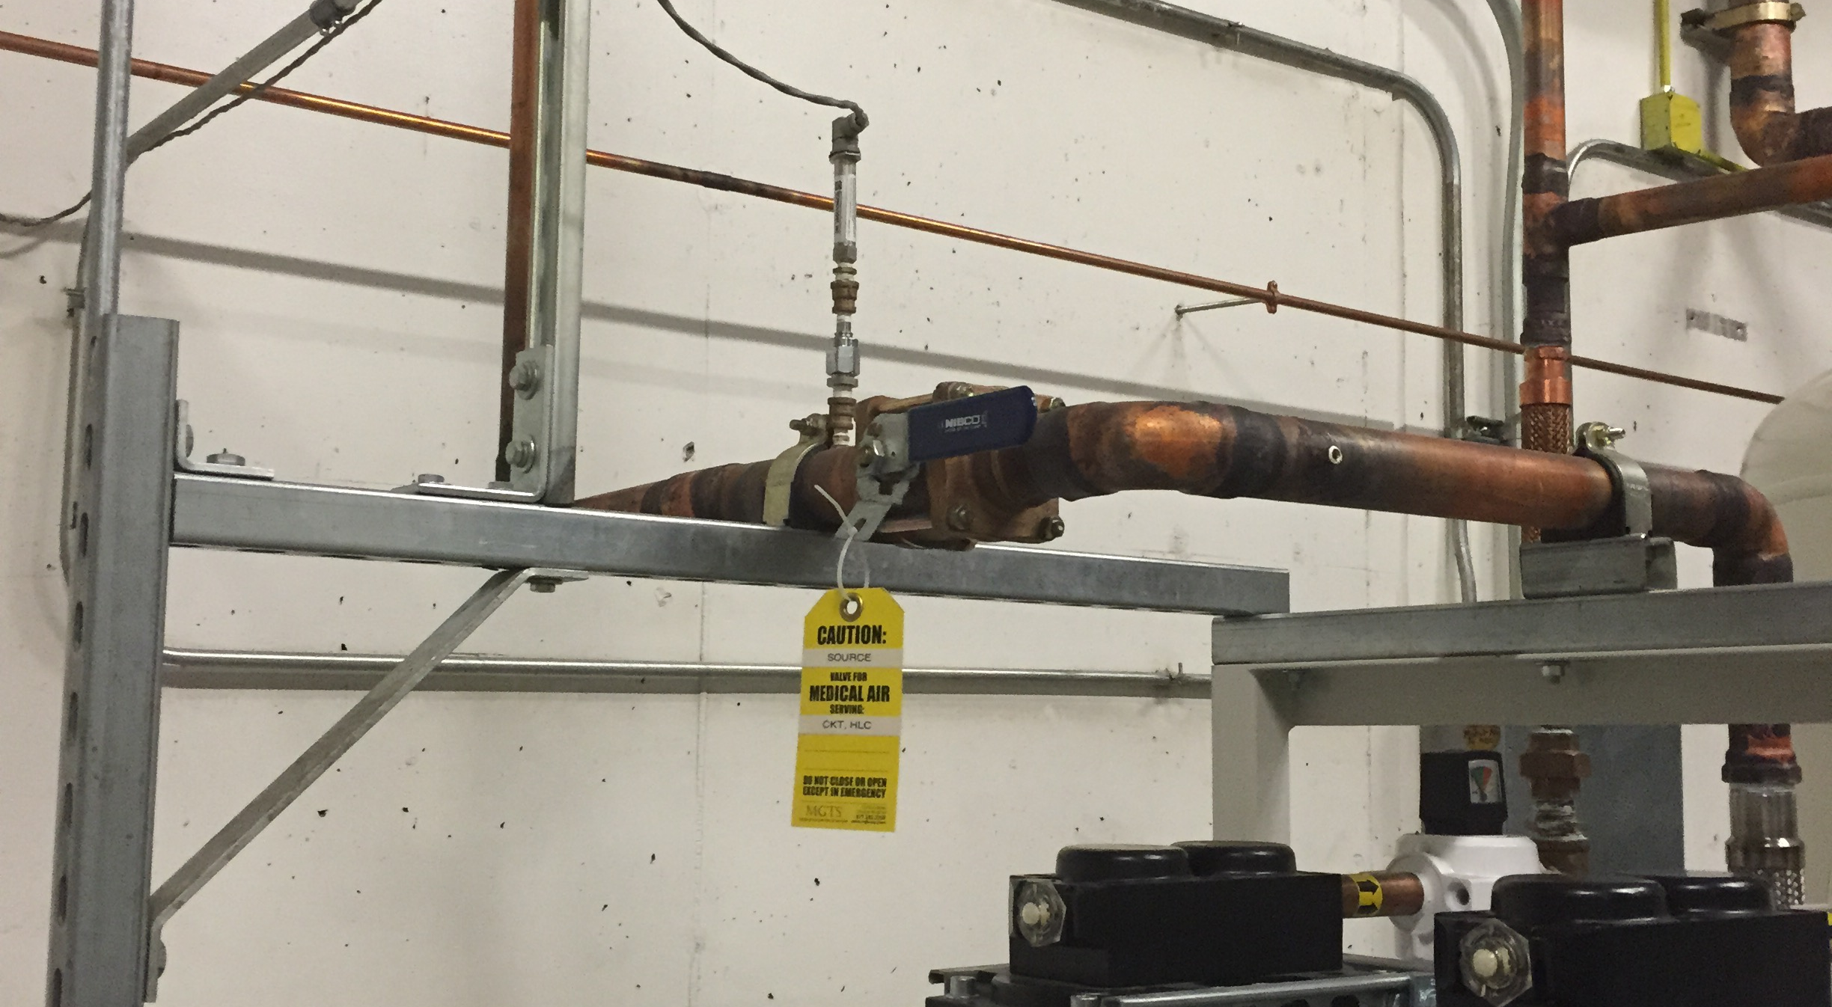
Proper source valve label

Slide 18
Questions?

Slide 19
Contact Information
If you have additional questions or concerns:
Larry Schutt
larry@mgts-usa.com
Medical Gas Technical Services
8504 N 29th Street
Omaha, NE 68112
(877) 282-2709

