Slide 1
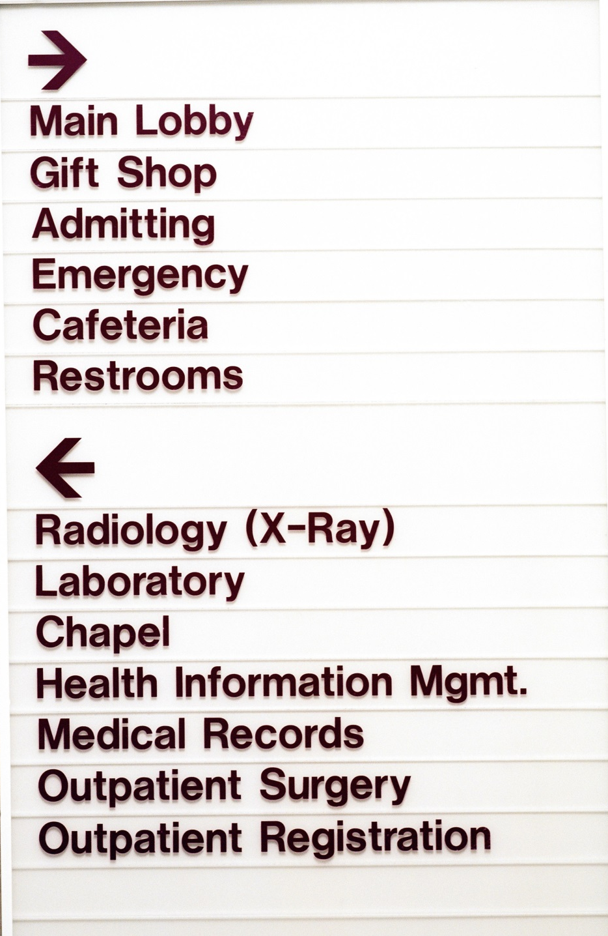
Hospital Department Renovation Unit Costs
Colby Vetter
Senior Estimator
JE Dunn Construction

Slide 2
Objectives:
Construction Cost Inclusions and Exclusions
Hospital Department Unit Cost Range
Factors For Variance in Unit Costs

Slide 3
Unit Cost Range
Size of Project – “Economy of Scale”
Phased
Relocations
Extended General Conditions – 4%-12% of Cost
Cost Escalations
5%-7% Per Year, Currently – Applied Quarterly
Project Location – Urban vs Rural
Proximity to Contractor Pool
Additional Parameters
Off Hours Requirements
Neighboring Departments
Elevated vs SOG

Slide 4
Unit Cost Range
Construction Contingencies
Normally Not Included in Hard Bid Contract
Applied to Competitive GMP Based off Early Docs
Percentage Dependent on Design
Level of Detail
Detail Increases, Contingency Decreases
10%-12% At Early Stages, 2%-3% at full design
Not Uncommon for Owner to Carry Separate Contingency for Unknowns or Scope

Slide 5
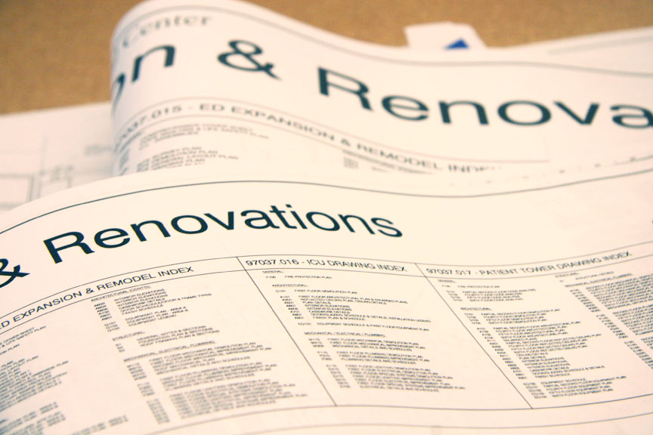
Unit Cost Range
Typically Included in Construction Costs:
General Conditions
Temporary Measures
Permits
Necessary Bonds
Insurance
Construction Costs
Infectious Control
Demolition
Contractor Contingency
Fees

Slide 6
Unit Cost Range
Levels of Renovation
Light
Finishes
Medium
Some reconfiguration
Heavy
Gut & Remodel

Slide 7
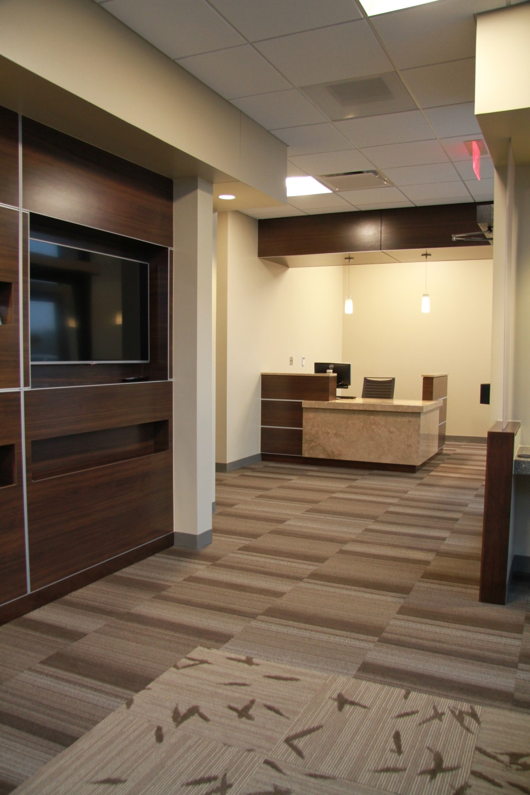
Unit Cost Range
Levels of Renovation
Light
Finishes
Medium
Some Reconfiguration
HEAVY
Gut & Remodel

Slide 8
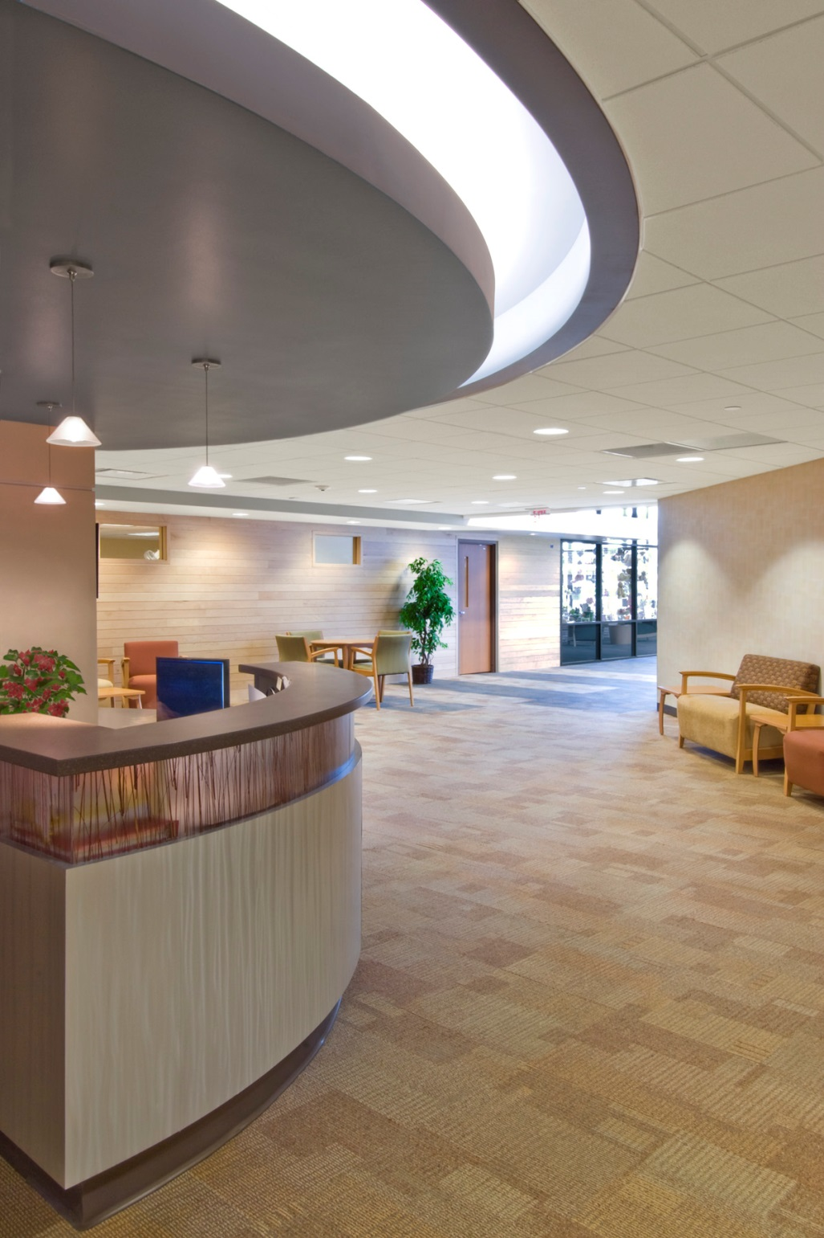
Departments
Entry & Main Lobby - $120 – $170 / SF
Higher Level of Finishes
Tile, Carpet, Walk-Off Mat
Architectural Features
Ceiling Soffits and Light Coves
Donor Wall
Centerpiece – Fireplace or Waterfall
Millwork – Nourishment Station, Kiosks, Etc…
Reception Desks, Check-In Station
Relatively Open Space
Low Voltage – V&D, Speaker System
Entry – Aluminum Entrance or Revolving Doors
Gift Shop
Interior Glazed Wall – Wood or Aluminum
Millwork

Slide 9
Departments
Administration & Offices - $100 - $135 / SF
High Density of Walls / Doorways
Level of Finish
Carpet & Paint
Lower Level of Millwork & Casework
Conference Spaces – Can Have Higher Level of Finish
Millwork
Projection Screens
Video Conference Capabilities
Power & Voice & Data
Controlled Access - $2k - $3k / Door

Slide 10
Departments
Waiting Room Spaces - $95 - $125 / SF
Level of Finishes
Similar to Lobby
Support Spaces – Nourishment, Quiet Rooms
Millwork & Casework
Controlled Access
Sound System & Public Address

Slide 11
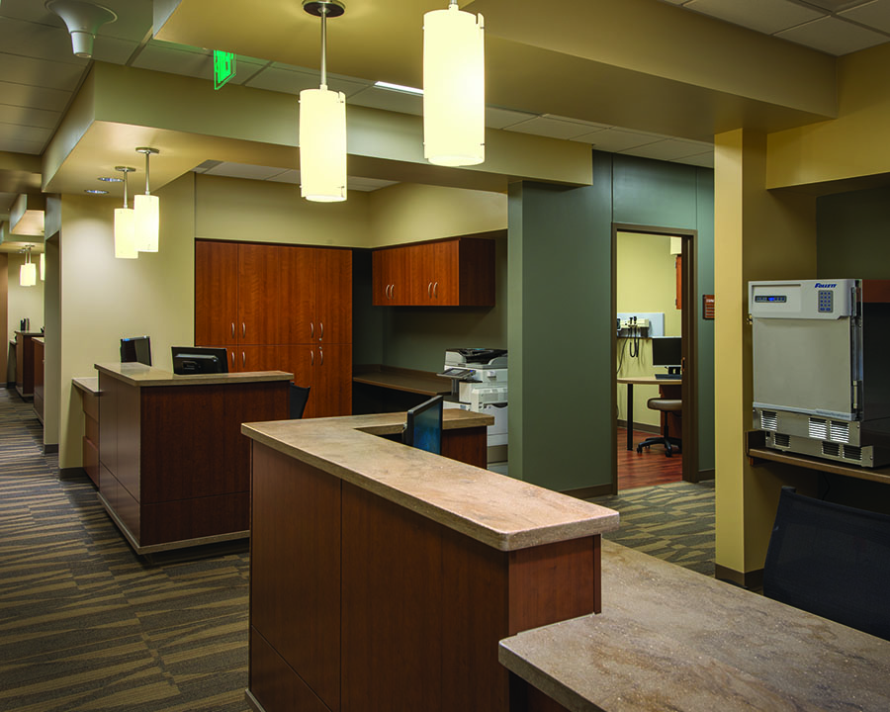
Departments
Exam & Clinic Spaces - $145- $180 / SF
Density of Partitions – Sound Control
Level of Finish
Sheet Vinyl vs Carpet & VCT
Level of Casework – Typ. Rooms, Nurse Stations
Extent of Blocking & Backing
Specialties – Wall Protection, Curtain Track, B.A.
Toilet Count – Dependent on Clinic Type
V&D & Equipment Power Requirements
Special Systems – Nurse Call, Access Control
Configuration

Slide 12
Exam Room Double Door Configuration

Slide 13
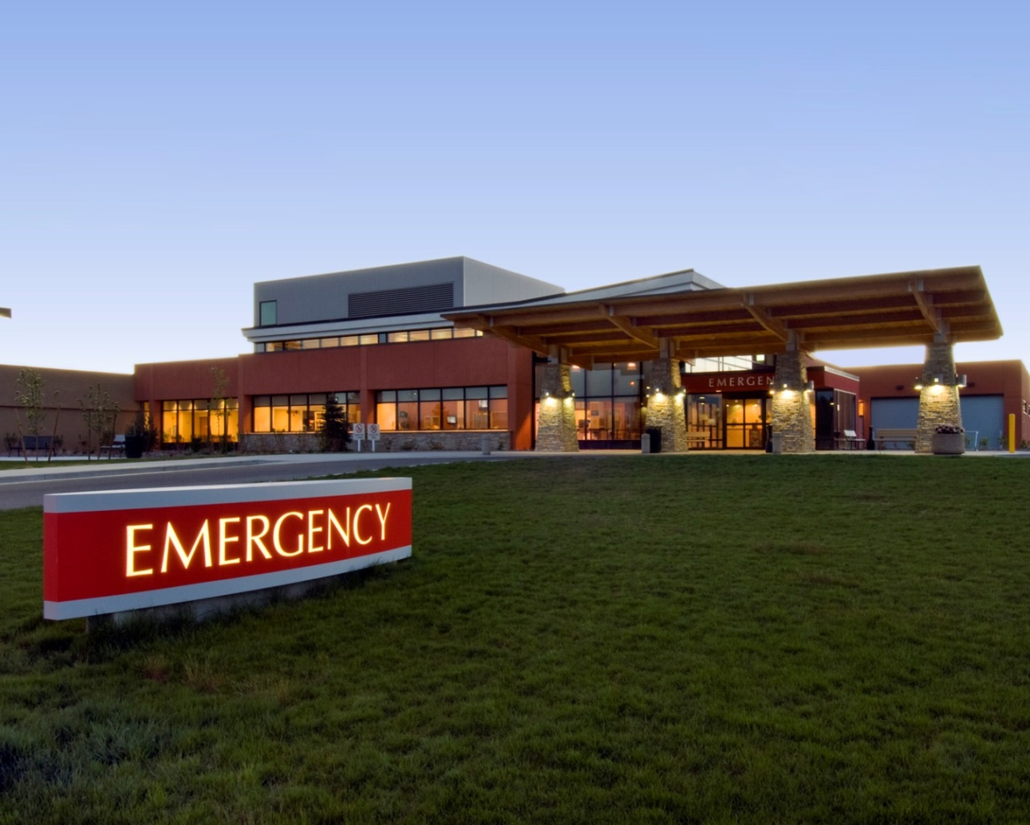
Departments
Emergency Department - $255- $315 / SF
Specialty Doors
Sliding Entry
Telescoping ED - $4,500-$5,000/ Set
Auto Operators - $2,500-$3,000/Set
Cleanable Surfaces
Hardened Ceiling – GWB vs ATC
Epoxy Paint, Sheet Vinyl/Epoxy Floors
Specialties – Wall Protection/B.A./CCT/Rails
Decontamination – Shower & Collector
Ceiling-Mounted Equipment – Bracing
Headwalls & Med Gas
Phased Construction - Must Remain Operational
Temporary Entry/Locations
Emergency Power

Slide 14
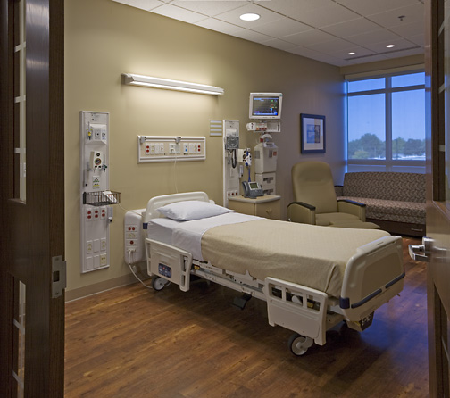
Departments
Patient Rooms - $210 - $268 / SF
Level of Finish – Med-Surg to ICU rooms
Sheet Vinyl Flooring at Rooms
Core Areas
Millwork
Headwalls & Footwalls
Storage Cabinets
Countertops & Workspaces
Solid Surface Material (SSM) Tops
Nurse Stations & Support Area Casework
Specialties – B.A., Wall Protection, Rails, Patient Lifts (Support)
Pneumatic Tube Stations
Restrooms
Double Bed to Single Bed Rooms
ICU May or May Not Include a Restroom
Underfloor Piping
Medical Gas Outlets
Special Systems & Emergency Power
Infant Alarm Systems at Neonatal Floors.
Controlled Access, Nurse Call, V&D

Slide 15
Departments
Behavioral Units - $230- $260 / SF
“Hardened” Space – Patient/Staff Protection
Reinforced Partitions-Plywood, Fiberglass
Shatterproof Barrier at Exterior Windows
Vandal-Proof Specialties
Hard Ceilings – Drywall
Monitoring Systems
Specialty Access Door Systems – Wicket Door System
Controlled Access
Temporary Facilities
Hardened Temporary Walls
Phased
Additional Construction Manpower – Security Watch

Slide 16
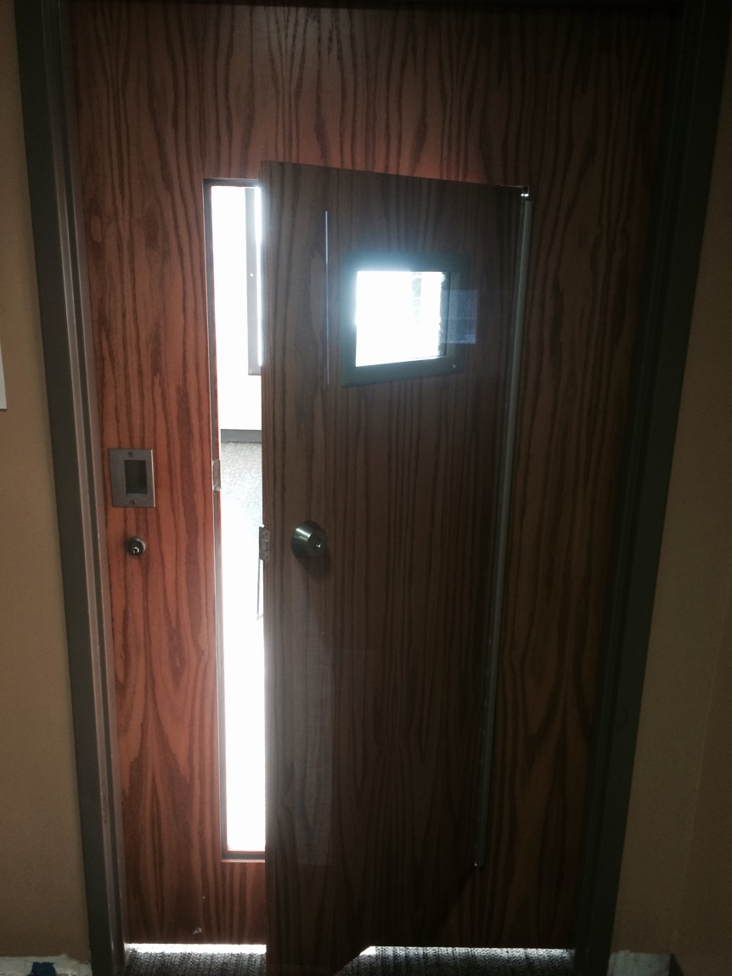
Behavioral Unit “Wicket” Door

Slide 17
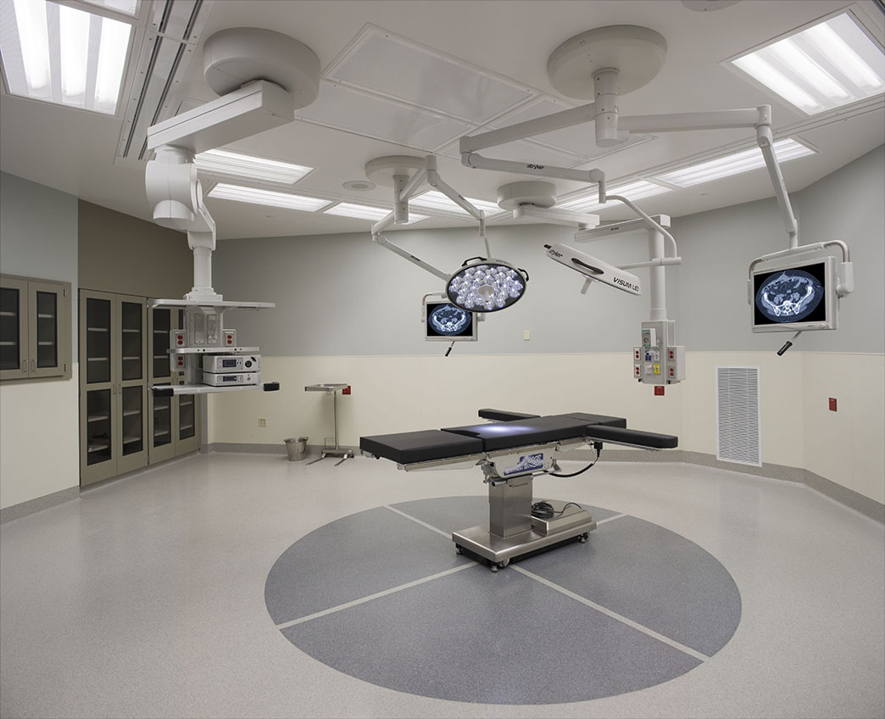
Departments
Surgery Department - $260 – $360 / SF
Finishes
Sterile Atmosphere
Flooring – Epoxy or Rubber Floor
Epoxy Painted Walls
Hard Ceilings
Bracing for Ceiling-Mounted Equipment/Booms
Auto Door Operators
Specialties – Wall Protection
Specialized HVAC – Hepa, S.S. Duct
Independent Unit for Surgery Area – Additional Cooling Loads
Medical Gases
Plumbing Fixtures – Scrub Sinks (Owner or GC Supplied?)
Emergency Power
Support Spaces
Lounges & Locker Rooms
Central Sterile

Slide 18
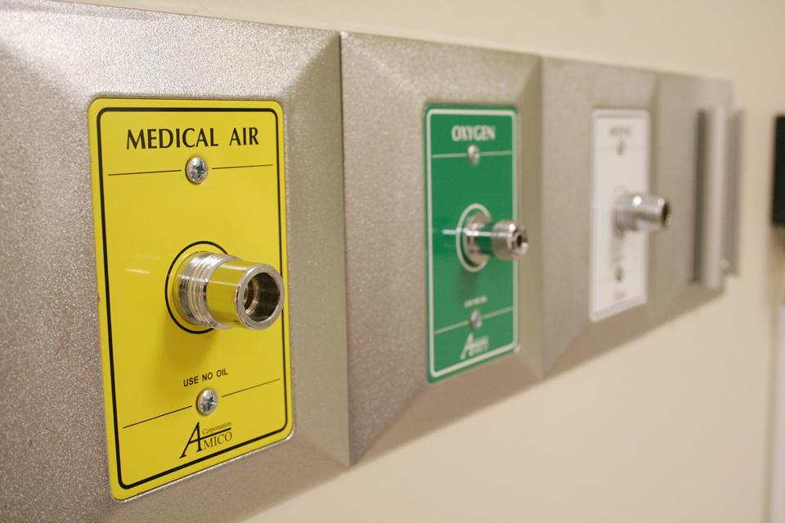
Departments
Pre & Post Op - $230 – $280 / SF
Level of Finish
Sheet Vinyl, Wall Finish
Soffits
Compartmentalized vs Open - Bays
Casework – Storage & Nurse Stations
Specialties – Wall Protection, B.A., CCT
Medical Gases
Emergency Power Requirements
Special Systems – Nurse Call, A/V

Slide 19
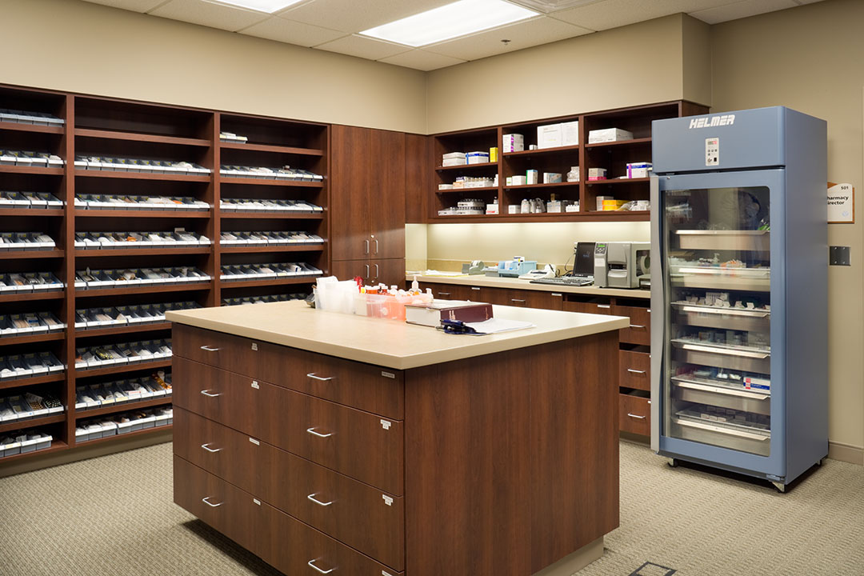
Departments
Lab Space & Pharmacy - $215 – $265 / SF
Generally, Large Open Spaces
Level of Finishes Varies – Standard to Sterile
Laboratory Casework – By Owner or GC
Pharmacy Casework – Split Retail Counters vs. Shelving
Laboratory Equipment – By Owner
Include MEP Connections
Coordination of OFOI Equip
Fume Hoods – Exhaust
Pneumatic Tube Stations.
Controlled Access
Emergency Power – Lab Equipment

Slide 20
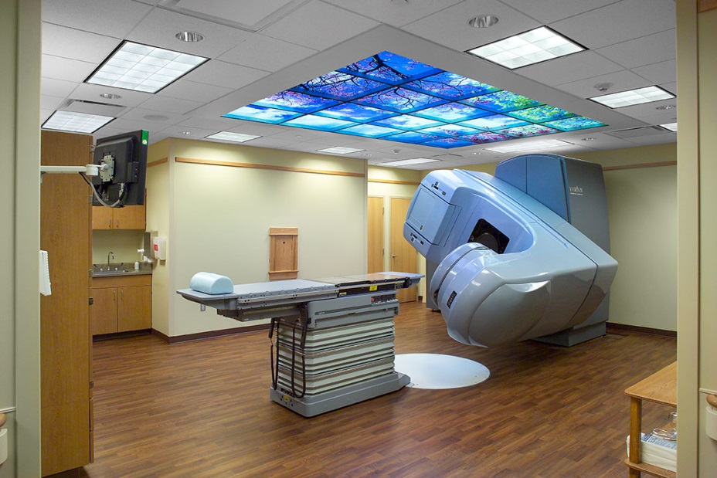
Departments
Imaging - $235 - $310 / SF
MRI, CT, PET, Linear Accelerator
Shielding
Lead-Lined Drywall - $10 - $12 / SF Premium
Copper Shielding - $60k - $75k for typical room config.
Concrete or Lead Brick (Linear Accelerator) 3’-6’ thick
Vault - $700-1,000 / SF
Envelope – Maze door - $50K.
Smaller Square Footages
High Level of Electrical Rough-In – Control Cabling
Equipment Access to Space – Level of Complexity
Coordination of Staging & Installation of OFOI Equipment
Higher Cooling Load – MRI: Added Chiller. By Whom?
Location of Power Source

Slide 21
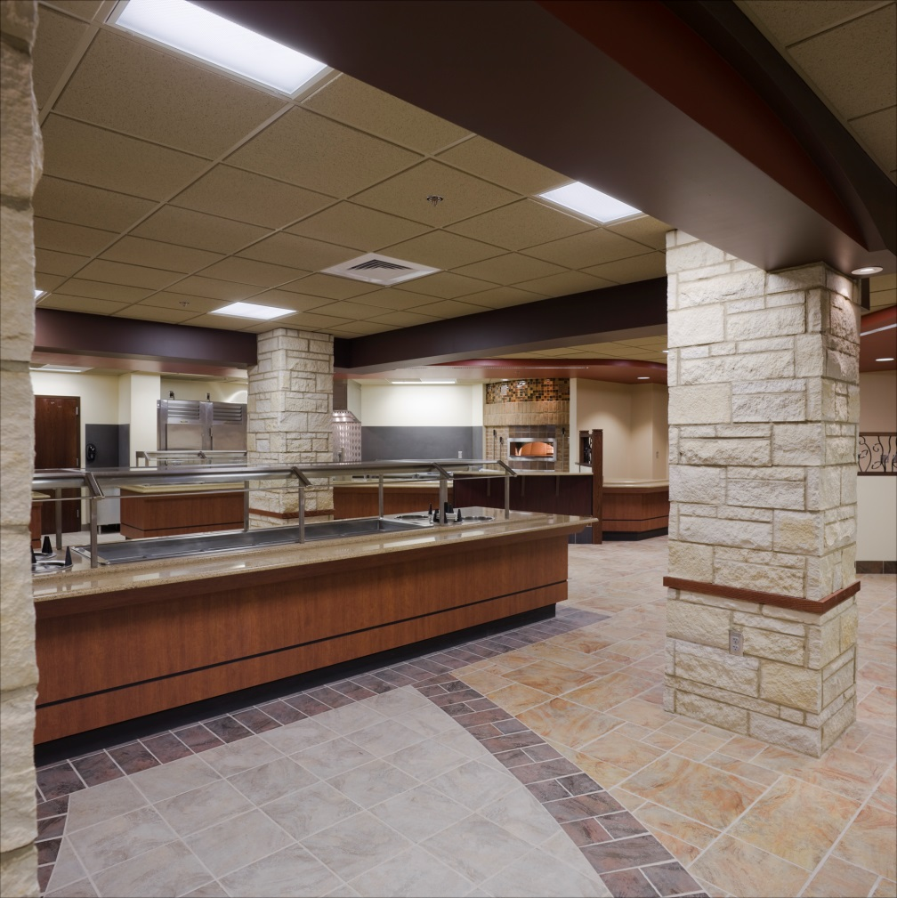
Departments
Servery & Dining - $120 - $200 / SF
Kitchen Equipment Can Be Included, Or By Owner
Equipment: $70 – $140 / Square Foot of Kitchen.
Servery vs. Food Prep
Level of Finish
Floor Finishes – VCT to Tile
Wall Finishes – Paint to VWC, FRP, Stainless Steel
Millwork – Trim & Paneling
Dining Casework – Owner’s Vendor
Phasing – Renovated in Space, Operational.
High MEP Requirements
Sinks & Drains
Equipment Hook-Ups
Hoods & Ansul Systems

Slide 22
Departments
Gang Restrooms - $40,000 - $60,000 / Each
A.D.A. Upgrades
Level of Finish
Tile
Specialties
Compartments
Bath Accessories
Ceilings – GWB vs ATC
Mechanical
Fixture Quantity - $2,500-$3,500/Fixture
Below-Floor Rough-In – Elevated vs SOG
Bariatric Fixtures
Light Fixtures – Decorative
Small Area – Unable to Stack Trades

Slide 23
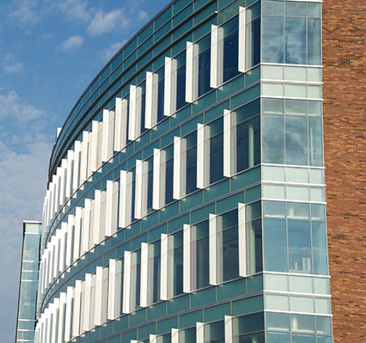
Structure
Building Envelope
Single vs Multi Story
Structure – Steel, Concrete, Wood
Foundation Type – Shallow vs. Deep
Skin – Brick, Glazing, Metal Panel
Vertical Transportation
MEP Systems – Independent vs CUP
Sitework
Earthwork – Balanced Site
Retaining Walls
Landscaping
Paving & Parking
Design for Future Expansion

Slide 24
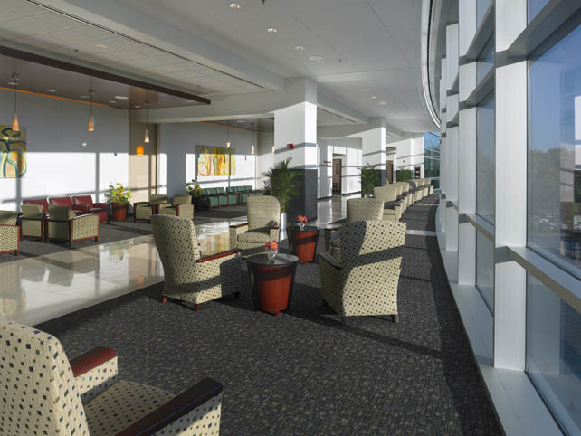
Not Generally Included in Cost
Design Fees
Architectural – 6%-12% of Construction Costs
Civil, Structural, & MEP
FF&E – Furniture, Fixtures, & Equipment
Laboratory, Kitchen Equipment
Medical Equipment – Booms, Gurneys, Sharp’s, etc…
Technology - Phone & Computer Equipment
Data Cabling
Furniture & Systems Furniture
Artwork
Signage – Interior & Exterior
Testing & Inspections
MEP Commissioning
Asbestos Abatement or Mold Mitigation

Slide 25
Questions?

Slide 26
THANK YOU FOR YOUR TIME!
Enjoy the Conference!

