Slide 1
Steam Quality
For
Autoclave (Steam Sterilizers)
& Humidifiers

Slide 2
Topics
Making Steam
Autoclaves (Steam Sterilization)
Humidification

Slide 3
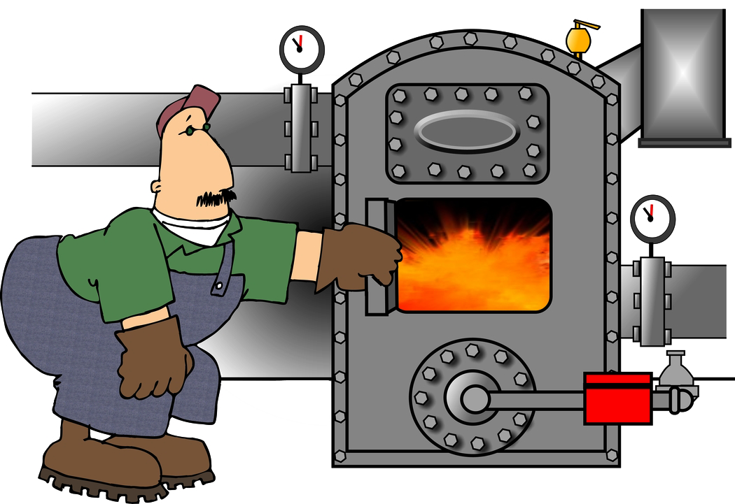
The Steam Boiler
Steam
Feedwater
Condensate+ Makeup

Slide 4
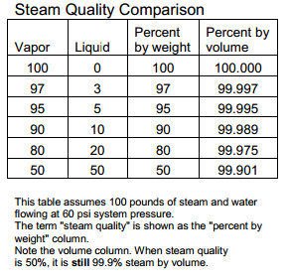
Steam Quality Guidelines
*Steam Quality is defined as the amount of
Liquid traveling with the steam vapor expressed
as a weight percentage. For example, if 100 pounds
Flows through the steam line, and
5 pounds is liquid water , then 95
Pounds is steam vapor. It is 95%
Steam quality.
*Courtesy Walt Deacon - Thermo Diagnostics

Slide 5
Steam Quality Guidelines
Good quality steam should have values within the following control parameters:
Total Hardness (as CaCO3) - 0 ppm
pH - 7.8 to 8.8
Conductivity - < 50 Mmhos
Iron (as Fe) - < .1 ppm
Copper (as Cu) - < .05 ppm
Corrosion Rates - < 1 MPY (Mild Steel)
Steam should be saturated but have a steam quality of at least 0.97

Slide 6
Steam Quality Guidelines
The Association for the Advancement of Medical Instrumentation (AAMI) indicates that there is no approval process for boiler water additives intended for use in steam sterilization.
However, AAMI references the lists in 21 CFR 173.310 and 21 CFR 100.11 as appropriate chemicals for use in boilers. These lists include compounds that are allowed for use in steam where food contact will occur.

Slide 7
Steam Quality Guidelines
The FDA has established limits on the amount of amine
which can be fed in food applications which is also applicable for autoclaves. limits are listed below:
Morpholine 10 ppm (mg/L)
DEAE 15 ppm (mg/L)
Cyclohexylamine 10 ppm (mg/L)
Octadecylamine 3 ppm (mg/L)

Slide 8
What Causes Poor Quality Steam
Boiler carryover
All boilers carryover to some degree. The key is to minimized it with good steam separating equipment and maintaining proper drum water level.
Non-insulated steam pipes
Condensation in hot steam pipes against cooler pipes and/or walls forms liquid water. Pipe insulation plays a big part in minimizing condensation and maintaining steam quality.

Slide 9
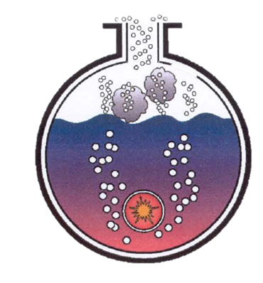
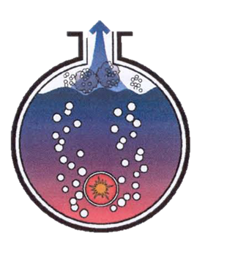
What Causes Poor Quality Steam
Priming/Mist Carryover
(Violent spasmodic action of boiler water)
Sudden Load Demand
(Creates vacuum in boiler)

Slide 10
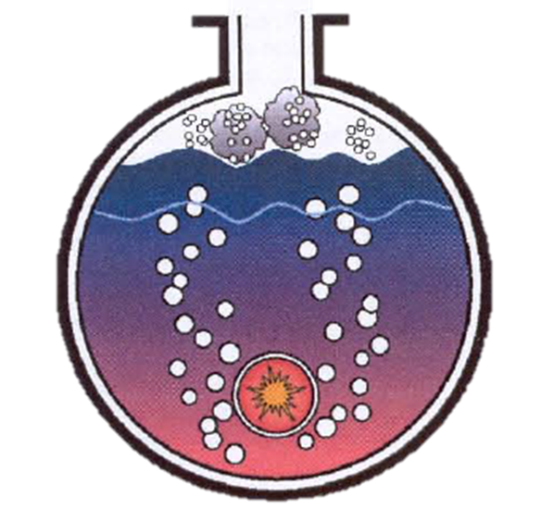
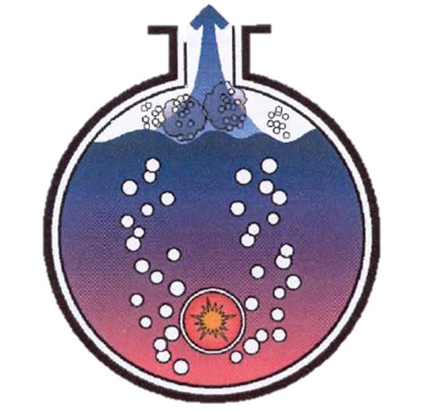
What Causes Poor Quality Steam
High Boiler Water Level
(No space for steam separation)
Result – boiler water
is pulled with steam

Slide 11
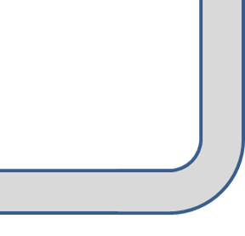
What Causes Poor Quality Steam
Steam line corrosion byproducts
Boiler water in the steam can cause specks on
Autoclave instruments. Low pH condensate (and liquid
water from carryover) corrodes metal piping.
In addition, high velocity water scrubs steel
or copper oxidation off pipe walls causing
specks and wet packs.
Water droplets forming on uninsulated steam pipe

Slide 12
What Causes Poor Quality Steam
Poor functioning steam-traps
A steam trap is an automatic valve that drains liquid water but keeps ‘traps’ steam in the system. The internal mechanism senses condensate and opens the valve to drain the water. Steam pressure pushes the undesired fluid out.
When the liquid water is not removed, it can add to specks on instruments and wet packs.

Slide 13
Autoclave (Steam Sterilizers)

Slide 14
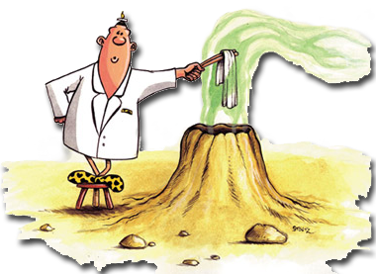
Importance of Steam Quality
From the earliest sterilizers, wet packs and
specks on instruments have often been blamed
on poor steam quality.
The reality is, a properly
operated boiler and steam
system will seldom
Contribute to wet pack
or speck issues

Slide 15
Disinfection vs Sterilization
disinfection is the process of eliminating or reducing harmful microorganisms from objects and surfaces; examples include liquid products such as Bleach, Hydrogen Peroxide and Peracetic Acid
sterilization is the process of killing all microorganisms, example Autoclaves (steam sterilizers).

Slide 16
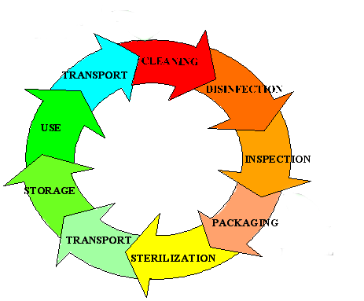
Typical Autoclave Operating Cycle

Slide 17
Operating Principles of Steam
Sterilization
There are four basic steps to operating a steam Sterilizer (autoclave).
loading the items to be sterilized
Removal of air from the chamber
Sterilization at the necessary temperature and pressure
Drying.

Slide 18
Operating Principles of Steam
Sterilization - Loading
Materials are typically wrapped in a
reusable cloth or disposable material. Once
wrapped, these are called "packs." Step 1, the loading
of the items to be sterilized, usually involves arranging
the packs vertically on a loading cart. Sufficient room
is allowed between packs to permit air removal, direct
steam contact, and proper drying

Slide 19
Operating Principles of Steam
Sterilization – Air Removal
The removal of air from the chamber is often
accomplished by drawing a vacuum on the chamber. If this is the case, the unit is referred to as operating in a "pulse," "pre-vac," or "high-vac" mode.
Sometimes air is removed simply by gravity, with steam injected at the top and the air forced out through the bottom of the unit. The unit is operating in a "gravity" mode. It is important to remember complete air removal is essential for proper sterilization

Slide 20
Operating Principles of Steam
Sterilization
Sterilization takes place at temperatures of 250 to 275 °F (120 to135 °C) for approximately 15 minutes. This corresponds to a steam pressure of 15 to 30 psi. The steam should be saturated but have a steam quality of at least 0.97.

Slide 21
Operating Principles of Steam
Sterilization – Drying
The drying process, is typically carried out
under vacuum. Sterilizers are steam jacketed so that the walls of the unit are kept hot to prevent condensation at the walls during the drying process. To verify proper sterilization conditions, indicator tape is often used to show that air is being adequately removed from the chamber and that the sterilization has been successful.

Slide 22
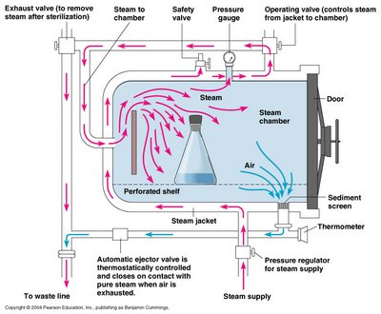
Typical Steam Autoclaves

Slide 23
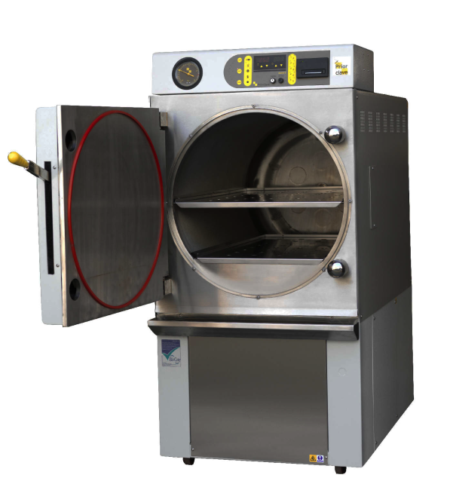
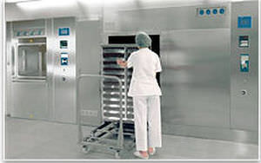
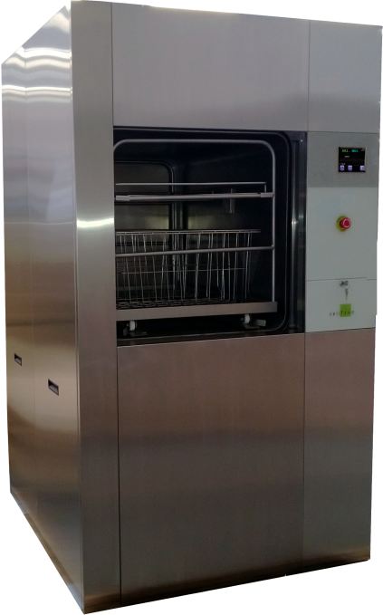
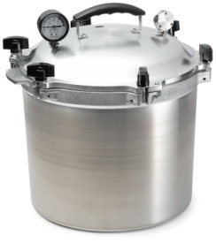
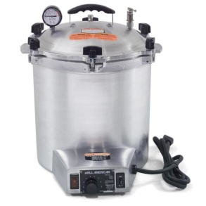
Autoclaves Come in All Sizes & Types

Slide 24
How To Solve Wet Loads (Packs)
Check the quality of your Facility Steam, including possible excessive demands on your boiler.
Check piping insulation from your steam source, to the autoclave.
Check the way you package your loads…do not over pack the chamber!
Check the size and operation of the steam traps, jacket traps, and drain check valves.
Check for clogged drains and drain ports.
Check your vacuum drying phase program, settings and operation.
Check or add a load heat up phase at beginning of cycle.

Slide 25
How To Identify Spotting Issues
Orange-Brown stain Residual detergents, blood
Blackish spots Iron deposits, reaction of metals
with sulfides
Light & Dark spots Mineral deposits left by air-drying
Greenish spots Copper deposits
Black, Brown & Pitting Low pH and/or exposed to Bleach
Black Stain Possible exposure to ammonia

Slide 26
Humidification

Slide 27
Why Humidification?
To Low a humidity Causes:
Headaches, sore eyes and throat, nasal stuffiness, lethargy, skin complaints and an increased susceptibility to colds and coughs are all symptoms of a dry atmosphere
Perhaps more importantly is the effect of electrostatic shocks which build up below 40% relative humidity (rh).

Slide 28
Why Humidification?
To High a humidity Causes:
Stuffy feeling and can cause condensation on walls, floors and other surfaces that triggers the growth of harmful bacteria, dust mites and molds. These allergens can cause respiratory problems and trigger allergy and asthma flare-ups.

Slide 29
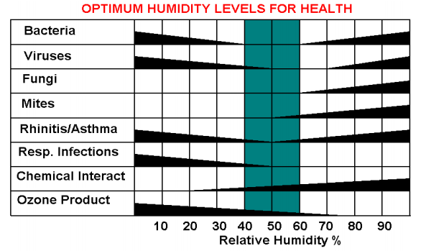
Why Humidification?
OSHA Guidelines: 20%-60% rh
Mayo Clinic Recommendation: 30-50% rh
Article written by D. Scott Herr, President, Carel USA

Slide 30
Mold & Mildew Detection and Control
detection is by the use of ultraviolet (UV) light. Under UV light, a microorganism’s growth will appear luminescent.
RH levels should be routinely monitored. Spore germination is less likely to occur if rh is controlled between 45% and 55%
HEPA filters capture 99.97% of 0.3 micron particles. Mold spores are usually between 1-20 microns.

Slide 31
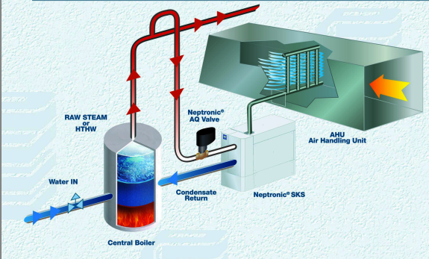
Example of Simple Humidifier System

Slide 32
Types of Humidifiers
HEATING BOILER DIRECT STEAM INJECTED - This system uses steam from the heating boiler to inject steam directly into the airstream.
HEATING BOILER STEAM USED TO POWER CLEAN STEAM GENERATORS - This system uses steam from the heating boiler to generate clean steam at multiple remote clean steam generators, which then inject steam into the airstream.
CENTRAL CLEAN STEAM BOILER - This system has a dedicated clean steam central boiler system that directly injects clean steam into the airstream. The steam system does not include any chemical treatment, so all piping and steam remains “clean.” Piping is typically SS.
LOCAL GAS-FIRED HUMIDIFIERS - This system utilizes natural gas-fired humidifiers located next to the AHU or duct distribution manifolds.
LOCAL ELECTRIC HUMIDIFIERS - This system uses small electric humidifiers located next to each AHU or duct distributor.
ADIABATIC HUMIDIFIERS - This system utilizes highly atomized water to increase the moisture content of the airstream. This is typically accomplished using a compressed air/water mixture or highly pressurized water system.

Slide 33
Humidification, Amines, And The Impact Of Ashrae Standards 62. 1 And 170
ASHRAE Standard 170 states,
Steam chemical additives used for humidifiers serving health care facilities shall comply with FDA requirements. (U.S. Dept. of Health and Human Services. Food and Drug Administration in Federal Register. 173.310. April 1999.)
ASHRAE Standard 170; and therefore most states require humidification of many health care spaces to a minimum of 20% or 30% relative humidity. It is also common for equipment manufacturers of diagnostic health care equipment to require the rooms to be above 40% rh. Illinois requires operating rooms to be above 40% rh.

Slide 34
Neutralizing Amines & Humidifiers
The Food and Drug Administration (FDA) allows only the neutralizing amines morpholine, diethylaminoethanol (DEAE) or cyclohexylamine to be used. Further, the FDA limits the allowable level of each in treated steam as follows:
Morpholine to 10 parts per million (ppm)
DEAE to 15 ppm
Cyclohexylamine to 10 ppm
In addition, FDA allows 25 ppm total amine when any or all are used in combination, provided that individual limits are not exceeded.

Slide 35
Thank You
Questions ?

