Slide 1
ASHRAE Standard 188-2015 Legionellosis: Risk Management for Building Water Systems & ASHRAE STANDARD 170-2013 VENTILATION OF HEALTH CARE FACILITIES
Prepared for:
NSHE Winter Telehealth Conference
February 12. 2016
Notes:
Presentation created on October 11, 2015 by Eric Granzow

Slide 2
Presenter bio
Eric Granzow, P.E., F.P.E., HFDP, LEED AP, CEM
Chief Mechanical Engineer – Specialized Engineering Solutions
Registered Professional Mechanical Engineer:
Nebraska, Iowa, Wisconsin, Illinois
Registered Professional Fire Protection Engineer:
Nebraska
ASHRAE Certified Healthcare Facility Design Professional
Corresponding Member on ASHRAE Technical Committee TC 9.6: Healthcare
Chair of Water Sub-Committee (beginning June 2016)
Corresponding Member on ASHRAE Standing Standard Project Committee 170: Ventilation of Health Care Facilities
Practicing engineer for 15 years.
Notes:
A little about myself.

Slide 3
Agenda
Overview: ASHRAE Standard 188-2015
What’s next – An update from the ASHRAE Winter Conference
Overview: ASHRAE Standard 170-2013
What’s next – An update from the ASHRAE Winter Conference
Q&A

Slide 4
ASHRAE Standard 188-2015
Notes:
Standard 188 intro slide. Standard 188 was officially adopted at the 2015 Summer Meeting in Atlanta. This was the culmination of almost a decade of development, discussion, debate, and revisions by countless individuals.

Slide 5
Standard Overview
What is in the standard:
1. Purpose
2. Scope
3. Definitions
4. Compliance
5. Building Survey
6. General Requirements
7. Requirements for Building Water Systems
8. Requirements for Designing Building Water Systems
9. References
Normative Annex A. Health Care Facilities
Informative Annex B. Bibliography
Informative Annex C. Guidance IF Legionella Testing is Utilized
Notes:
Document overview.

Slide 6
Standard Overview
What is NOT in the standard:
How
The standard covers what should be done
The standard does not cover how to do it
Left open for new technologies, methods, etc.
Why
Other than a general statement about protecting health, the history of legionellosis has not been included
A quick search on any major web search engine will turn up millions of results on cases, outbreaks, and support documentation

Slide 7
Who must comply
Current Adoption
NYC adopted as of August 17, 2015
Proposed for consideration in major consensus building codes
Being debated for next revision cycle
Scope:
“This standard provides minimum legionellosis risk management requirements for the design, construction, commissioning, operation, maintenance, repair, replacement, and expansion of new and existing buildings and their associated (potable and nonpotable) water systems and components.”
“This standard applies to human-occupied commercial, institutional, multiunit residential, and industrial buildings. This standard does not include single-family residential buildings.”
So basically, this means everyone except single family homeowners must comply.
Notes:
Based on the definitions everyone must comply with this standard if adopted. However, the good news is that this really just means every building must go through sections 4, 5 and 6 to determine which, if any, systems within the building must comply. Only if compliance is determined as necessary under sections 4, 5 and 6 does section 7 and 8 come into play.

Slide 8
Documentation
Document, Document, Document!
General documentation
Every building must have a compliance document
Designers must document designs prior to construction
Owners must document compliance once per year and any time modifications are made to the building
Must include
Building survey
Statement of compliance
Any documentation covered in section 6 or 7 if survey identifies systems requiring compliance.

Slide 9
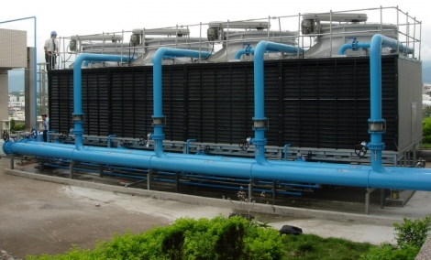
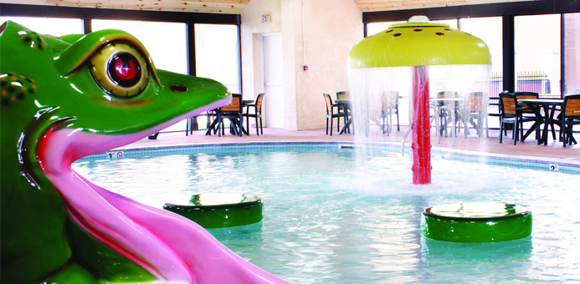
triggers
Which systems trigger compliance requirements?
Cooling towers
Evaporative Condensers
Whirlpools/spas
Ornamental fountains
Misters
Atomizers
Air washes
Humidifiers
Nonpotable water systems that release water aerosols
Notes:
These are the type of systems the standard deems potentially hazardous and worthy of a risk management program.

Slide 10
triggers
Which types of Occupancies trigger compliance requirements?
Multiple housing units with one or more CENTRAL potable water-heater systems
More than 10 stories (includes below grade levels)
Health Care facility where patient stay exceeds 24 hours
Building contains one or more areas for housing or treating occupants for burns, chemotherapy for cancer, or solid organ / bone marrow transplant
Building containing areas for housing or treating occupants who are immuno-compromised, at risk, are taking drugs that weaken the immune system, have renal disease, have diabetes, or have chronic lung disease
Building identified by the owner for the purpose of housing occupants over 65 years of age
Notes:
These are the type of occupancies the standard deems potentially hazardous and worthy of a risk management program.

Slide 11
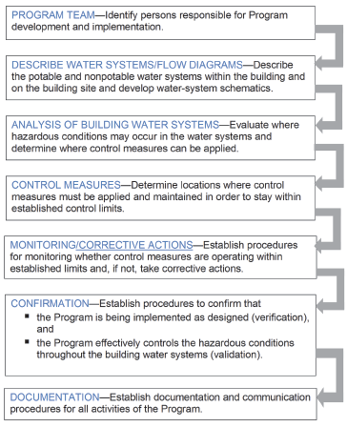
Requirements
Common Elements
The Water Management Program includes the following:
Analysis
Control
Monitoring
Confirmation
Documentation
The program is a team approach. The team can include
Owner
Employees
Suppliers
Consultants
Others to whom the owner has delegated authority and responsibility for actions required by the program
Notes:
These elements are the core of a water management program. There are separate requirements for each system type which will be described later. These apply to each of those as well as any others identified by the team.

Slide 12
Health care facility requirements
Two paths are available
Option 1: Follow Standard 188 Sections 4.2, 6 and 7.
No special requirements must be met for this option. These are the same sections that ALL facilities must follow.
Option 2: Follow Normative Annex A, “Health Care Facilities”
Special Requirements must be met
Facility must be accredited by a regional, national or international accrediting agency or by the AHJ overseeing the facility Infection Prevention and Control (IC) activities.
IC program must have an infection preventionist that is certified in infection prevention control by CBIC or other regional, national, or international certifying body
OR
The facility has an epidemiologist with a minimum of a master’s degree or equivalent.

Slide 13
requirements
Option 1 Typical Requirements:
Have a plan for startups and shutdowns
Have a plan and procedure for proper maintenance
Inspection of storage
Flushing stagnant and low flow areas
Maintenance and monitoring of system components
Tanks, ice machines, water hammer arrestors, filters, faucets, aerators, eyewash/showers, shower head, cooling towers, humidifiers, pools, etc.
Have a treatment plan
Monitoring method and schedule for
Temperature in hot and cold systems
Disinfectant residual (chlorine or chloramine)
Procedures for
Interruptions or breaks in supply or piping
Maintaining disinfectants
Known or suspected case of legionellosis or health directive
Emergency disinfection

Slide 14
requirements
Option 2 Typical Requirements
Annex A was included to provide a compliance path that mirrors current regulatory and accreditation requirements for health care facilities such as:
CFR 482.41 & 482.42
VHA Directive 1601
Joint Commission EC.02.05.01
HFAP 11.07.01
Designate a Team
Diagram the systems
Document and Implement a Risk Management Plan

Slide 15
Minimizing Risk
It starts with planning
Well thought out uses and locations minimize risk
It continues with proper operation and maintenance
Well planned maintenance and proper use of treatments minimize risk
It comes together with communication
Communication between all affected parties minimizes risk
Don’t forget: Document, Document, Document!

Slide 16
What’s Next
ASHRAE
The Committee in charge of 188 is currently reviewing and rewriting ASHRAE Guideline 12 to better align with the new 188-2015 standard. This document will provide implementation guidance and best practice information to assist the industry in implementing the standard.
Industry
New products and services are under development promising mitigation assistance as well as planning assistance.
Proceed with caution. Many of these new products are untested and need further research before mainstream adoption.
Education:
The ASHRAE Winter Conference and AHR Expo had 5 training sessions and countless vendor discussions regarding the standard, recent outbreaks, new technologies, and other information regarding Legionella.
Locally, the ASHRAE chapter presented the standard to its members in October, we are here today, and ASPE will have a presentation in June.

Slide 17
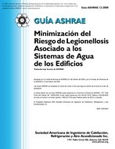
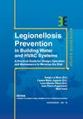
ADDITIONAL information
ASHRAE Guideline 12-2000: Minimizing the Risk of Legionellosis Associated with Building Water Systems
Currently under a re-write to align with Standard 188-2015. Draft anticipated in fall 2016.
Legionella.org: http://legionealla.org
CDC: http://www.cdc.gov/legionella/index.html
OSHA Technical Manual Chapter 7: https://www.osha.gov/dts/osta/otm/otm_iii/otm_iii_7.html
VHA Directive 1061: 2014
TM13: 2013 Minimizing the risk of Legionnaires’ disease
European standard maintained by CIBSE. Contains more information on “How” and includes Checklists
Guidebook No. 18-2013: Legionellosis Prevention in Building Water and HVAC Systems
REHVA (European association similar to ASHRAE) guideline

Slide 18
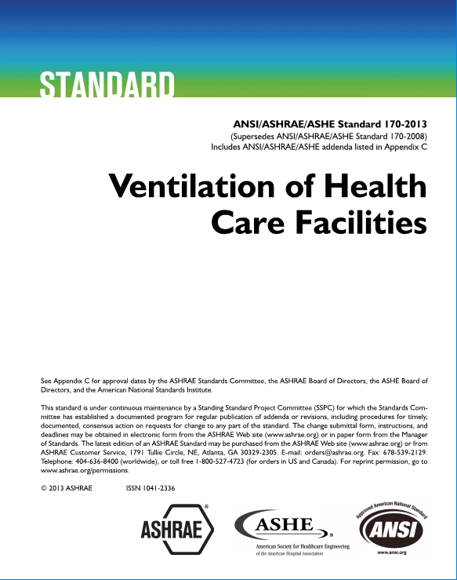
Ashrae standard 170-2013

Slide 19
Standard Overview
What is in the standard:
1. Purpose
2. Scope
3. Definitions
4. Compliance
5. Planning
6. Systems and Equipment
7. Space Ventilation
8. Planning, Construction, and System Startup
9. Normative References
Informative Appendix A. Operations and Maintenance Procedures
Informative Appendix B. Informative References and Bibliography
Informative Appendix C. Addenda Description Information
Notes:
Document overview.

Slide 20
Purpose
“The purpose of this standard is to define ventilation system design requirements that provide environmental control for comfort, asepsis, and odor in health care facilities.”
Notes:
Document overview.

Slide 21
Continuity of services
6.1 Utilities
The standard requires than Ventilation, Heating and Cooling be maintained as required to “support the owner’s facility operation plan”
This is required for routine maintenance activities, loss of normal electrical power, loss of primary combustion fuel, and/or breakdown of equipment.
What does this mean?
On-site backups for power and fuel.
Redundant equipment.
A PLAN defining the required facility operations, how to maintain them and what to do about the rest of the operations.

Slide 22
Risk mitigation
Source Contaminant Isolation
Intakes 25 feet from known sources (cooling towers, exhaust fans, generator stacks, boiler stacks, etc).
Intakes 6 feet above ground level or 3 feet above roof level.
Hazardous exhaust discharge a minimum of 10 feet above roof (AII rooms, ED and radiology waiting, fume hoods, etc).
General air movement from clean to less clean spaces.

Slide 23
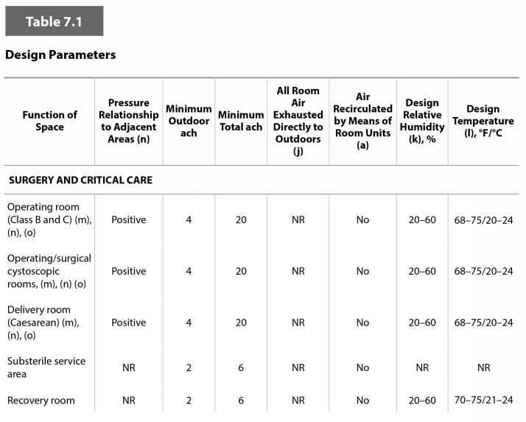
Table 7.1
What it is
Table 7.1 defines DESIGN requirements for air flow and space conditions to provide control of asepsis and odor.
What it isn’t
It is not intended to ensure comfort, safety, or transmission of airborne contagions.
Even though the standard states it provides for comfort, that is not the intent and it will be removed from future printings. ASHRAE Standard 55 provides requirements for the design of comfortable spaces.
The standard does NOT provide operational parameters for control of asepsis and odor. This is intentionally left to clinical staff.

Slide 24
What’s Next
FGI Correlation
The Committee in charge of 170 is currently reviewing and writing addenda to align, by the end of 2017, with the proposed FGI format for the 2018 FGI Guidelines Documents
InPatient Guidelines
OutPatient Guidelines
Residential Guidelines
Addendum ad (proposed) subdivides examination rooms beyond the current division of emergency and nonemergency rooms and establishes air change rates commensurate with the risk within those specialized rooms.
Administrative controls (such as assignment of patients to specialized rooms) are an important preventive strategy to supplement the benefit of environmental controls. As such these administrative controls would be applied to people presenting with undiagnosed gastrointestinal, respiratory, or skin infection symptoms, e.g. phone triage, prompt triage to an area away from others, and assignment to a Special Examination Room.
This will be issued as final in October of 2016.
Updated terminology for laboratories and methods for reducing air changes based on contaminant measurement are proposed in Addendum c. This will be issued as final in October of 2016.

Slide 25
What’s next
AAMI and ASHRAE Standard 170 Correlation
Currently, in the industry there is a discrepancy in several requirements for environmental conditions in areas of the Sterile Processing Department (SPD) between ASHRAE standards and AAMI standards.
ASHRAE standards guide the design of these areas, while AAMI standards guide the operation of these areas. Therefore, some amount of agreement is required between these two groups.
In April of 2015 representatives of ASHRAE, AAMI, FGI, AORN, ASHE and APIC met to discuss these issues.
Addendum h (proposed) represents the recommendations for space temperature in several spaces from this group.
This will be issued as final in October of 2016.

Slide 26
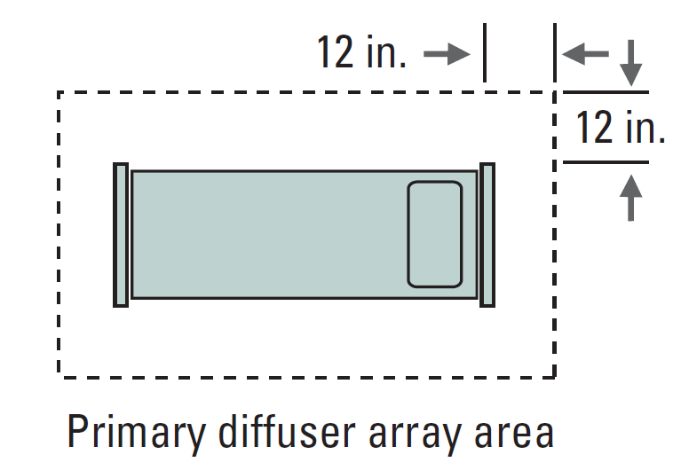
What’s Next
OR Ceiling Coordination
Addendum f (proposed) clarifies the intend of the Standard with regards to the 70% rule for air diffusion above the operating table.
70% must be used for air diffusion within the area of the table plus a 1 foot zone around the table. The area may not be increased to accommodate other ceiling items such as lights or booms.
This will be issued as final in October of 2016.

Slide 27
What’s Next
Upcoming Proposed Addendum Topics
Unoccupied Setback Guidance in the requirements table indicating in which spaces unoccupied setback control is intended to be allowed.
Increase filter requirement from MERV 7 to MERV 8 to align with filter industry standards.
Better definition of Treatment, Procedure, Operating Room application to match actual functions of rooms

Slide 28
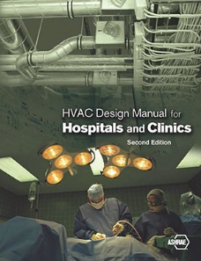
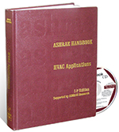
ADDITIONAL information
ASHRAE Health Care Facilities Resources (https://www.ashrae.org/resources--publications/bookstore/health-care-facilities-resources)
ASHRAE HVAC Design Manual for Hospitals and Clinics, 2nd ed.
ASHRAE 2015 Applications Handbook Chapter 8
ASHRAE Standing Standard Project Committee 170 (http://sspc170.ashraepcs.org/)
ASHRAE Technical Committee 9.6 – Healthcare Facilities (http://tc96.ashraetcs.org/)

Slide 29
Questions
?
Eric Granzow
egranzow@specializedeng.com

